Slide 1
A Million Big Images: Digitizing the US National Herbarium through Conveyor Technology
Sylvia Orli
NMNH, Department of Botany
orlis@si.edu

Slide 2
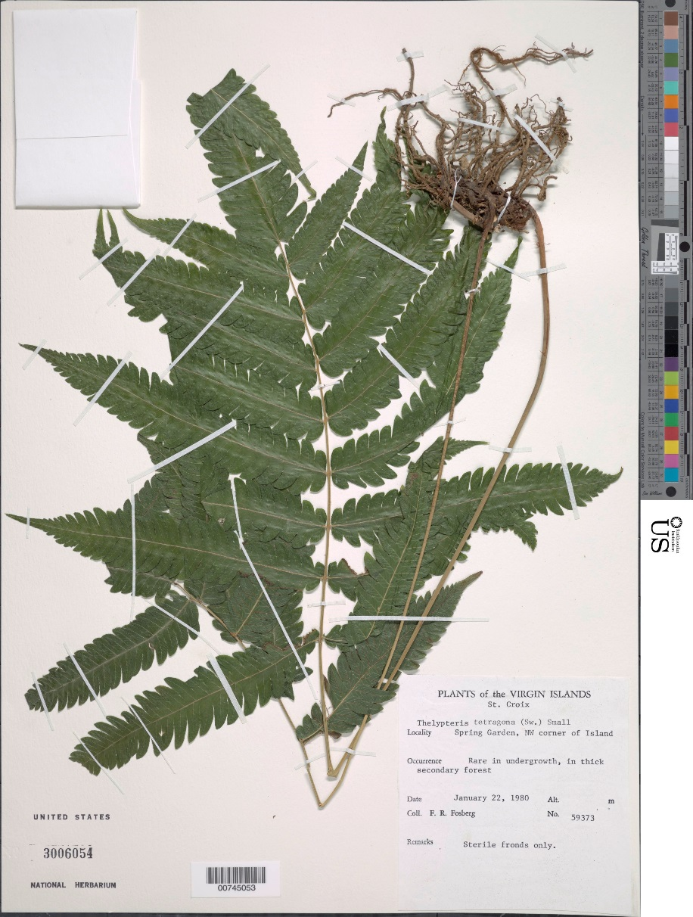
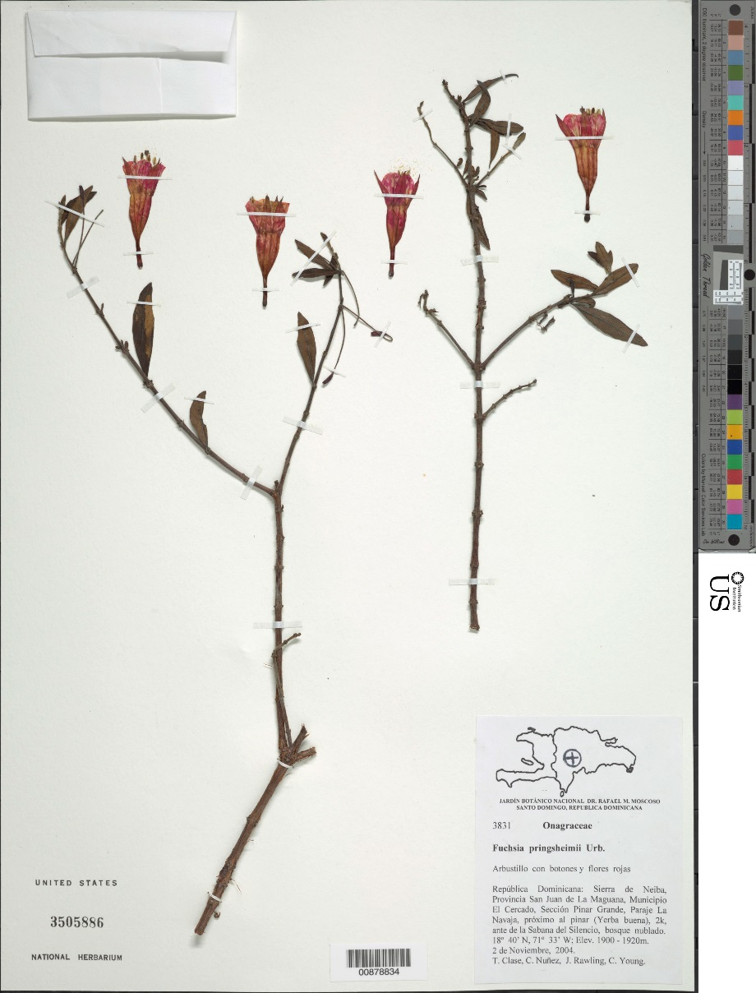

Slide 3
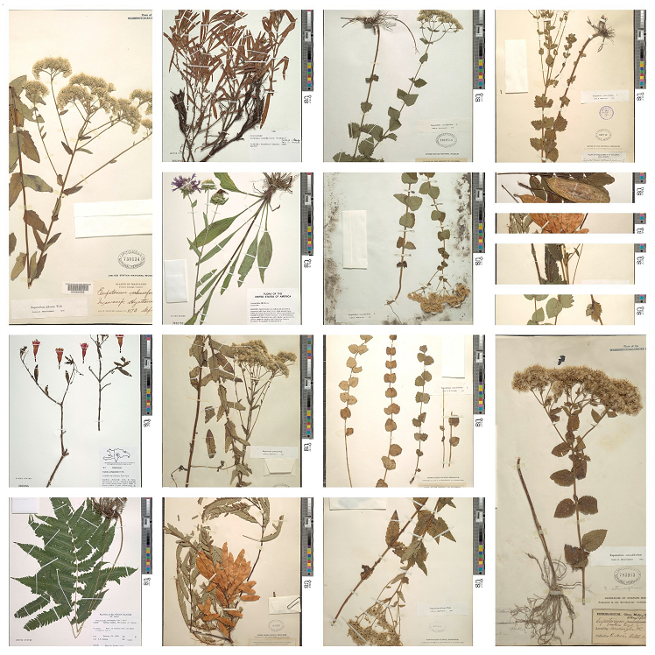

Slide 4
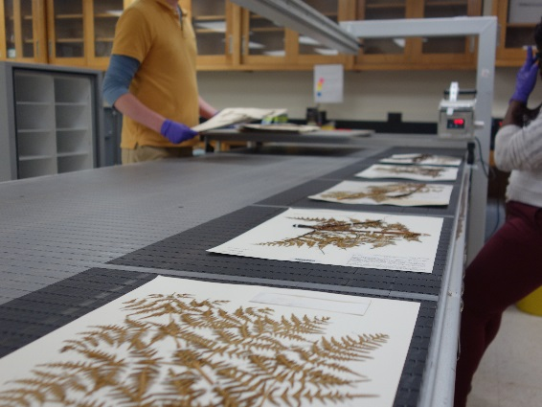
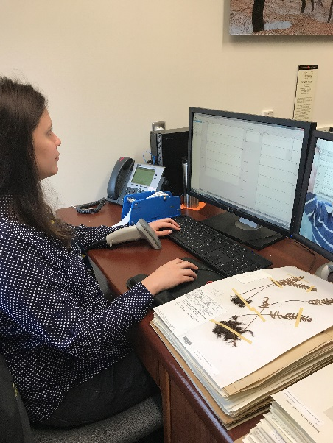
Digitization at US Herbarium
1970 – First digitization initiative
2001 – Images included in digital record
2015 - Digitization through conveyor
Summer 2017 - 2.2 million inventory records, 1.4 million specimen images total

Slide 5
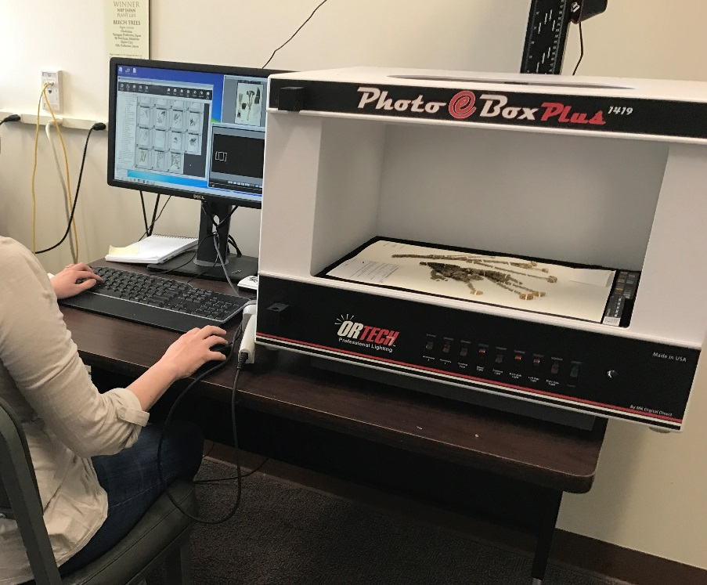
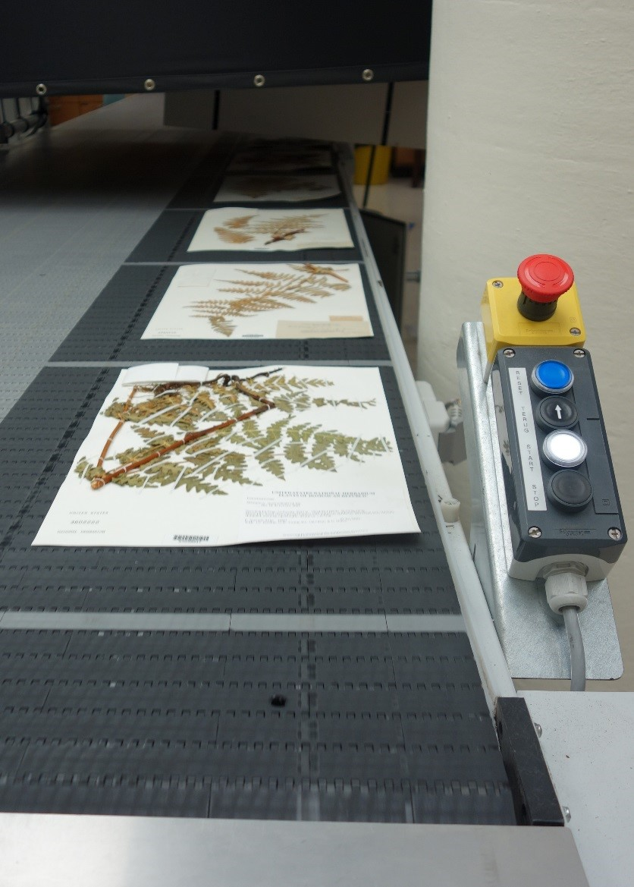
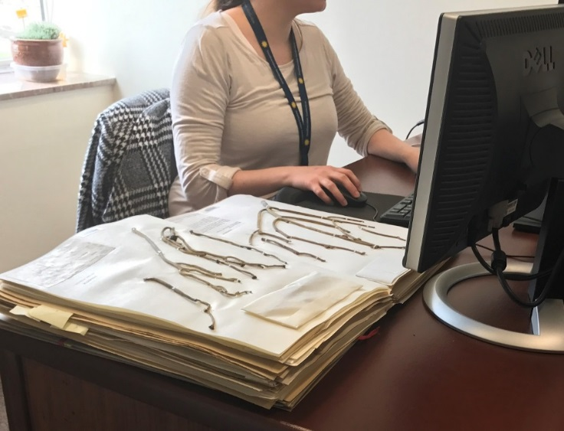
Approaches
To Digitization

Slide 6
U.S. National Herbarium Digitization
2.4 million digital descriptive records
1.4 million specimen images
Notes:
We significantly increased our rate of digitization and now have over 2.398 million digital descriptive records and 1.4 million specimen images. The conveyor belt has imaged over 1 million specimens, with 900,000 records being transcribed to create digital descriptive records. The remaining 100,000 were specimens that had previously been inventoried and were simply imaged on the conveyor belt. This has been a great way for us to significantly increase our rate of digitization, and with an estimated 5 million pressed specimens in our collection, it is moving us towards our ultimate goal of a completely databased and imaged herbarium collection.

Slide 7
Rapid Digitization by Conveyor
Notes:
The process of digitization is rather simple. Specimens are moved into the room where the conveyor belt is set up. The sheets are placed onto the belt, and if no barcode is on the specimen (indicating that it was not previously databased) a barcode is added. The Conveyor, takes an image of each specimen, each sheet is then returned to the folder it came from, and the folders are returned to the collection. The images from each day are sent to a company in Suriname for transcription, which we receive back within a few weeks. These transcriptions are then imported into EMu to create new digital descriptive records, and the images are attached (usually in that order, but sometimes the image is created first followed by the digital descriptive record). Sounds easy right? So what’s the problem? The problem is data clean-up. We want to ensure that the data we ingest into EMu is not just plentiful, but also precise and useful. We must balance speed and accuracy with both suffering slightly due to the other. I should mention that we are funded by a Smithsonian Unit outside of Natural History, so taking years to get our data into EMu is not an option. Without demonstrating that we

Slide 8
Conveyor Belt Speeds
3000-4000 specimen images created on conveyor belt daily
1 specimen image every 6 seconds or less
20,000 transcription records received from transcription company each week for review
60,000 transcription records cleaned, fixed and imported to EMu each month
Notes:
We significantly increased our rate of digitization and now have over 2.398 million digital descriptive records and 1.4 million specimen images. The conveyor belt has imaged over 1 million specimens, with 900,000 records being transcribed to create digital descriptive records. The remaining 100,000 were specimens that had previously been inventoried and were simply imaged on the conveyor belt. This has been a great way for us to significantly increase our rate of digitization, and with an estimated 5 million pressed specimens in our collection, it is moving us towards our ultimate goal of a completely databased and imaged herbarium collection.

Slide 9
Conveyor Players
Botany IT Team
Digitization Program Office (SI)
Picturae + Alembo
NMNH IT Support
Conveyor workers
Conveyor Move team
Data reviewers and importers
And many more….
Notes:
We significantly increased our rate of digitization and now have over 2.398 million digital descriptive records and 1.4 million specimen images. The conveyor belt has imaged over 1 million specimens, with 900,000 records being transcribed to create digital descriptive records. The remaining 100,000 were specimens that had previously been inventoried and were simply imaged on the conveyor belt. This has been a great way for us to significantly increase our rate of digitization, and with an estimated 5 million pressed specimens in our collection, it is moving us towards our ultimate goal of a completely databased and imaged herbarium collection.

Slide 10
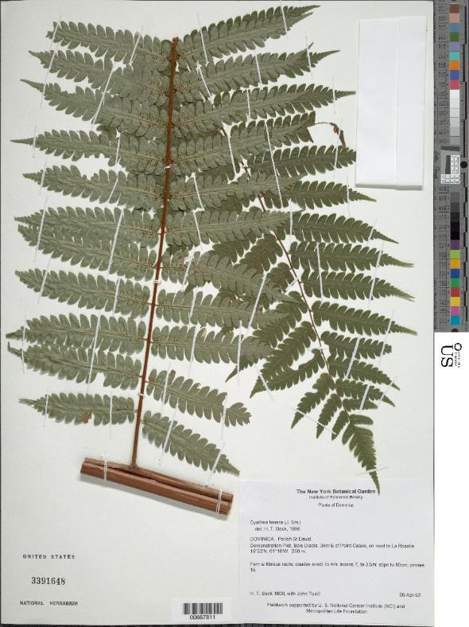
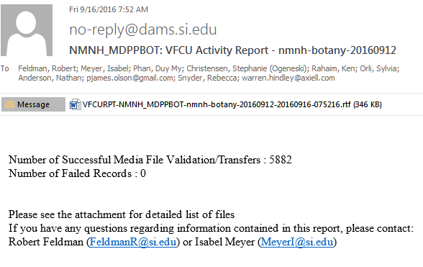
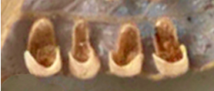
Raw and Tif file
100-200mb
6900 x 9100 pixels
540 dpi
40-50 micron range
Notes:
We significantly increased our rate of digitization and now have over 2.398 million digital descriptive records and 1.4 million specimen images. The conveyor belt has imaged over 1 million specimens, with 900,000 records being transcribed to create digital descriptive records. The remaining 100,000 were specimens that had previously been inventoried and were simply imaged on the conveyor belt. This has been a great way for us to significantly increase our rate of digitization, and with an estimated 5 million pressed specimens in our collection, it is moving us towards our ultimate goal of a completely databased and imaged herbarium collection.

Slide 12
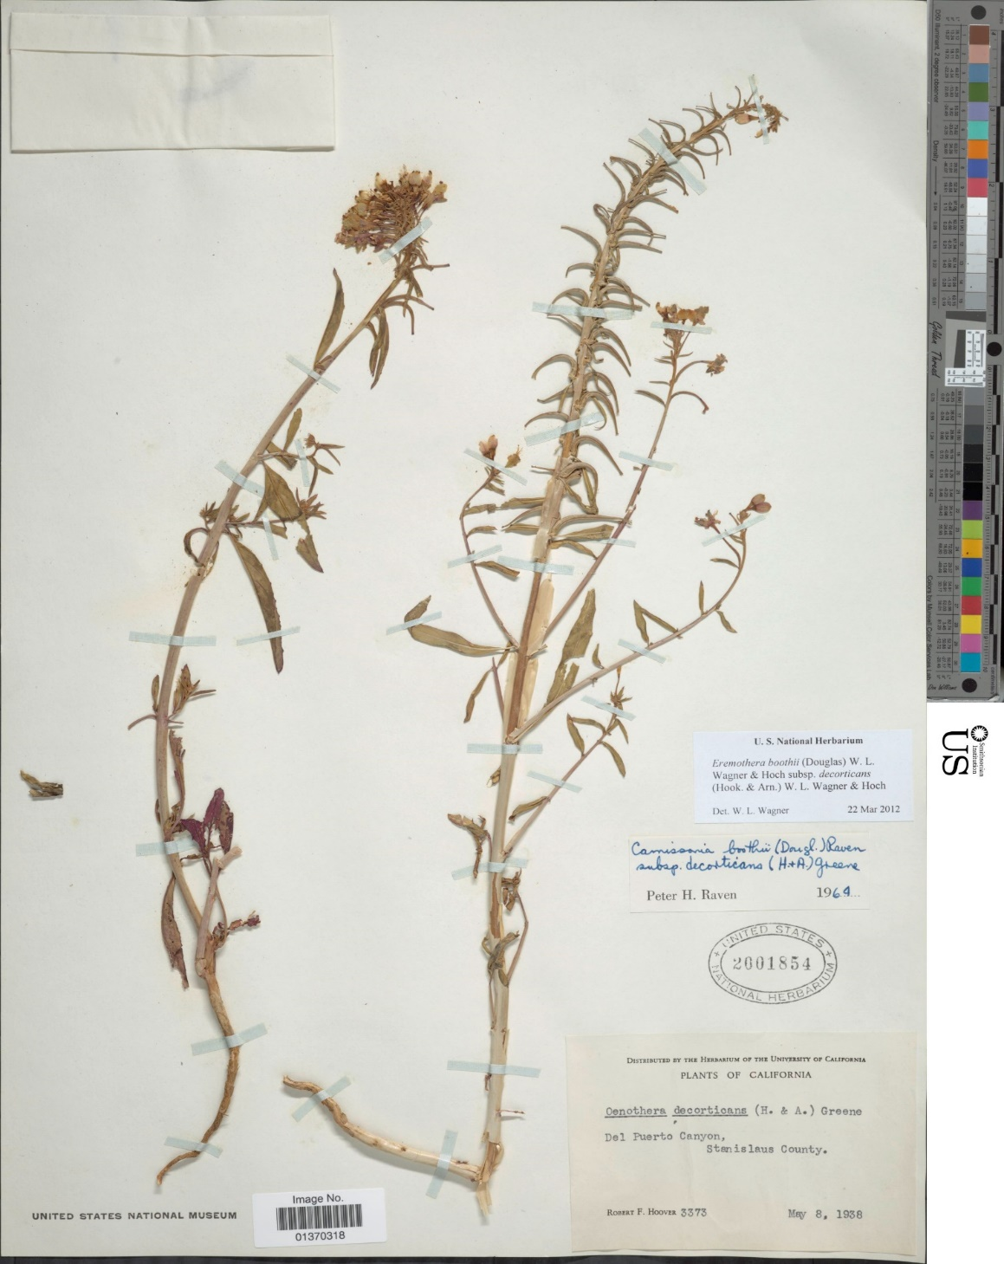
Transcription of labels
Fields Transcribed
Collectors
Primary Collection Number
Dates collected from
Dates collected to
Verbatim date
Country
State/Province/Territory
Precise Locality
Catalog Number (USNH Sheet Number)
Cultivated - Yes/No
Elevation
Latitude/Longitude
Notes:
So, since we are obviously concerned about getting really good clean data, what steps do we take to ensure we achieve that? On your left I’ve listed the fields we have transcribed by Alembo. Noticeably absent from this list is taxonomic identification. Since our collection is store phylogenetically, it is essential that we have the correct Emu “filed as” name in our records. In order to ensure this, we digitize this field separately in one of two ways.

Slide 13
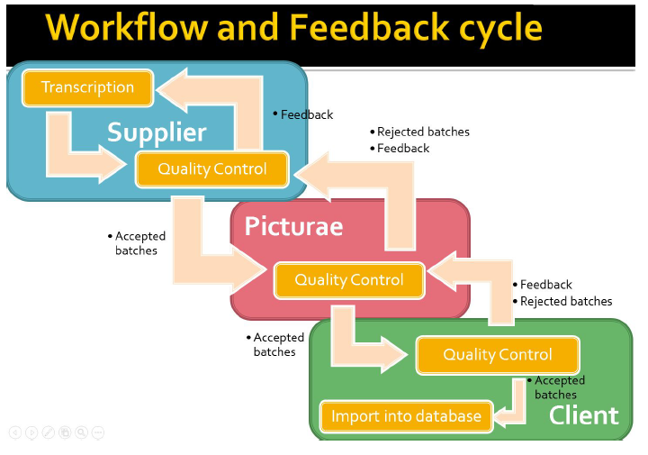
Transcription of labels

Slide 14
Alembo transcribes Specimen Labels transcribed by Alembo
Alembo transcribes cover taxonomic names; EMu taxonomic irns added if in picklist
Botany Conveyor Project:
Transcription Workflow
Picturae batches label transcriptions in sets of 4000 and does preliminary review
Picturae batches cover transcriptions in sets of 100-4000 and does preliminary review
NMNH Botany reviews label transcriptions at 2.5% check
NMNH Botany reviews label transcriptions and adds missing EMu irns
Batches of 30,000-40,000 transcription created from master SQL db; all records in batch reviewed for import to EMu
Rejected Sets returned to Picturae for correction
Accepted Label Transcription Sets added to Master Transcription SQL db
Taxonomic irns added to import batches
Import scripts run on import batch
Import to EMu

Slide 15
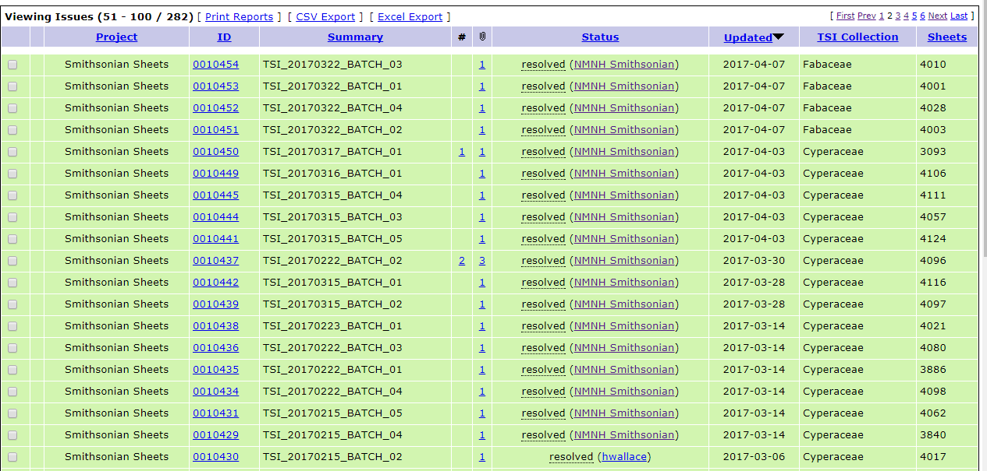

Slide 16
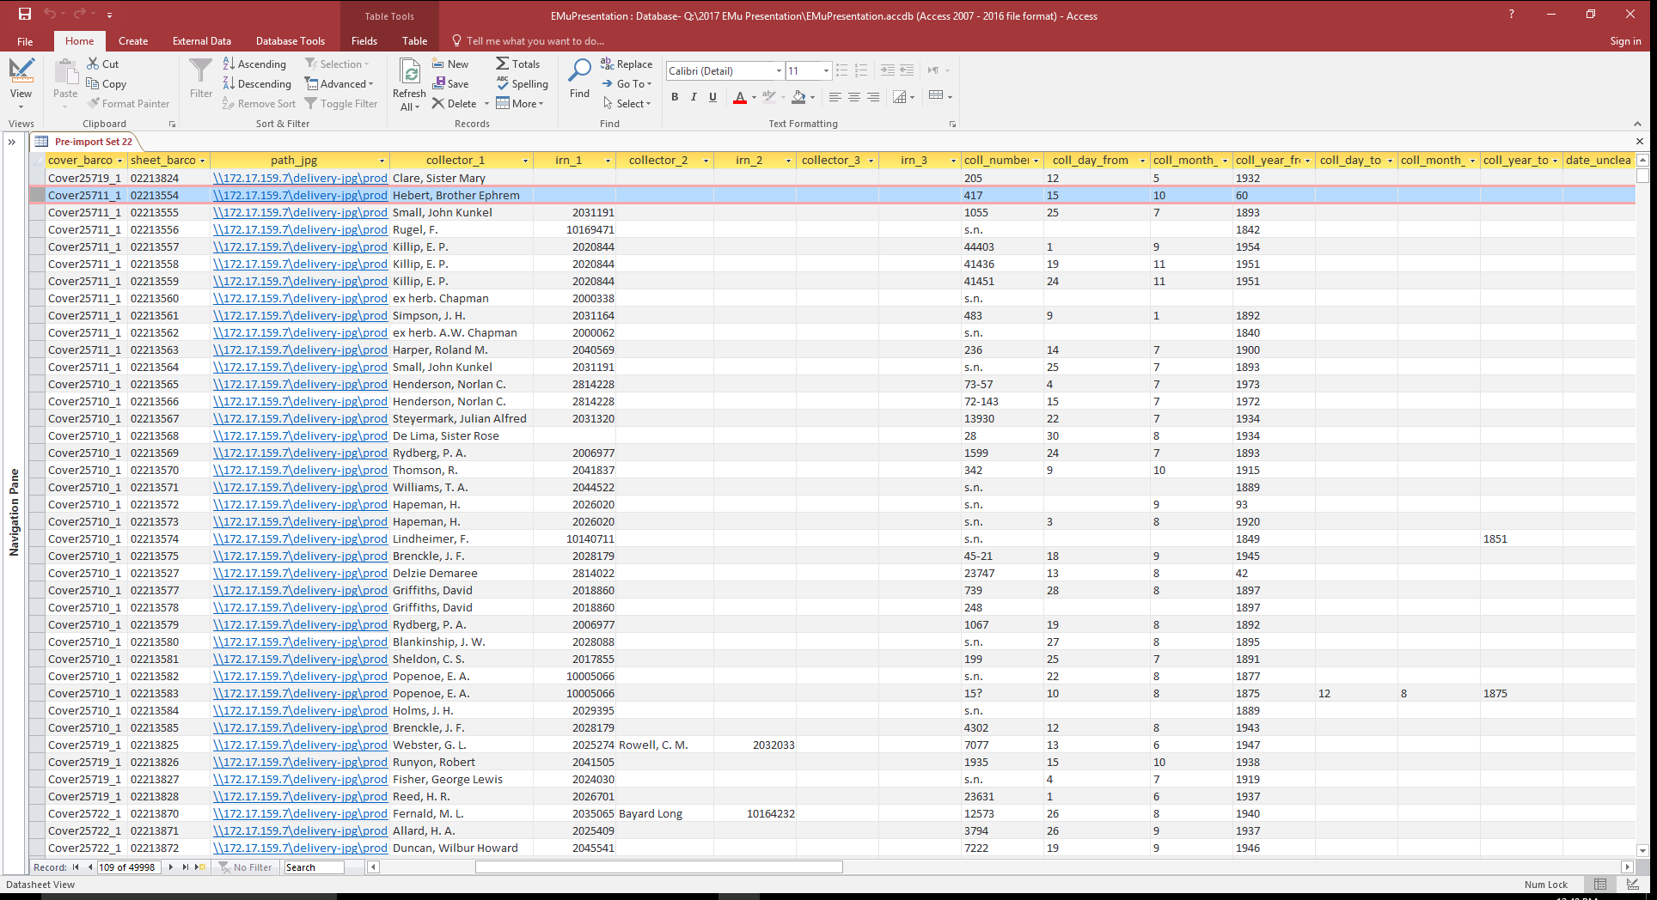
Transcribed Data from Alembo
Notes:
The specimens are sent to a company in Suriname called Alembo. This company has transcribed specimens from other herbaria in the past, and are familiar with herbarium sheets and how the data on them is often presented. We receive the data in a SQL database and work with it in Access.

Slide 17
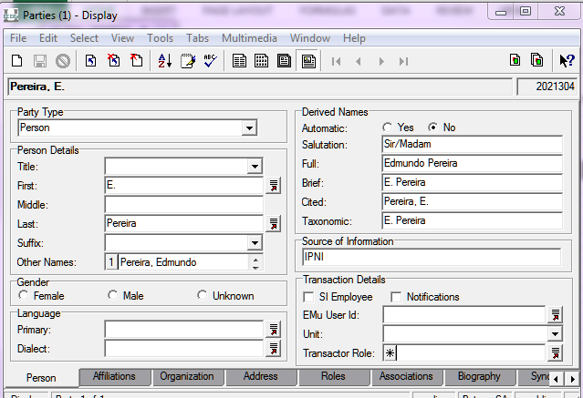
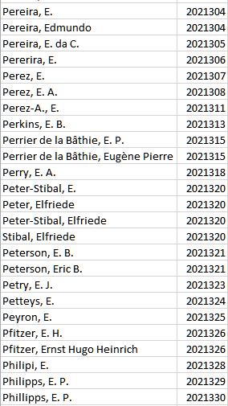
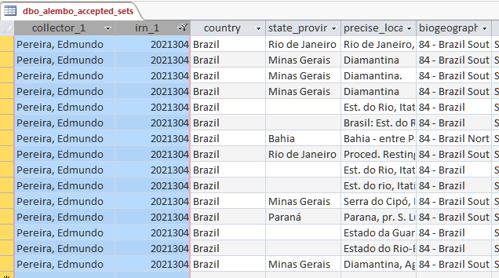
Collector Look Up with EMu IRNs
Transcribed Records

Slide 18
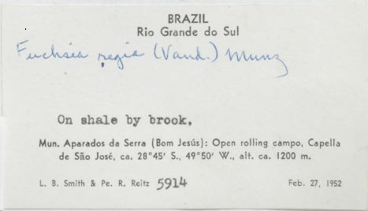
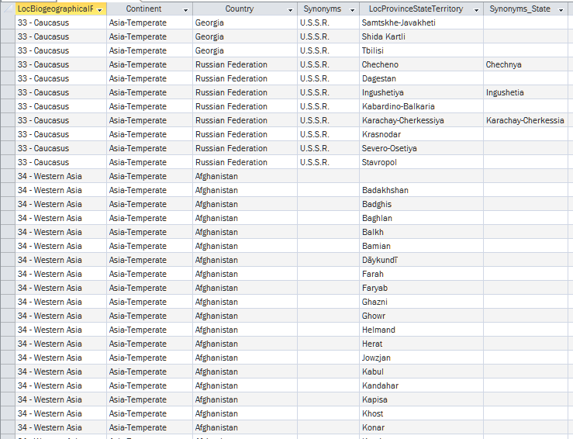
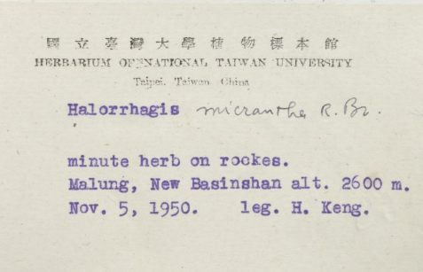
Country and State
Look Up List

Slide 19
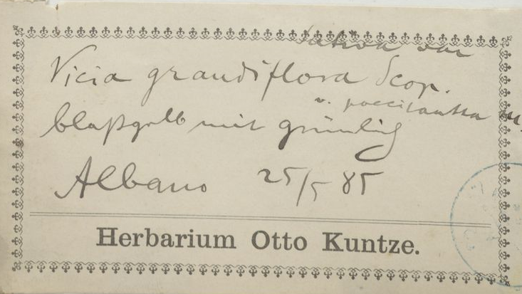
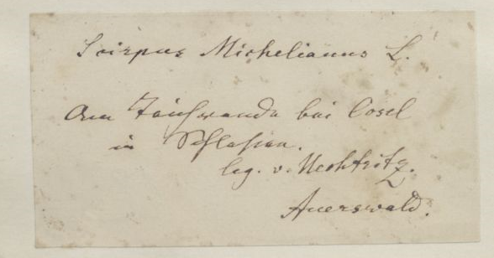

Slide 20
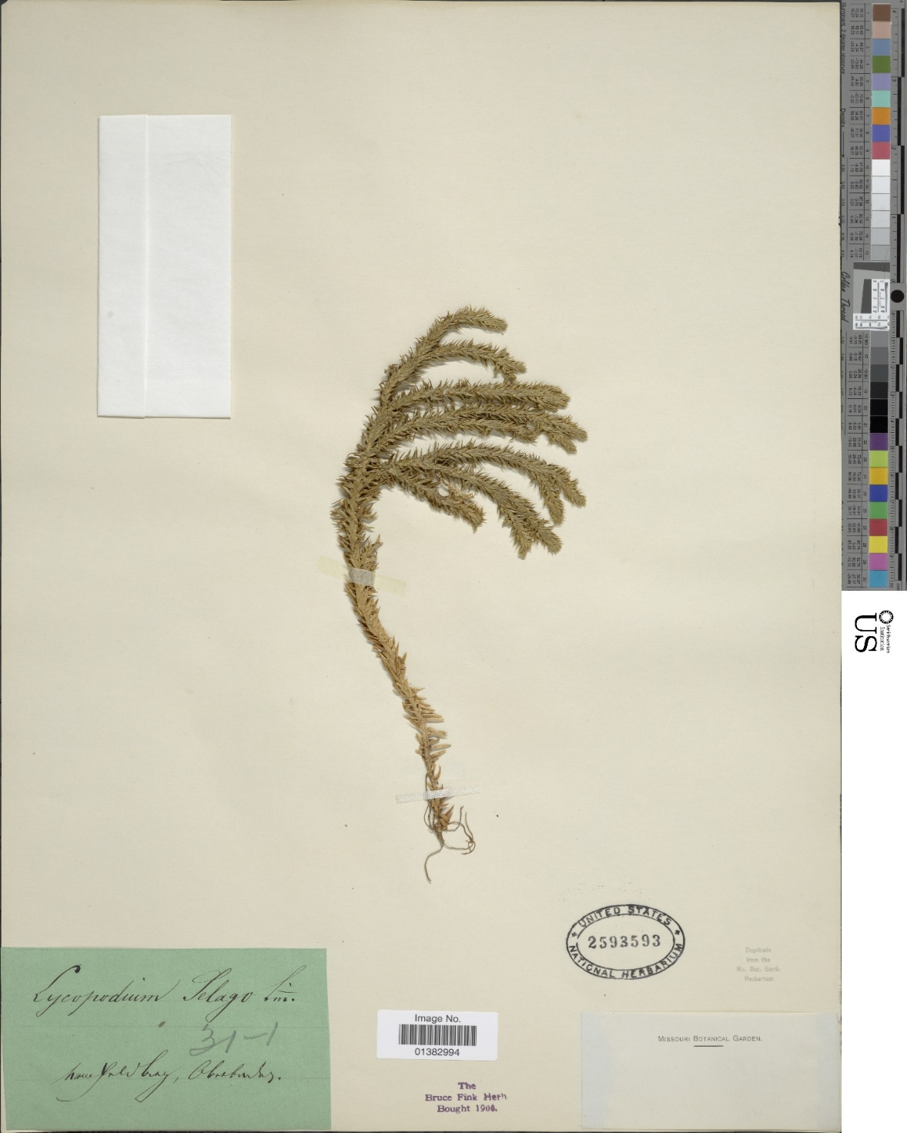
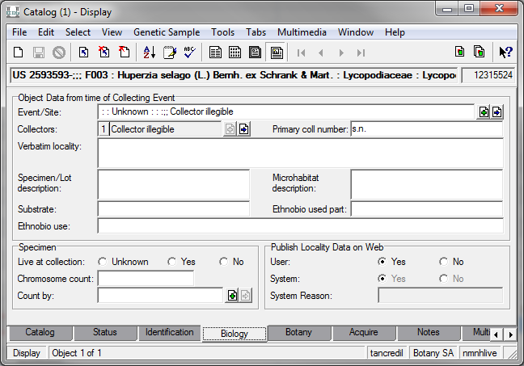

Slide 21
Results of Transcription Review
Set 22 (50,000 records) | Before Review | After Review
Country Unknown | 2496 (4.99%) | 510 (1.02%)
Precise Locality Interpreted | 4332 (8.66%) | 2055 (4.11%)
Collectors to add | 1943 | 657
Total as of FY17 (688,570 records imported)
Country Unknown | 14,469
Precise Locality Interpreted | 58,235
Precise Locality Illegible Text | 6,289
Foreign Script | 864
Collectors Added | 14,650
4-5 Weeks to complete

Slide 22
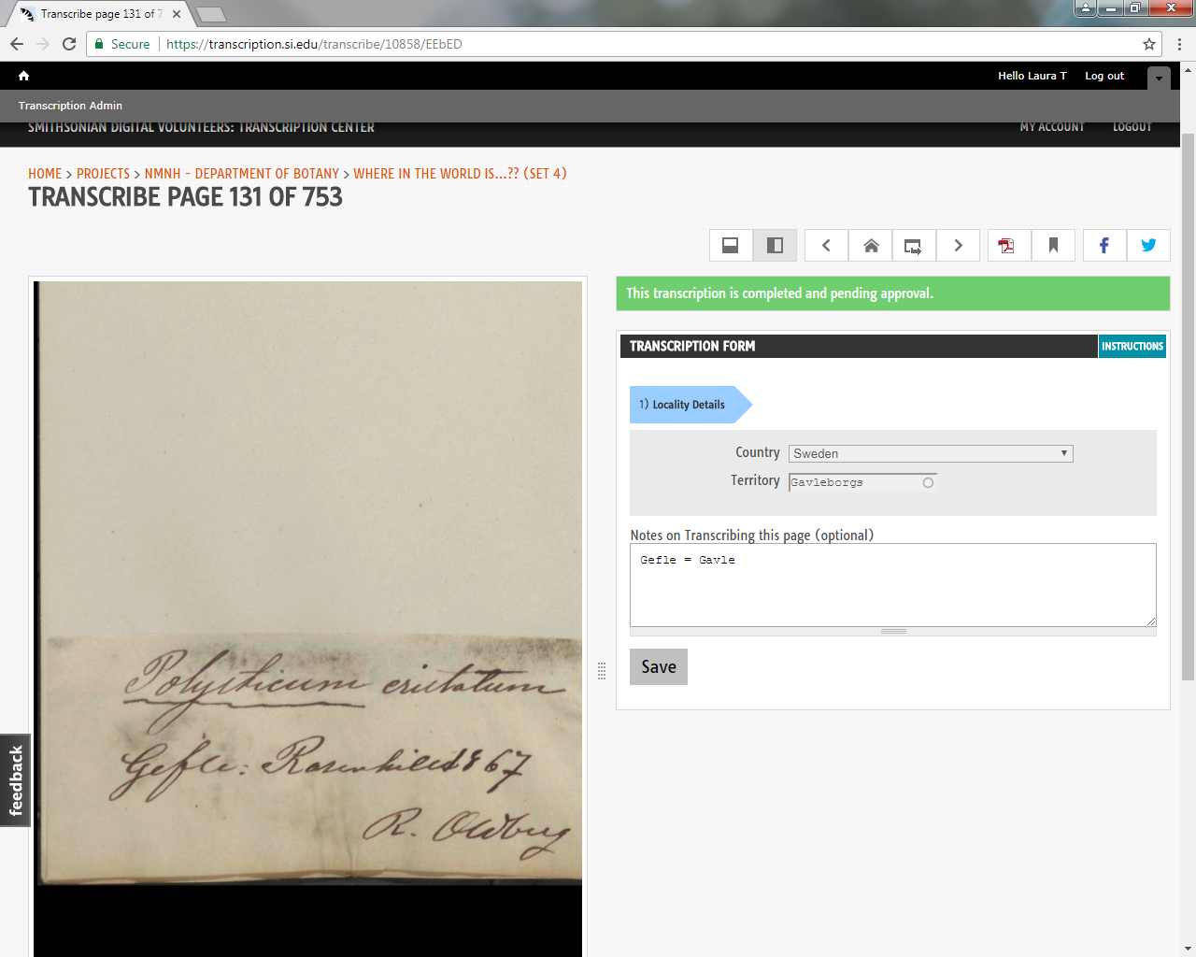
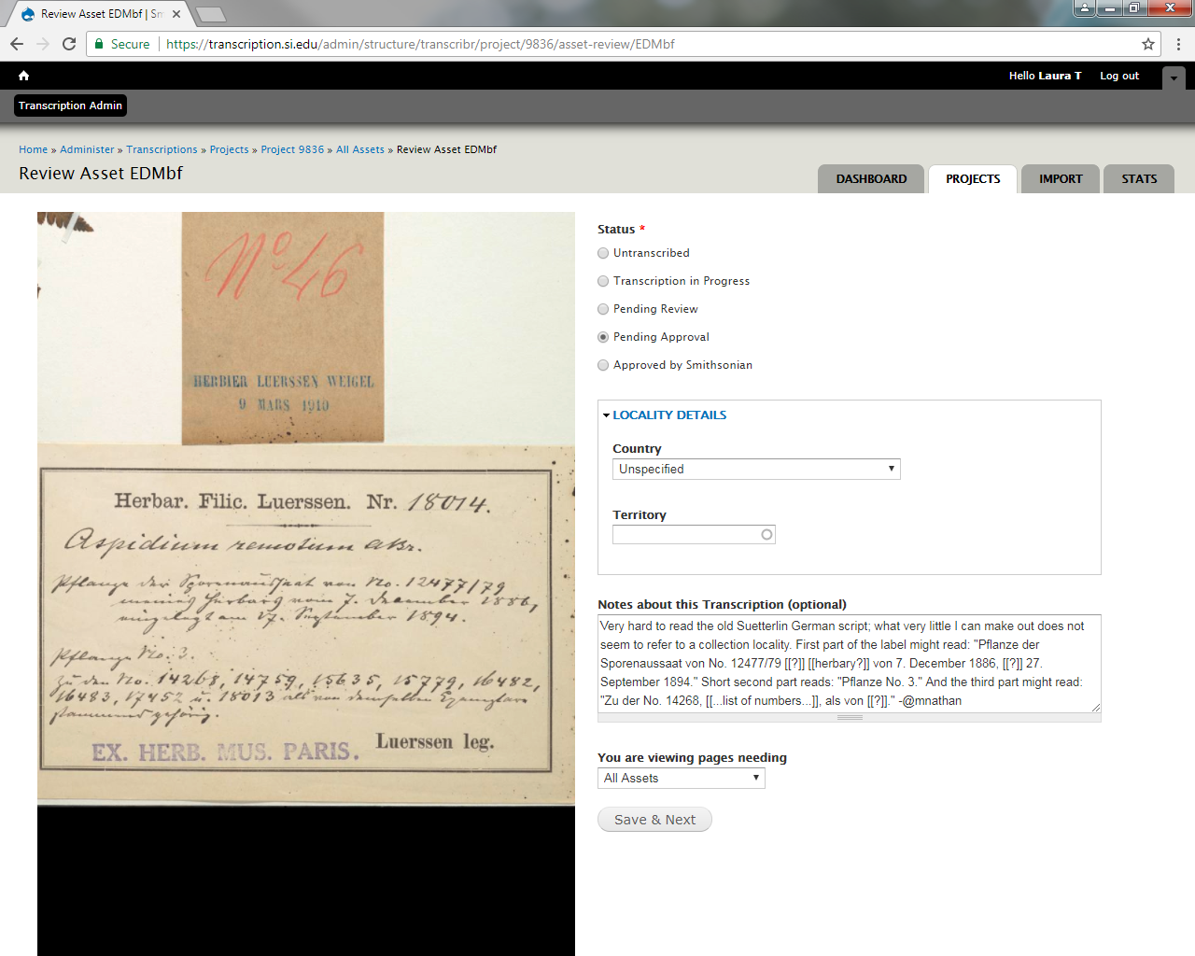
“Where in the world is…??” Crowdsourcing Project
4,565 Unknown Country records on SI Transcription Center – ~75% resolved by volunteers

Slide 23
Future Projects
Deep Learning
Already used by post office to “read” handwritten addresses.
Data Clean Up Tool
The Smithsonian Digitization Program Office has expressed interest in developing a tool to tackle problematic fields
Georeferencing
Mass georeferencing using EMu tools and Geolocate

Slide 24
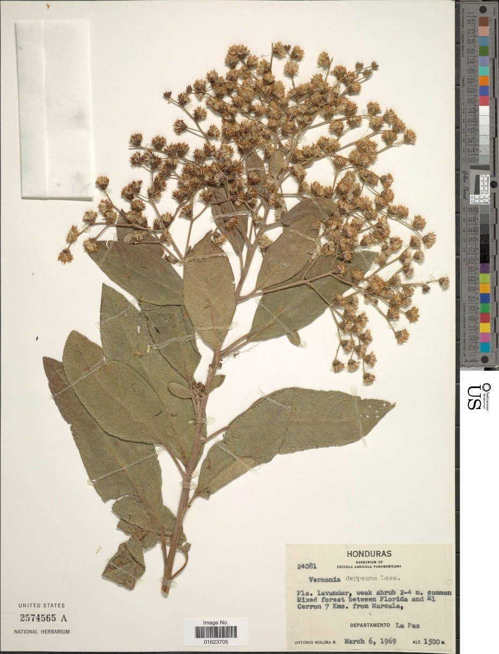
Thank you to:
Department of Botany Staff and Contractors
Smithsonian Digitization Program Office
NMNH Informatics

