Slide 1
Nimbus Tutorial Part II: Nimbus Architecture
Kate Keahey, David LaBissoniere,
John Bresnahan, Tim Freeman, Paul Marshall
Argonne National Laboratory
Computation Institute, University of Chicago

Slide 2
Tutorial Part II
Nimbus Architecture Overview
Workspace Service
Cumulus
Context Broker
Hands-on: Nimbus Installation

Slide 3
Nimbus IaaS: The Workspace Service and Cumulus

Slide 4
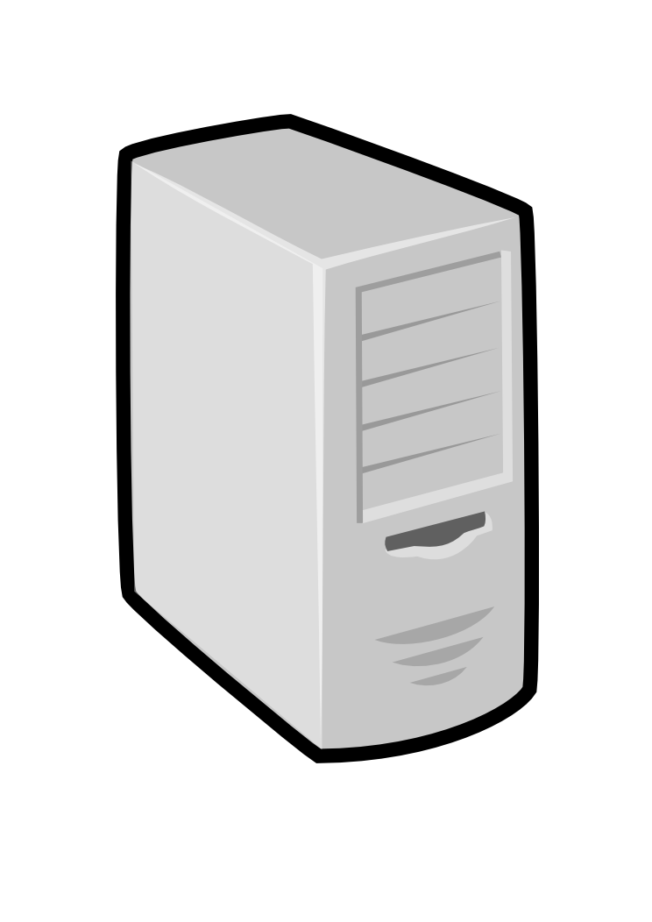
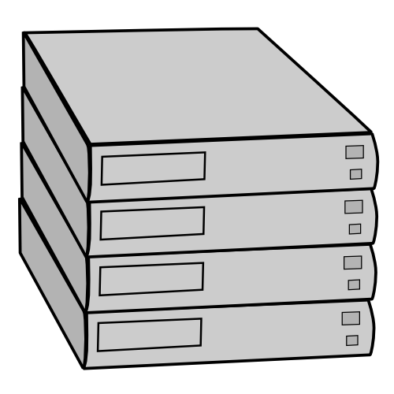
The IaaS Back Story
Cumulus and Workspace Service
allow clients to upload and
deploy VM images
Nimbus
Pool
node
Pool
node
Pool
node
Pool
node
Pool
node
Pool
node
Workspace back-end:
Resource manager for
a pool of physical nodes
Deploys and manages
Workspaces on the nodes
Pool
node
Pool
node
Pool
node
Each node must have a
VMM (Xen or KVM)‏ installed, as
well as the workspace control
program that manages
individual nodes
Pool
node
Pool
node
Pool
node

Slide 5
Nimbus: A Highly-Configurable IaaS Architecture
Workspace Interfaces
Cumulus interfaces
EC2: SOAP and Query
WSRF
S3
Workspace API
Cumulus API
Workspace Service Implementation
Cumulus Service Implementation
Workspace RM options
Default
Default+backfill/spot
Workspace pilot
Workspace Control Protocol
Cumulus Storage API
Workspace Control
Cumulus Implementation options
Virtualization
(libvirt)
Image Mngm
Network
Ctx
scp
…
POSIX
Xen
KVM
LANtorrent
BlobSeer

Slide 6
The Workspace Service

Slide 7
Workspace Service
Workspace Interfaces
EC2: SOAP and Query
WSRF
Workspace API

Slide 8
Workspace Service Interfaces
EC2 Interfaces
Support for both EC2 SOAP and EC2 Query
All base features except availability zones, security groups, and elastic IPs
WSRF Interfaces
Clients
Any standard EC2 client
Any standard EC2 client (Python, Java, boto, etc.)
WSRF clients
Reference client
Cloud client

Slide 9
Workspace Service Security
Workspace Service Authentication
X509 certificates for EC2 SOAP and WSRF
Token authentication for EC2 Query
Workspace Service Authorization
Id-based authorization
Privilege levels specified by administrator
E.g., total allocation, number of VMs per request, etc.
An Id can be assigned a privilege level
Secure access to VMs
EC2 key generation
Accessed from .ssh
Validating images and data
Research contribution from Vienna University of Technology
Descher et al., “Retaining Data Control in Infrastructure Clouds”,
ARES (the International Dependability Conference), 2009.

Slide 10
Workspace Service
Workspace Interfaces
EC2: SOAP and Query
WSRF
Workspace API
Workspace Service Implementation

Slide 11
Workspace Service Implementation
Workspace Service Implementation
Accounting
User Management
Configuration Management
Logging
Persistence
Network Leasing
State Machine
Task Management

Slide 12
Workspace Service
Workspace Interfaces
EC2: SOAP and Query
WSRF
Workspace API
Workspace Service Implementation
Workspace RM options
Default
Default+backfill/spot
Workspace pilot

Slide 13
Workspace Default RM
Implements on-demand leases
Datacenter technology equivalent
Basic slot fitting
Algorithms: load-balanced (default), greedy
Multi-tenancy and single-tenancy
More options coming in 2.7
Deployed on most current Nimbus installations

Slide 14
Workspace Default + Backfill/Spot
Challenge: utilization, catch-22 of on-demand computing
Solutions:
Backfill
Spot pricing
Bottom line: up to 100% utilization
Open Source community contribution
Preparing for running of production workloads on FG @ U Chicago
Nimbus release 2.7

Slide 15
Workspace Pilot
Challenge: configure a cloud without significantly changing the current operation model of your cluster
The Workspace Pilot uses a glidein approach: submits a “pilot” program that claims a resource slot
Integrates with popular LRMs (e.g., Torque)
Implements “best effort” leases
Bottom Line: a minimally invasive cloud
Significant open source community contributions and testing
Including administrator tools
Freeman et al., “Simple Leases with Workspace Pilot”, EuroPar08

Slide 16
The Workspace Pilot
Level 2:
provision VMs
Level 1:
provision raw
resources
Nimbus
VM
VM
Xen dom0
VM
VM
LRM/PBS
Xen dom0
Xen dom0

Slide 17
Workspace Service
Workspace Interfaces
EC2: SOAP and Query
WSRF
Workspace API
Workspace Service Implementation
Workspace RM options
Default
Default+backfill/spot
Workspace pilot
Workspace Control Protocol
Workspace Control
Virtualization
(libvirt)
Image Mngm
Network
Ctx
scp
…
Xen
KVM
LANtorrent

Slide 18
Workspace Control
Functions
Virtualization and VM control
Pluggable VM image propagation and management
Networking Management
Basic Contextualization
Interacts with Workspace Service and RM via a well-abstracted protocol

Slide 19
Virtualization
Fundamental virtualization abstraction provided by libvirt
Implementations:
Xen
KVM
Most current deployments use Xen

Slide 20
Image Management
Image Propagation
scp
LANTorrent
Also available HTTP, HDFS
Compression
Partition management
Creating blank partitions

Slide 21
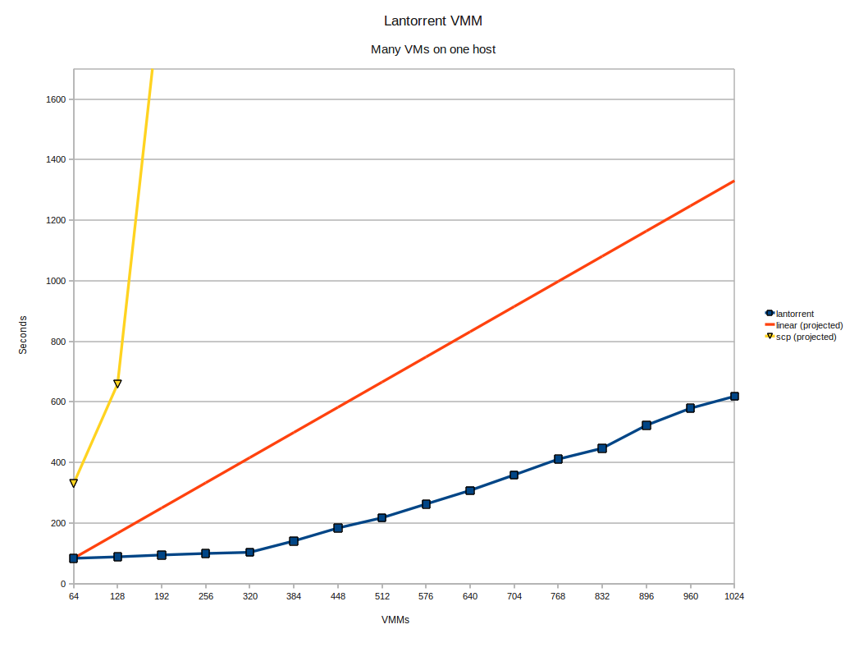
Deployment Performance
Challenge: make image deployment faster
Moving images is the main component of VM deployment
LANTorrent: the BitTorrent principle on a LAN
Streaming
Minimizes congestion at the switch
Detecting and eliminating duplicate transfers
Bottom line: a thousand VMs in 10 minutes
Nimbus release 2.6
Preliminary data using the Magellan resource
At Argonne National Laboratory
Alternative approaches:
Nicolae et al., BlobSeer
Riteau et al., QCOW

Slide 22
Networking
Network Solutions
External: public or private IPs (via VPN)
Internal: private network via a local cluster
Mixed: multiple NICs to create
Network mechanisms
Configures trusted (non-spoofable) networking layer for the VMs
Adapts to multiple site configurations
E.g., centralized versus decentralized DHCP
Creates private networks via a local cluster
Manages multiple NICs

Slide 23
Basic Contextualization
Image patching for basic contextualization
Meta-data server
EC2 meta-data interfaces (internal)
IP address authorization
Patching the server address as part of basic contextualization

Slide 24
The Cumulus Storage Cloud

Slide 25
Cumulus Highlights
S3 compatible
Works with popular 3rd party clients
Quota management for scientific applications
Easy to manage, easy to operate
Install and run with a single command
Easy-to-use set of user management tools
Customizable back-end systems
Default installation with POSIX
Works with HDFS, GPFS, or any other storage system that has a VFS kernel or FUSE module
BlobSeer (currently not included in the release)
Can be configured as a multi-node replicated server
With cumulus small providers can still be S3 protocol compliant
while making an independent choice on cost/reliability.

Slide 26
Cumulus Architecture
Cumulus interfaces
S3
Cumulus API

Slide 27
Cumulus Interfaces
Supports Amazon's S3 REST protocol
All common commands implemented
Can leverage S3’s redirect feature
Compatible with well known 3rd party clients: boto, JetS3t, s3cmd, etc.
Cumulus
S3 REST

Slide 28
Cumulus Security
Authentication
Access key (login id) / secret key (password)
Example id: 5xecKocxGi2DoCppttrnU
Example pw : XXm4jIim2rw16QiiqyvB8rHt409pFUBxHm3oMXGDz6
The secret is used to sign requests
Authorization
Users may set ACL access permissions on their objects
Add, remove users
Objects and Buckets
Read, write, ACL
Administrator sets a quota for specific user
Before a file is uploaded Cumulus checks the user quota.
If the quota will be exceeded the S3 error 'Account Problem' is sent

Slide 29
Cumulus Architecture
Cumulus interfaces
S3
Cumulus API
Cumulus Service Implementation

Slide 30
Cumulus Service Implementation
User management tools
Easy to use tools that: create, remove, edit, and list users
CLI options that make scripting easy
Logging and accounting
Configuration management
Service persistence
State represented in a database stored on site
Object meta data
User authentication and access information

Slide 31
Cumulus Architecture
Cumulus interfaces
S3
Cumulus API
Cumulus Service Implementation
Cumulus Storage API
Cumulus Implementation options
POSIX
BlobSeer

Slide 32
Cumulus Backends
Cumulus Storage API is extensible to support many back-ends
POSIX API included with Cumulus
This support for many filesystems (HDFS, GPFS, Sector, etc) via kernel VFS or FUSE
Can be configured as a set of replicated hosts
Support for BlobSeer being contributed
Cumulus
Cassandra
POSIX
Sector
HDFS
BlobSeer

Slide 33
Cumulus Transfer
Transfer Reliability
md5sum checksums (part of the s3 protocol)
Client side retry logic (supported by most s3 clients)
Performance
On par with other popular, and fast data transfer protocols
Approaches bottleneck speeds (disk) as file size increases
For more see our SC10 poster

Slide 34
The Context Broker

Slide 35
Context Broker Goals
Can work with every appliance
Appliance schema, can be implemented in terms of many configuration systems
Can work with every cloud provider
Simple and minimal conditions on generic context delivery
Can work across multiple cloud providers, in a distributed environment

Slide 36
Turnkey Virtual Clusters
IP1
HK1
IP2
HK2
IP3
HK3
IP1
HK1
IP1
HK1
IP1
HK1
MPI
IP2
HK2
IP2
HK2
IP2
HK2
IP3
HK3
IP3
HK3
IP3
HK3
Context Broker
Turnkey, tightly-coupled cluster
Shared trust/security context
Shared configuration/context information

Slide 37
Context Broker
Context Broker
provides
Appliance
Context Object
requires
create
context
address of Ctx Broker
context id
secret
address of Ctx Broker
context id
secret
Client
VMM/datacenter/IaaS
Resource Provider

Slide 38
Context Broker Status
Release history:
In alpha since 08/07
Initially released as a service in 2008
Source code released in Nimbus 2.3 02/10
Many updates since then
Both SOAP and REST interfaces
Integrates with Chef
Used for contextualizing hundreds of images for production runs
Contextualizable images on Science Clouds marketplace
Used and extended by OOI
Paper: Keahey&Freeman, “Contextualization: Providing One-Click Virtual Clusters”,
eScience 2008

Slide 39
Summary
Not just an IaaS implementation
IaaS services: Workspace Service and Cumulus
“Sky Computing” tools: making IaaS easy to use
Independent of Nimbus IaaS
Not just an open source project – an open source community
Implementation, release policy and social practice designed to reach out
Many examples of successful contributions
Come and join the team!

Slide 40
www.nimbusproject.com
Let’s make cloud computing for science happen.

