Slide 1
Nimbus Tutorial: An Introduction to Nimbus
Kate Keahey, David LaBissoniere,
John Bresnahan, Tim Freeman, Paul Marshall
Argonne National Laboratory
Computation Institute, University of Chicago

Slide 2
Cloud Computing for Science
Need for control
Complex codes

Slide 3
Nimbus Goals
Enable developers to extend, experiment and customize
High-quality, extensible, customizable,
open source implementation
Enable users to use IaaS clouds
Sky Computing Tools
Context Broker
Elastic Scaling Tools
Nimbus Clients
Enable providers to build IaaS clouds
Infrastructure-as-a-Service Tools
Workspace Service
Cumulus

Slide 4
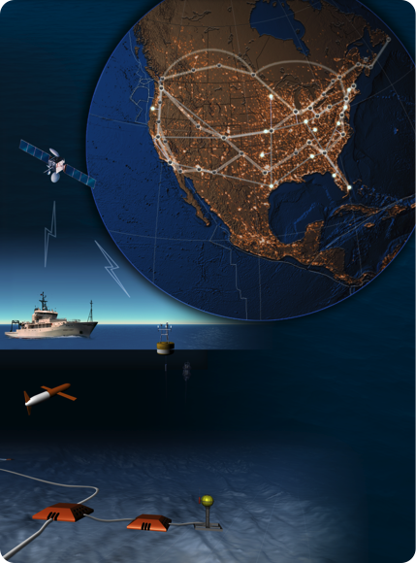
Tutorial Overview
Part I (9 AM):
An Introduction to Nimbus
Hands-on: Get on the Cloud
Break (10:30 AM – 11 AM)
Part II (11 AM)
Nimbus Architecture Overview
Hands-on: Nimbus Installation

Slide 5
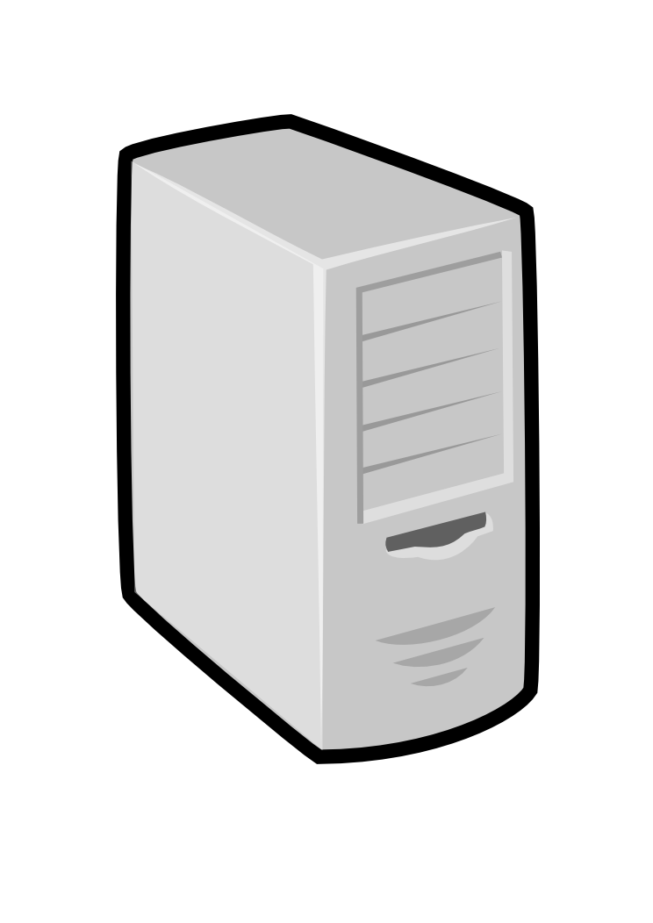
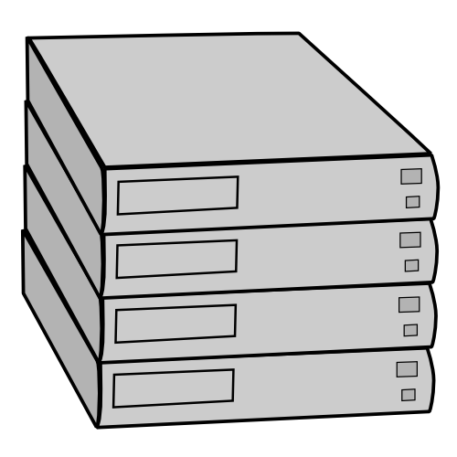
Nimbus IaaS: How it Works
Pool
node
Pool
node
Pool
node
Nimbus
Pool
node
Pool
node
Pool
node
Pool
node
Pool
node
Pool
node
Pool
node
Pool
node
Pool
node

Slide 6
Nimbus IaaS: How it Works
Nimbus publishes
information about each VM
Pool
node
Pool
node
Pool
node
Nimbus
Pool
node
Pool
node
Pool
node
Users can find out
information about their
VM (e.g. what IP
the VM was bound to)
Pool
node
Pool
node
Pool
node
Pool
node
Pool
node
Pool
node
Users can interact directly with their VM in the same way the would with a physical machine.

Slide 7
Sky Computing Tools: Working with Hybrid Clouds
Creating Common Context
Nimbus Elastic Provisioning
interoperability
automatic scaling
HA provisioning
policies
private clouds
(e.g., FNAL)
community clouds
(e.g., Science Clouds)
public clouds
(e.g., EC2)

Slide 8
Nimbus: A Highly-Configurable IaaS Architecture
Workspace Interfaces
Cumulus interfaces
EC2: SOAP and Query
WSRF
S3
Workspace API
Cumulus API
Workspace Service Implementation
Cumulus Service Implementation
Workspace RM options
Default
Default+backfill/spot
Workspace pilot
Workspace Control Protocol
Cumulus Storage API
Workspace Control
Cumulus Implementation options
Virtualization
(libvirt)
Image Mngm
Network
Ctx
scp
…
POSIX
Xen
KVM
LANtorrent
HDFS

Slide 9
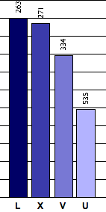
A Brief History of Nimbus
OOI
starts
First STAR
production
run on EC2
Experimental
Clouds for
Science
Xen released
Science Clouds
available
EC2 released
2004
2006
2008
2010
“A Case for Grid Computing on VMs”
In-Vigo, VIOLIN, DVEs,
Dynamic accounts
Policy-driven negotiation
First Nimbus
release
Nimbus
Context Broker
release

Slide 10
Resources, Applications and Ecosystem

Slide 11
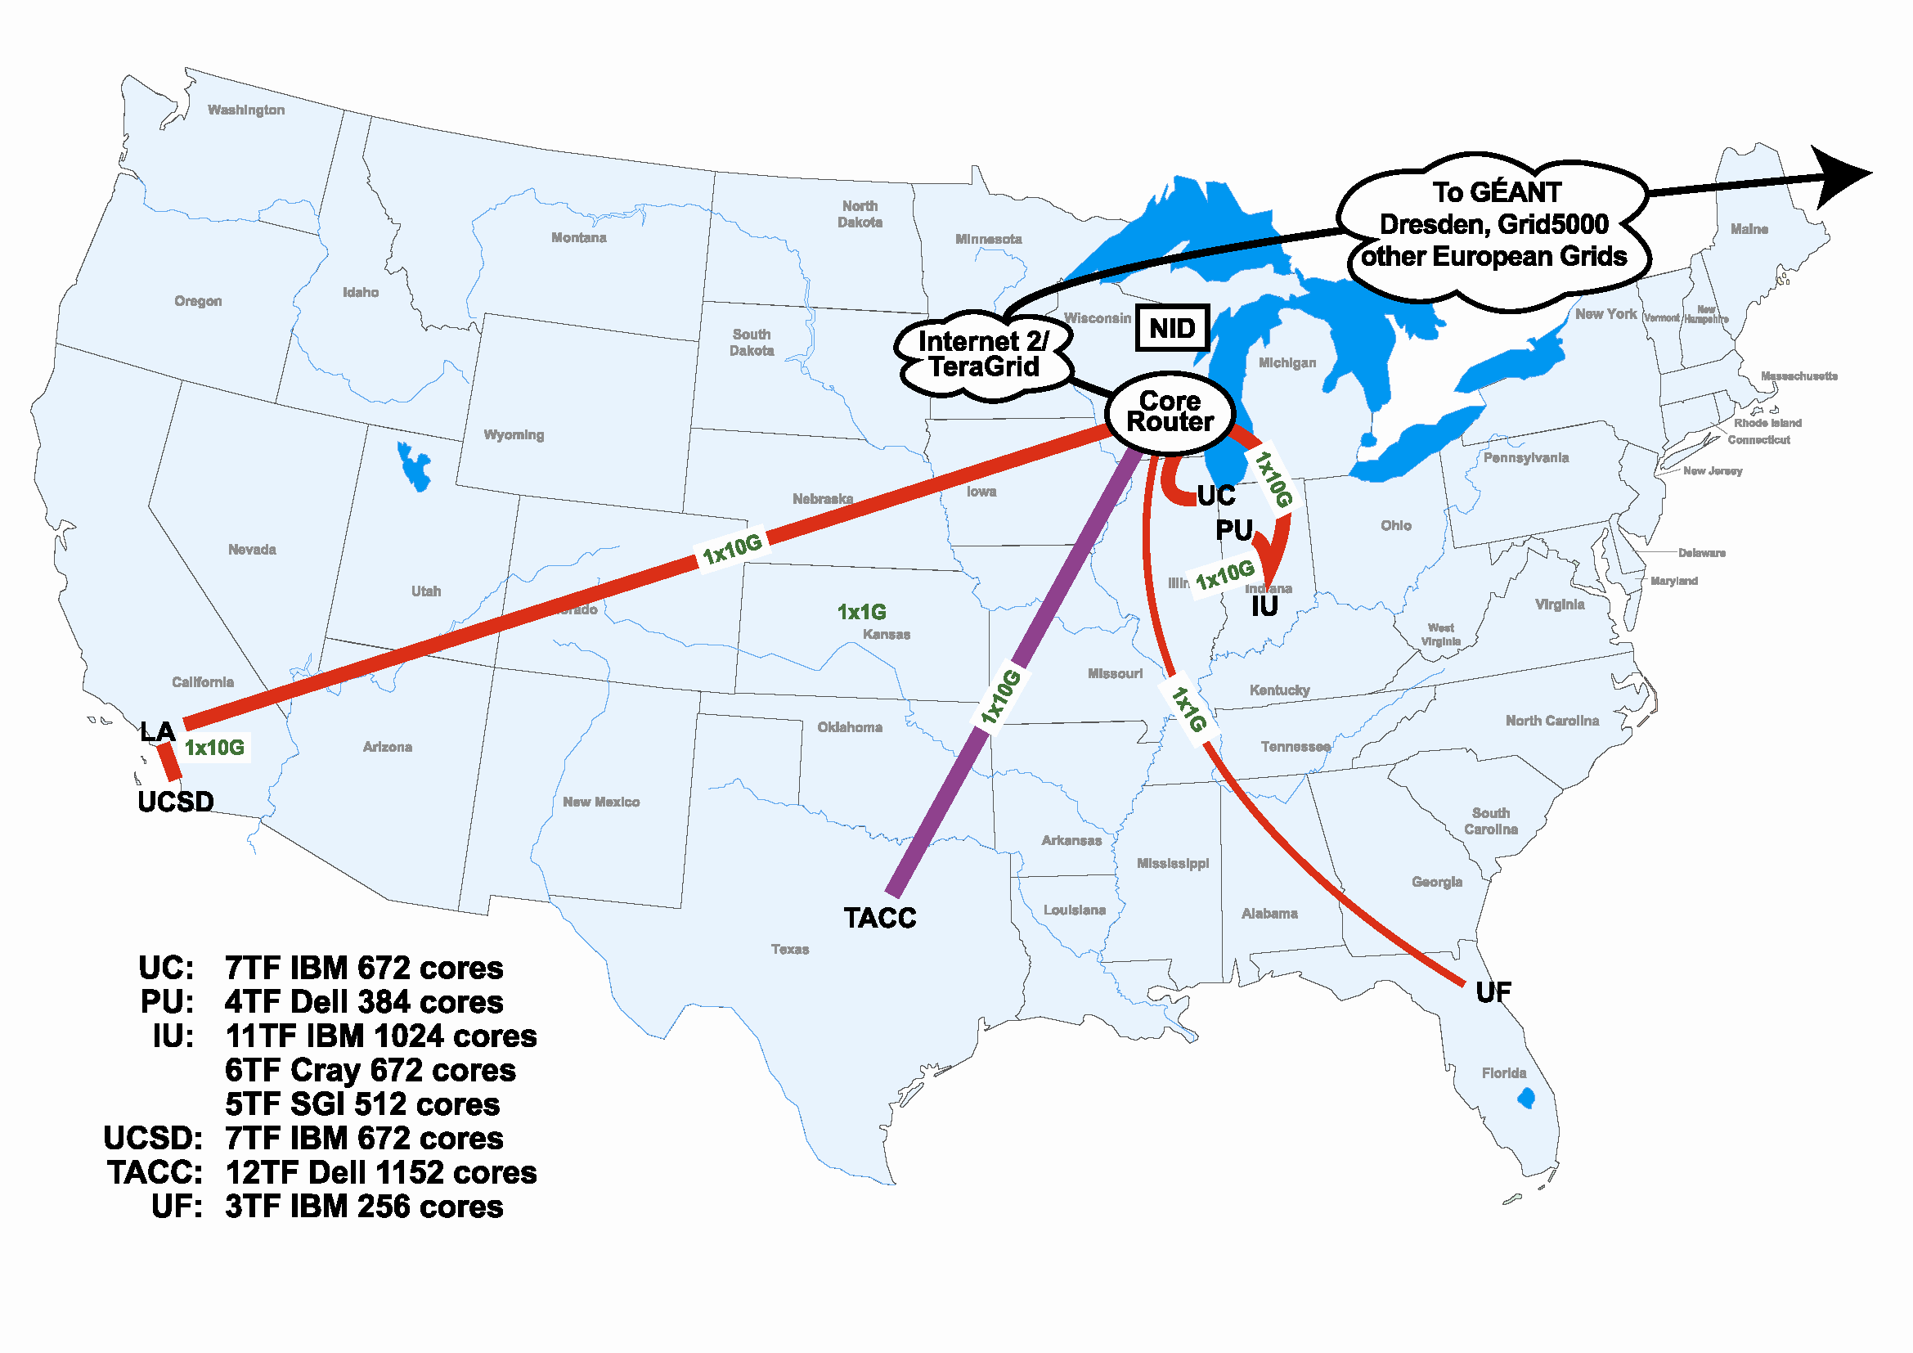
Scientific Cloud Resources
Science Clouds
UC, UFL, Wispy@Purdue
~300 cores
Magellan
DOE cloud @ ANL&LBNL
~4000 cores@ANL
FutureGrid
~6000 cores
DIAG =
Data Intensive Academic Grid
U of Maryland School of Medicine in Baltimore
~1200-1500 cores
Outside of US:
WestGrid, Grid5000
Magellan
FutureGrid
DIAG

Slide 12
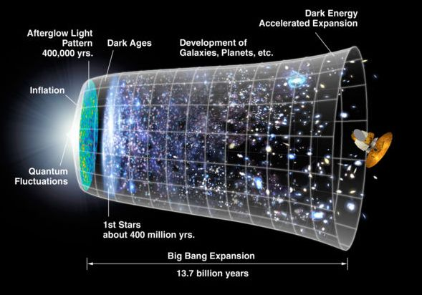
Work by Jerome Lauret (BNL) et al.
STAR: a nuclear physics experiment at Brookhaven National Laboratory
Approach:
Nimbus Science Clouds -> EC2 runs
Virtual OSG clusters with Nimbus Context Broker
Impact
Production runs on EC2 since 2007
The Quark Matter 2009 deadline: producing just-in time results

Slide 13
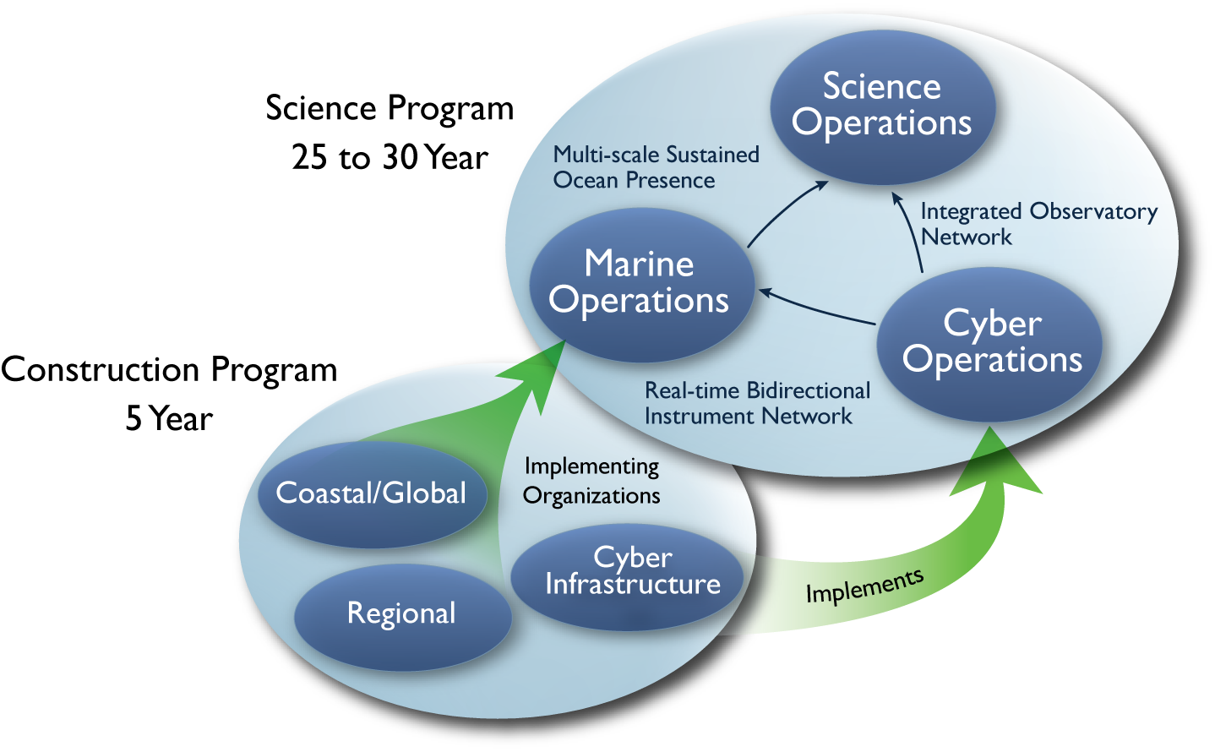
Large NSF-funded observatory with requirements for adaptive, reliable, elastic computing
Approach:
Private Nimbus regional clouds -> commercial clouds
Highly Available (HA) services that provision resources on many clouds based on need
Significant OOI CI infrastructure in data and sensor management based on this model
Status:
Scalability and reliability tests on 100s of EC2, FutureGrid and Magellan resources
HA elastic services release in Spring 2011
Trail-blazing project

Slide 14
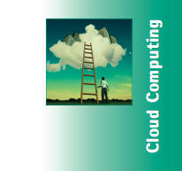
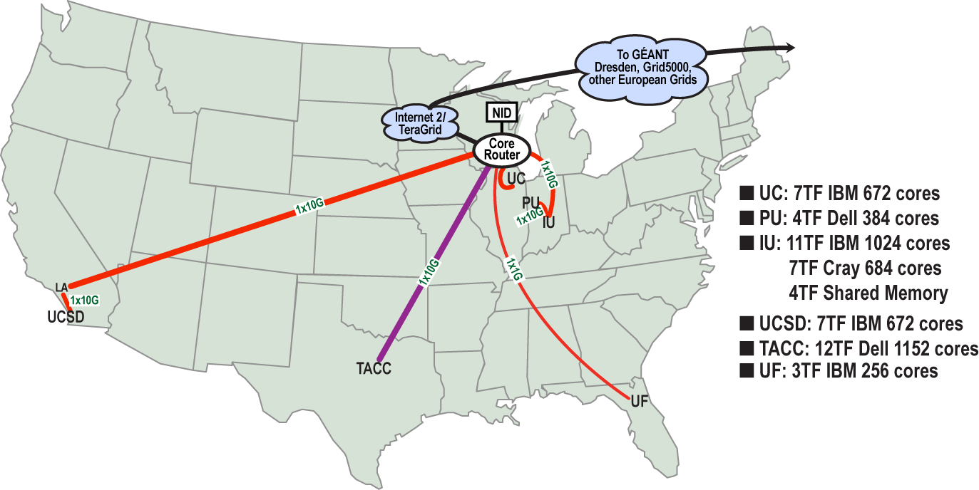
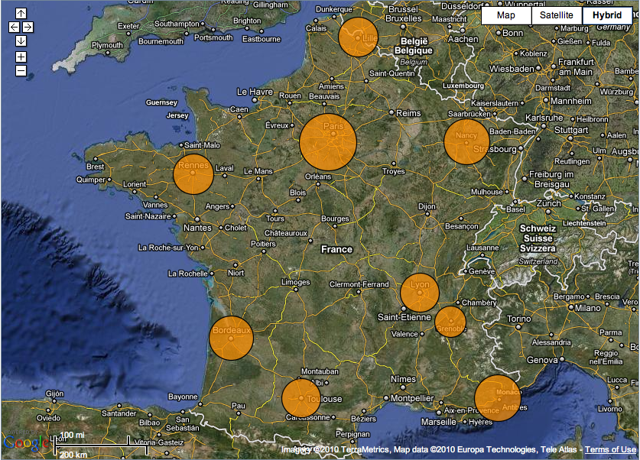
Sky Computing
Work by Pierre Riteau et al,
University of Rennes 1
Sky Computing = a Federation of Clouds
Approach:
Combine resources obtained in multiple Nimbus clouds in FutureGrid and Grid’ 5000
Combine Context Broker, ViNe, fast image deployment
Deployed a virtual cluster of over 1000 cores on Grid5000 and FutureGrid – largest ever of this type
Grid’5000 Large Scale Deployment Challenge award
Demonstrated at OGF 29 06/10
TeraGrid ’10 poster
“Sky Computing”
IEEE Internet Computing, September 2009
iSGTW: www.isgtw.org/?pid=1002832

Slide 15
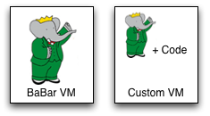
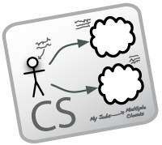
Work by the UVIC team
Canadian Efforts
BarBar Experiment at SLAC in Stanford, CA
Using clouds to simulating electron-positron collisions in their detector
Exploring virtualization as a vehicle for data preservation
Approach:
Distributed Nimbus clouds
Appliance preparation and management
Cloud Scheduler
Running production BaBar workloads

Slide 16
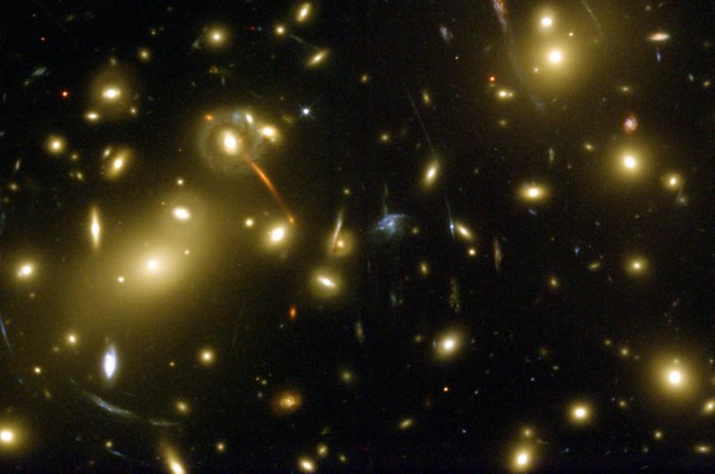
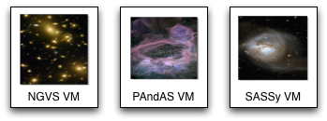
Work by the UVIC team
Provide infrastructure for six observational astronomy survey projects
Approach:
Running on a Nimbus cloud on WestGrid
Dynamic Condor pool for astronomy
Appliance creation and management
Status:
MACHO experiment Dark Matter search
In production operation since July 2010

Slide 17
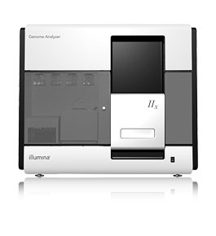
Sam Angiuoli
Institute for Genome Sciences
University of Maryland School of Medicine
The emergent need for processing
A virtual appliance for automated and portable sequence analysis
Approach:
Running on Nimbus Science Clouds, Magellan and EC2
A platform for building appliances representing push-button pipelines
Impact
From desktop to cloud
http://clovr.org

Slide 18
Coming Down the Assembly Line: Elastic Scaling

Slide 19
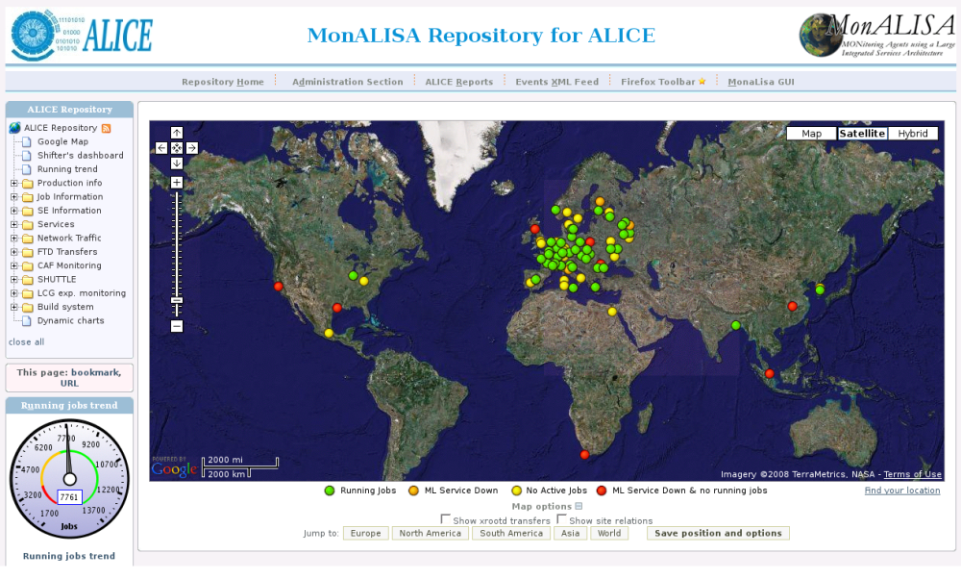
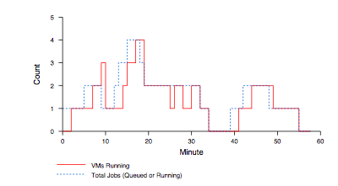
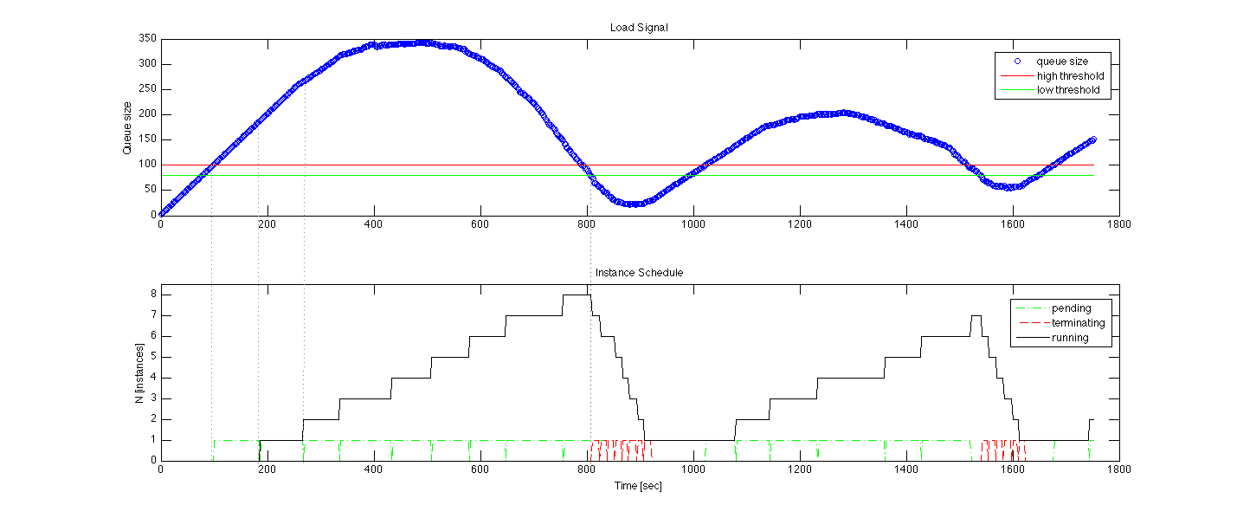
Elasticity, Reliability and Failure
Elasticity and reliability are different sides of the same coin.
2008: The ALICE proof-of-concept
2009: ElasticSite prototype
2009: OOI pilot
Paper: “Elastic Site”, CCGrid 2010
Need for generic, HA,
elastic service model

Slide 20
Elasticity, Reliability and Failure
Assumption: a workload queue
ALiEn, PBS, AMQP,…
React to sensor information
Queue properties a sensor
Scale to demand
Across different cloud providers
Use contextualization to integrate machines across hybrid clouds
Highly Available
Scalable: latest tests scale to 100s of nodes on EC2, target is thousands
Release in early 2011
Customizable to input, policy, provider, etc.
Start with a queue
Sensor information
Policy
Provision resources
private
EC2
community

Slide 21
Nimbus Team

Slide 22
Nimbus Collaboration

Slide 23
The Nimbus Team
Project lead: Kate Keahey, ANL&UC
Comitters:
Tim Freeman - University of Chicago
Ian Gable - University of Victoria
David LaBissoniere - University of Chicago
John Bresnahan - Argonne National Laboratory
Patrick Armstrong - University of Victoria
Pierre Riteau - University of Rennes 1, IRISA
Github Contributors:
Tim Freeman, David LaBissoniere, John Bresnahan, Pierre Riteau, Alex Clemesha, Paulo Gomez, Patrick Armstrong, Matt Vliet, Ian Gable, Paul Marshall, Adam Bishop
And many others
See http://www.nimbusproject.org/about/people/

Slide 24
Open Source Project
Necessary conditions
Open source license
Open code
Sufficient conditions
Design for extensibility
Acceptance test framework
Social coding mechanisms
Inclusive team dynamic

Slide 25
Parting Thoughts
Cloud computing is a powerful tool for science
A change of paradigm -> a change of pattern
New technology requirements
Cost comparisons, elastic scaling, data management, resource management, etc.
New work patterns and new opportunities
Appliances, elastic scaling integration, etc.
Open source an essential tool to effect change

Slide 26
www.nimbusproject.com
Let’s make cloud computing for science happen.

