Slide 1
Nimbus: Cloud Computing for Science
Workshop on High Performance Applications
of Cloud and Grid Tools
Kate Keahey
keahey@mcs.anl.gov
Argonne National Laboratory
Computation Institute, University of Chicago

Slide 2
Cloud Computing for Science
Control over environment
On-demand computing

Slide 3
The Nimbus Project
Enable developers to extend, experiment and customize
High-quality, extensible, customizable,
open source implementation
Enable users to use IaaS clouds
Nimbus Platform
Context Broker
Workspace
Gateway
Deployment
Coordination
Elastic Scaling Tools
Enable providers to build IaaS clouds
Nimbus Infrastructure
Workspace Service
Cumulus

Slide 4
Nimbus Infrastructure: a Highly-Configurable IaaS Architecture
Workspace Interfaces
Cumulus interfaces
EC2 SOAP
EC2 Query
WSRF
S3
Workspace API
Cumulus API
Workspace Service Implementation
Cumulus Service Implementation
Workspace RM options
Default
Default+backfill/spot
Workspace pilot
Workspace Control Protocol
Cumulus Storage API
Workspace Control
Cumulus Implementation options
Virtualization
(libvirt)
Image Mngm
Network
Ctx
ssh
…
POSIX
Xen
KVM
LANtorrent
HDFS

Slide 5
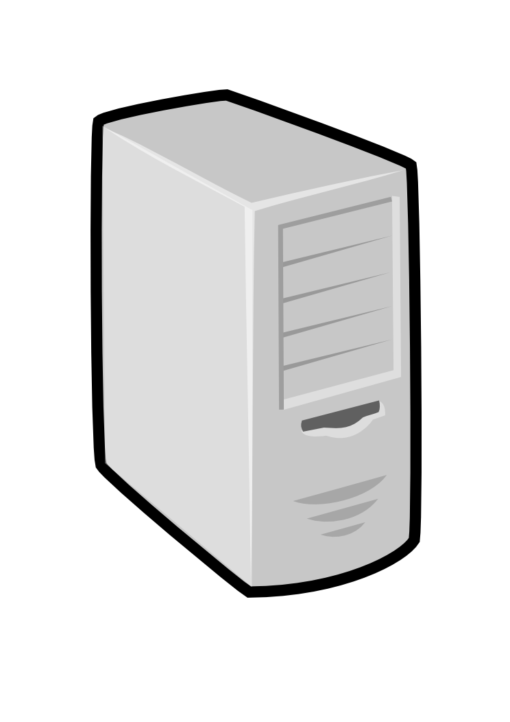
Nimbus Platform: Working with Hybrid Clouds
Creating Common Context
Nimbus 3: Multi-Cloud Tools
Cloudinit.d
Elastic Scaling
HA Services
private clouds
(e.g., FNAL)
community clouds
(e.g., Science Clouds)
public clouds
(e.g., EC2)

Slide 6
Nimbus Infrastructure Highlights

Slide 7
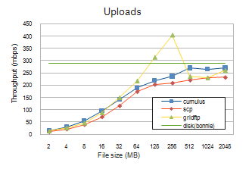
Cumulus: a Scalable Storage Cloud
Challenge: a scalable storage cloud with use-what-you-have approach
S3-compatible open source implementation
Quota support for scientific users
Pluggable back-end to various technologies such as POSIX, HDFS, Sector, BlobSeer
Configurable to take advantage of multiple servers
Paper @ ScienceCloud 2011 and HPDC 2011

Slide 8
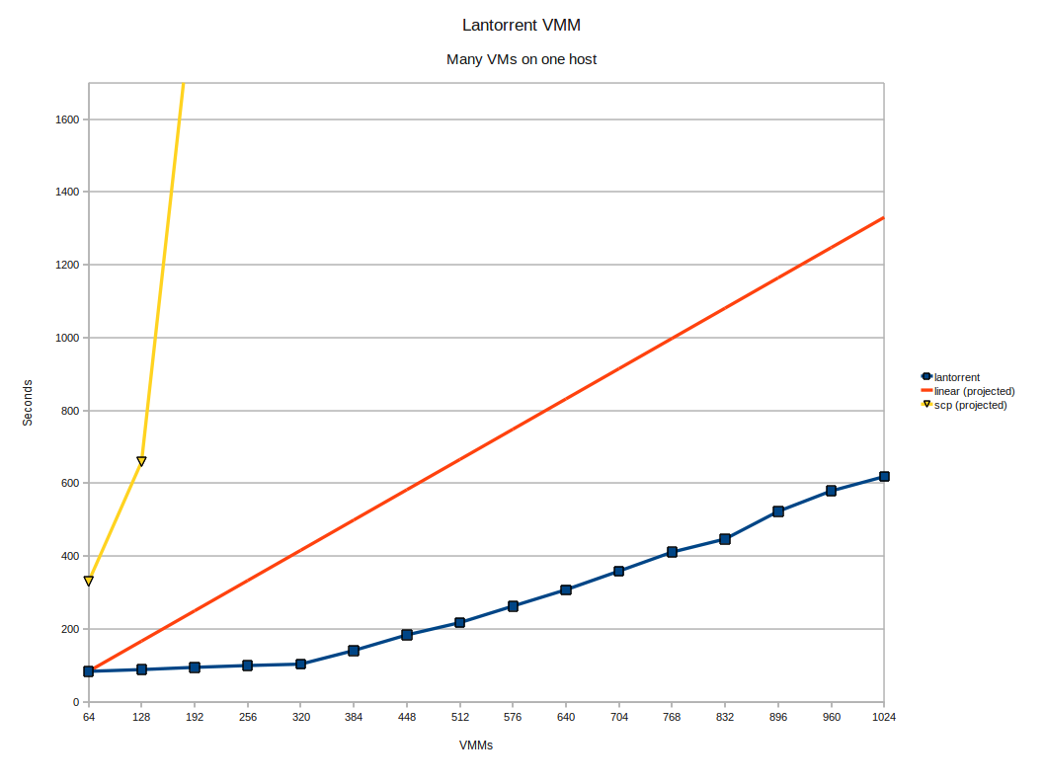
LANTorrent: Fast Image Deployment
Challenge: make image deployment faster
Moving images is the main component of VM deployment
LANTorrent: the BitTorrent principle on a LAN
Streaming
Minimizes congestion at the switch
Detecting and eliminating duplicate transfers
Bottom line: a thousand VMs in 10 minutes on Magellan
Nimbus release 2.6, see www.scienceclouds.org/blog
Preliminary data using the Magellan resource
At Argonne National Laboratory

Slide 9
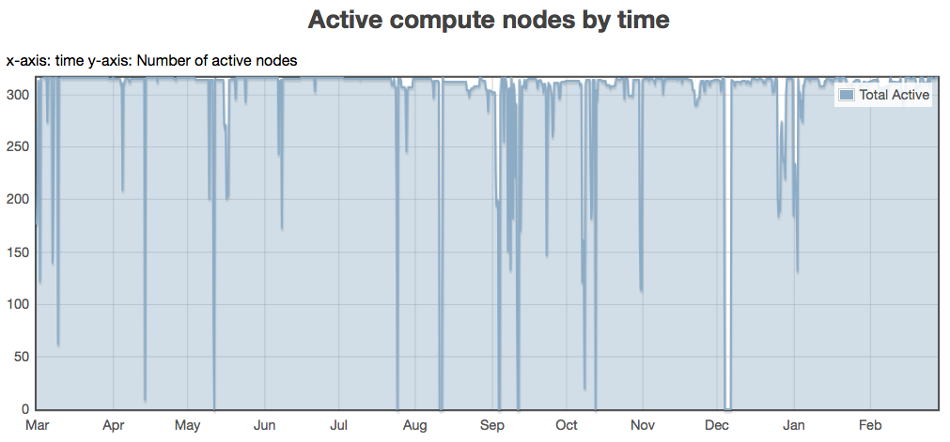
Backfill: Lower the Cost of Your Cloud
1 March 2010 through 28 February 2011
Challenge: utilization, catch-22 of on-demand computing
Solution: new instances
Backfill
Spot pricing
Bottom line: up to 100% utilization
Open Source community contribution
Preparing for running of production workloads on FG @ U Chicago
Nimbus release 2.7
Paper @ CCGrid 2011
94%
78%
62%
47%
31%
16%

Slide 10
Nimbus Platform Highlights

Slide 11
Cloudinit.d
Repeatable deployment of sets of VMs
Coordinates launches via attributes
Works with multiple IaaS providers
User-defined launch tests (assertions)
Test-based monitoring
Policy-driven repair of a launch
Coming in Nimbus 3
Web
Server
NFS
Server
Web
Server
Postgress
Database
Web
Server
Run-level 1
Run-level 2

Slide 12
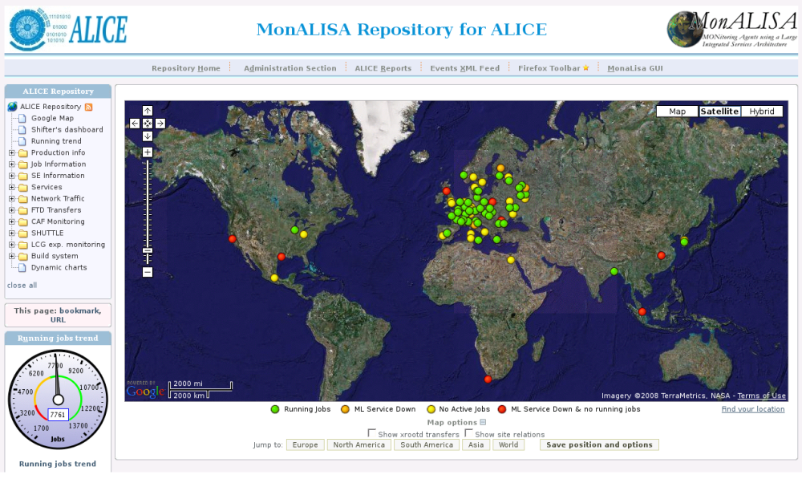
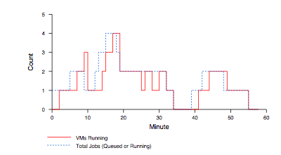
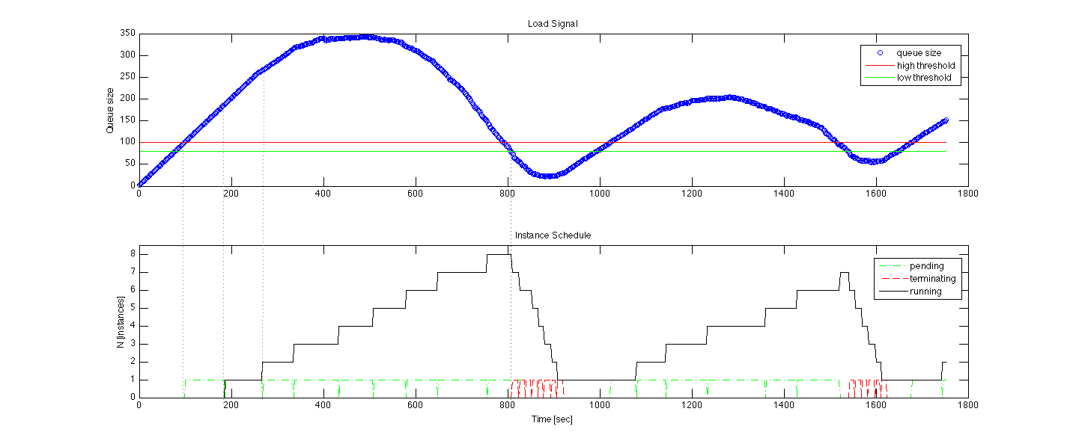
Elastic Scaling Tools: Towards “Bottomless Resources”
Early efforts:
2008: The ALICE proof-of-concept
2009: ElasticSite prototype
2009: OOI pilot
Challenge: a generic HA Service Model
React to sensor information
Queue: the workload sensor
Scale to demand
Across different cloud providers
Use contextualization to integrate machines into the network
Customizable
Routinely 100s of nodes on EC2
Coming in Nimbus 3
Paper: “Elastic Site”, CCGrid 2010

Slide 13
The Nimbus Team

Slide 14
The Nimbus Team
Project lead: Kate Keahey, ANL&UC
Committers:
Tim Freeman - University of Chicago
Ian Gable - University of Victoria
David LaBissoniere - University of Chicago
John Bresnahan - Argonne National Laboratory
Patrick Armstrong - University of Victoria
Pierre Riteau - University of Rennes 1, IRISA
Github Contributors:
Tim Freeman, David LaBissoniere, John Bresnahan, Pierre Riteau, Alex Clemesha, Paulo Gomez, Patrick Armstrong, Matt Vliet, Ian Gable, Paul Marshall, Adam Bishop
And many others
See http://www.nimbusproject.org/about/people/

Slide 15
Parting Thoughts
Nimbus is about outsourcing computing for science
Benefits of outsourcing:
Economy of scale, access to different resources, no operation overhead, more flexible use
Cloud computing a fundamental paradigm shift
Criteria for outsourcing
Does it provide the right offering? Is it scalable? Easy to use? Easy to outsource? Cost-effective?
Role of Nimbus
Full stack: from infrastructure to platform
Working with open source community and tools
Working with many scientific applications
Both cloud computing and scientific computing may have to change
Mohammand and the Mountain: www.scienceclouds.org

Slide 16
www.nimbusproject.com
Let’s make cloud computing for science happen.

