Slide 1
Cloud versus Cloud: the Blessings and Challenges of Cloud Computing for Science
Kate Keahey
keahey@mcs.anl.gov
Argonne National Laboratory
Computation Institute, University of Chicago

Slide 2
Cloud versus Cloud
Custom user environments!
On-demand access!
Elastic computing!
Growth and cost management!
Capital expense -> operational expense!
You mean I have to install my own OS?
How long does it take to deploy 5000 nodes
on a cloud?
Elasticity is fine, but how do I use it in practice over
many incompatible clouds?
It costs too much! And what if Amazon raises prices?
You can’t do HPC on the cloud!

Slide 3
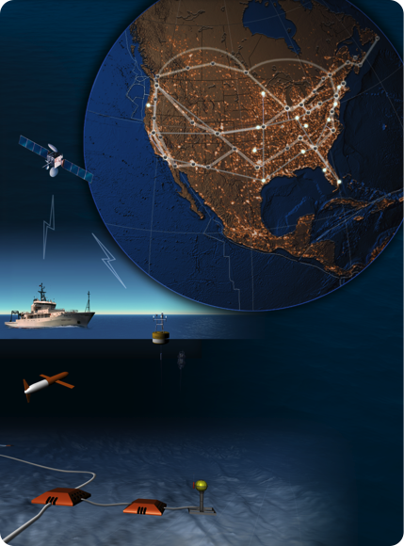
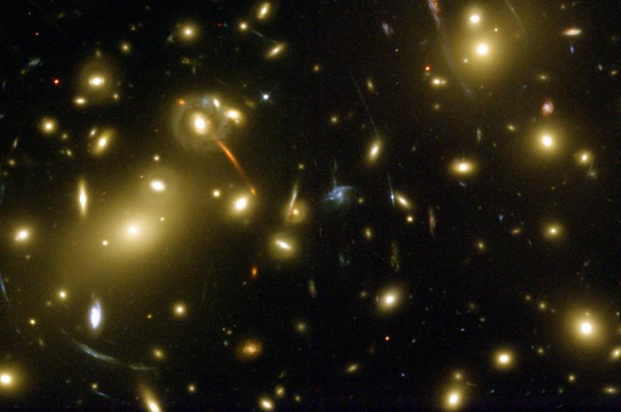
On the Nimbus Team…
Do whatever it takes to enable
Infrastructure clouds for science
Applications and Ecosystem
Count our blessings and
face the challenges…

Slide 4
Nuts and Bolts: Infrastructure Cloud Computing with Nimbus

Slide 5
Nimbus Components
Enable developers to extend, experiment and customize
High-quality, extensible, customizable,
open source implementation
Enable users to use IaaS clouds
Nimbus Platform
Context Broker
Nimbus Clients
Elastic Scaling Tools
Gateway
Enable providers to build IaaS clouds
Nimbus Infrastructure
Workspace Service
Cumulus

Slide 6
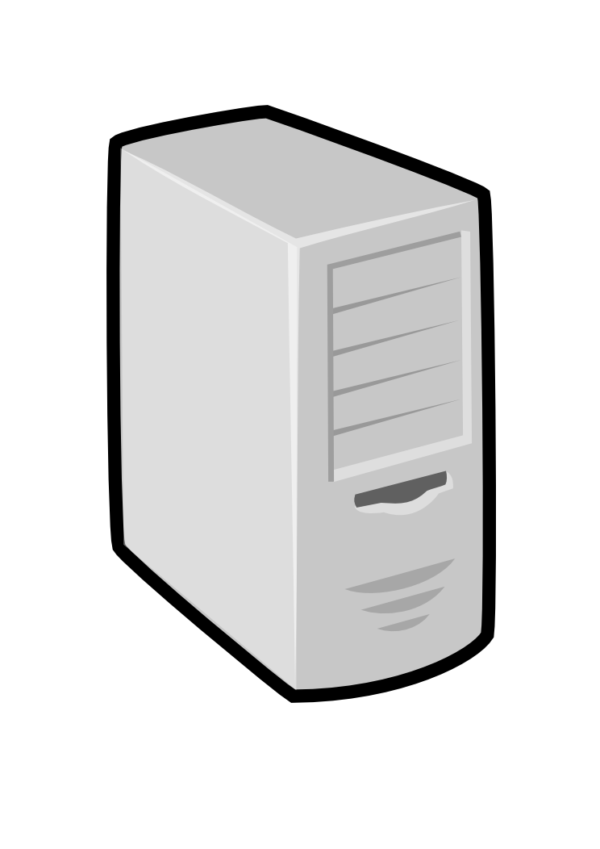
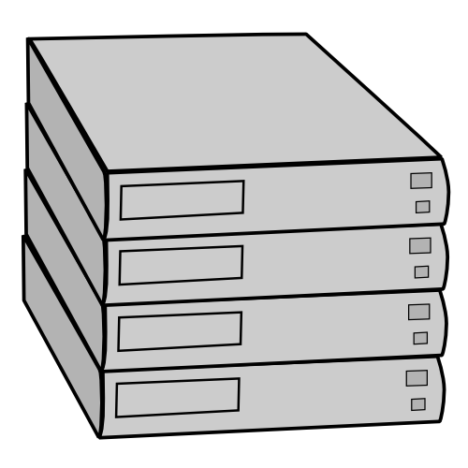
IaaS: How it Works
Pool
node
Pool
node
Pool
node
Nimbus
Pool
node
Pool
node
Pool
node
Pool
node
Pool
node
Pool
node
Pool
node
Pool
node
Pool
node

Slide 7
IaaS: How it Works
Nimbus publishes
information about each VM
Pool
node
Pool
node
Pool
node
Nimbus
Pool
node
Pool
node
Pool
node
Users can find out
information about their
VM (e.g. what IP
the VM was bound to)
Pool
node
Pool
node
Pool
node
Pool
node
Pool
node
Pool
node
Users can interact directly with their VM in the same way the would with a physical machine.

Slide 8
Nimbus Infrastructure: a Highly-Configurable IaaS Architecture
Workspace Interfaces
Cumulus interfaces
EC2 SOAP
EC2 Query
WSRF
S3
Workspace API
Cumulus API
Workspace Service Implementation
Cumulus Service Implementation
Workspace RM options
Default
Default+backfill/spot
Workspace pilot
Workspace Control Protocol
Cumulus Storage API
Workspace Control
Cumulus Implementation options
Virtualization
(libvirt)
Image Mngm
Network
Ctx
ssh
…
POSIX
Xen
KVM
LANtorrent
HDFS

Slide 9
Nimbus Platform: Working with Hybrid Clouds
Creating Common Context
Allow users to build turnkey dynamic virtual clusters
Nimbus Elastic Provisioning
interoperability
automatic scaling
HA provisioning
policies
private clouds
(e.g., FNAL)
community clouds
(e.g., Science Clouds)
public clouds
(e.g., EC2)

Slide 10
Applications and Ecosystem

Slide 11
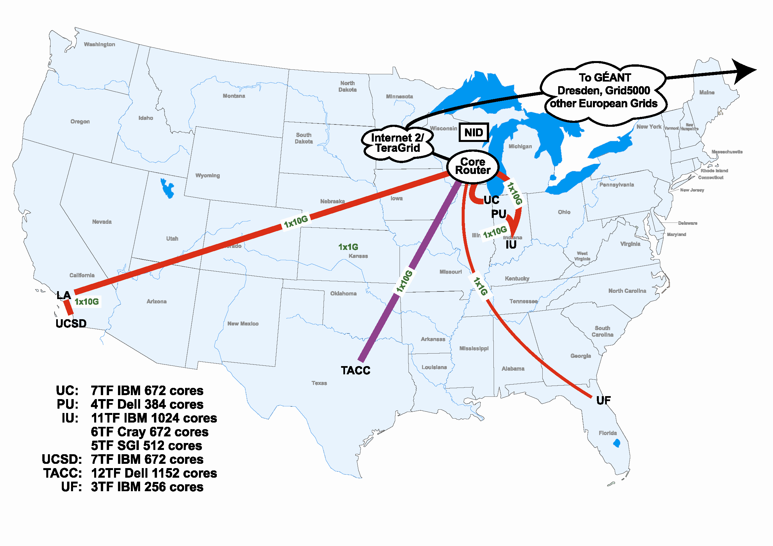
Scientific Cloud Resources
Science Clouds
UC, UFL, Wispy@Purdue
~300 cores
Magellan
DOE cloud @ ANL&LBNL
~4000 cores@ANL
FutureGrid
~6000 cores
DIAG =
Data Intensive Academic Grid
U of Maryland School of Medicine in Baltimore
~1200-1500 cores
Outside of US:
WestGrid, Grid’5000
Magellan
FutureGrid
has cloud cycles for you!
DIAG

Slide 12
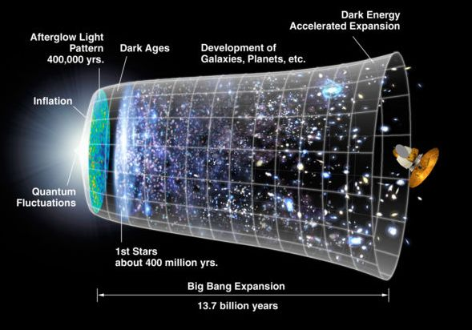
Work by Jerome Lauret (BNL) et al.
STAR: a nuclear physics experiment at Brookhaven National Laboratory
Approach:
Nimbus Science Clouds -> EC2 runs
Virtual OSG clusters with Nimbus Context Broker
Impact
Production runs on EC2 since 2007
The Quark Matter 2009 deadline: producing just-in time results
The small issues of cost

Slide 13
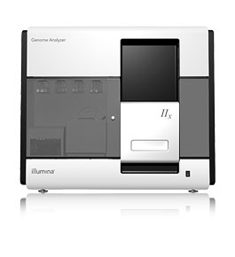
Sam Angiuoli
Institute for Genome Sciences
University of Maryland School of Medicine
The emergent need for processing
A virtual appliance for automated and portable sequence analysis
Approach:
Running on Nimbus Science Clouds, Magellan and EC2
A platform for building appliances representing push-button pipelines
Impact
From desktop to cloud
http://clovr.org

Slide 14
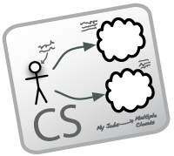
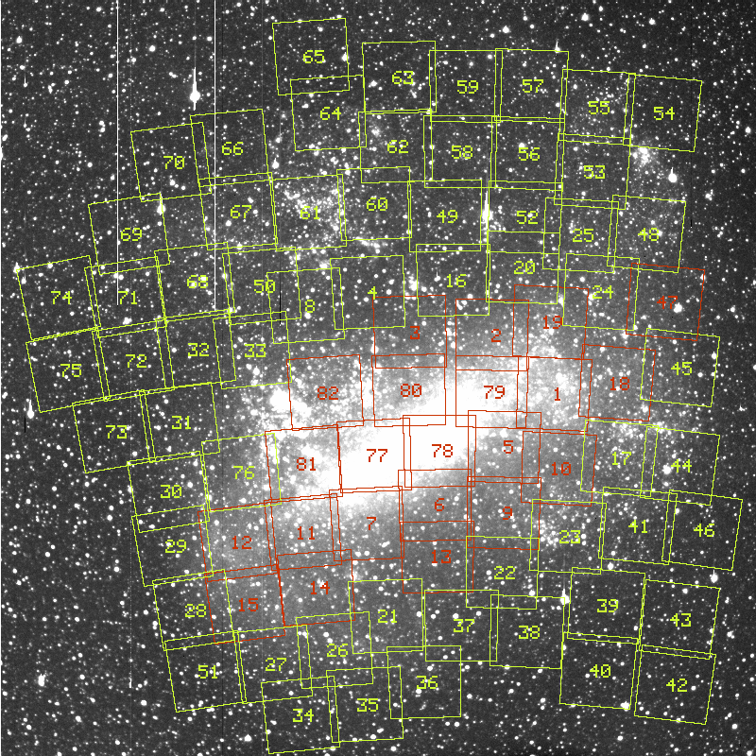
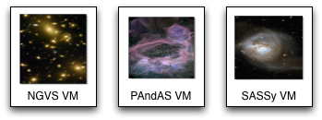
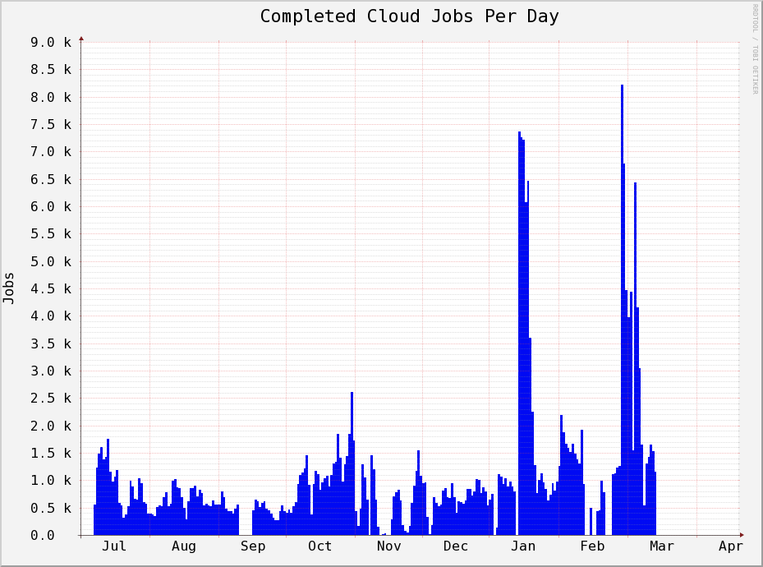
Work by the UVIC team
Detailed analysis of data from the MACHO experiment Dark Matter search
Provide infrastructure for six observational astronomy survey projects
Approach:
Running on a Nimbus cloud on WestGrid
Appliance creation and management
Dynamic Condor pool for astronomy
Status:
In production operation since July 2010

Slide 15
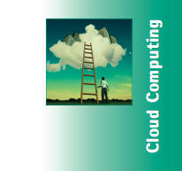
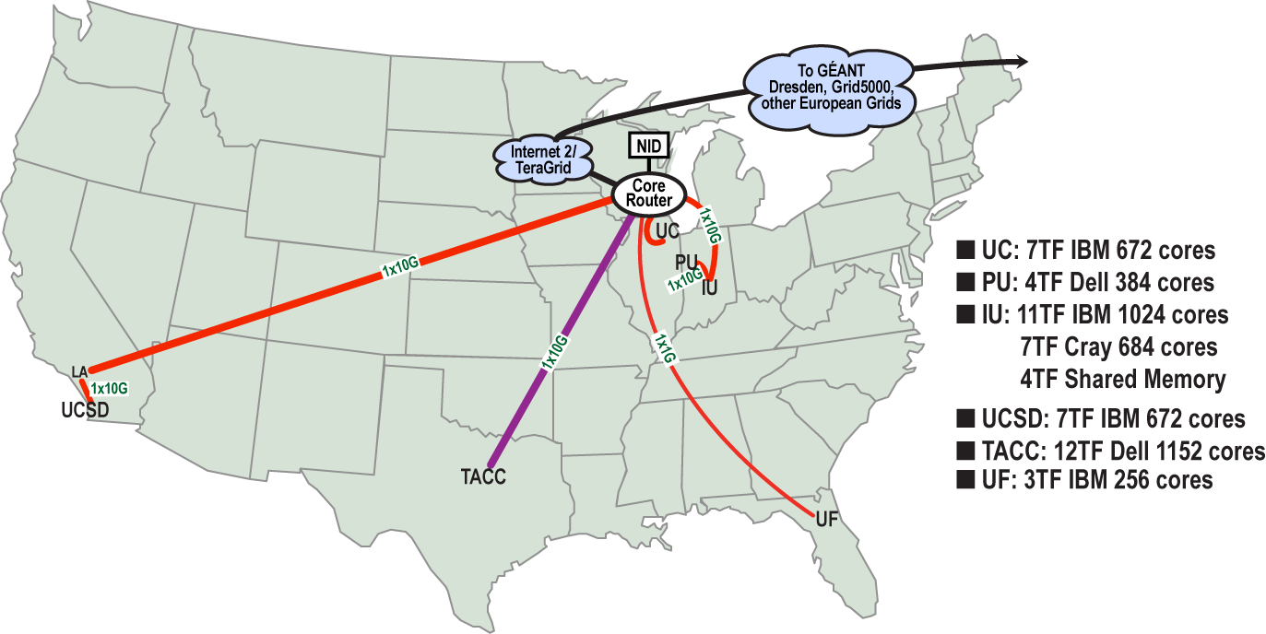
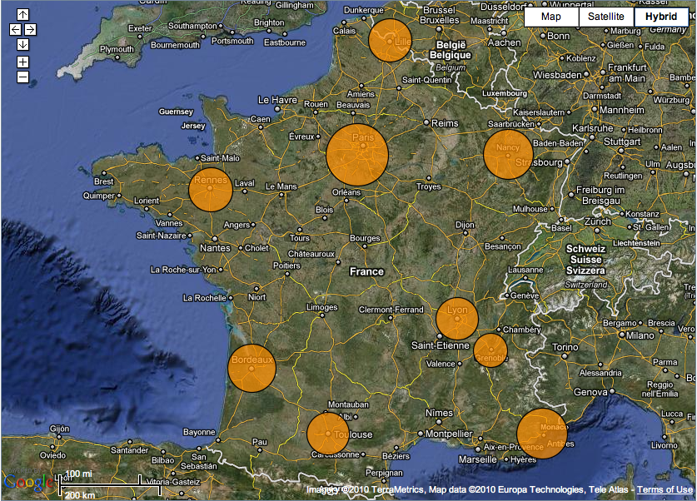
Sky Computing
Work by Pierre Riteau et al,
University of Rennes 1
Sky Computing = a Federation of Clouds
Approach:
Combine resources obtained in multiple Nimbus clouds in FutureGrid and Grid’ 5000
Combine Context Broker, ViNe, fast image deployment
Deployed a virtual cluster of over 1000 cores on Grid5000 and FutureGrid – largest ever of this type
Grid’5000 Large Scale Deployment Challenge award
Demonstrated at OGF 29 06/10
TeraGrid ’10 poster
More at: www.isgtw.org/?pid=1002832
“Sky Computing”
IEEE Internet Computing, September 2009

Slide 16
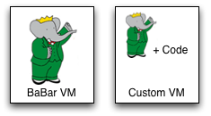
Work by the UVIC team
Canadian Efforts
BarBar Experiment at SLAC in Stanford, CA
Using clouds to simulating electron-positron collisions in their detector
Exploring virtualization as a vehicle for data preservation
Approach:
Appliance preparation and management
Distributed Nimbus clouds
Cloud Scheduler
Running production BaBar workloads

Slide 17
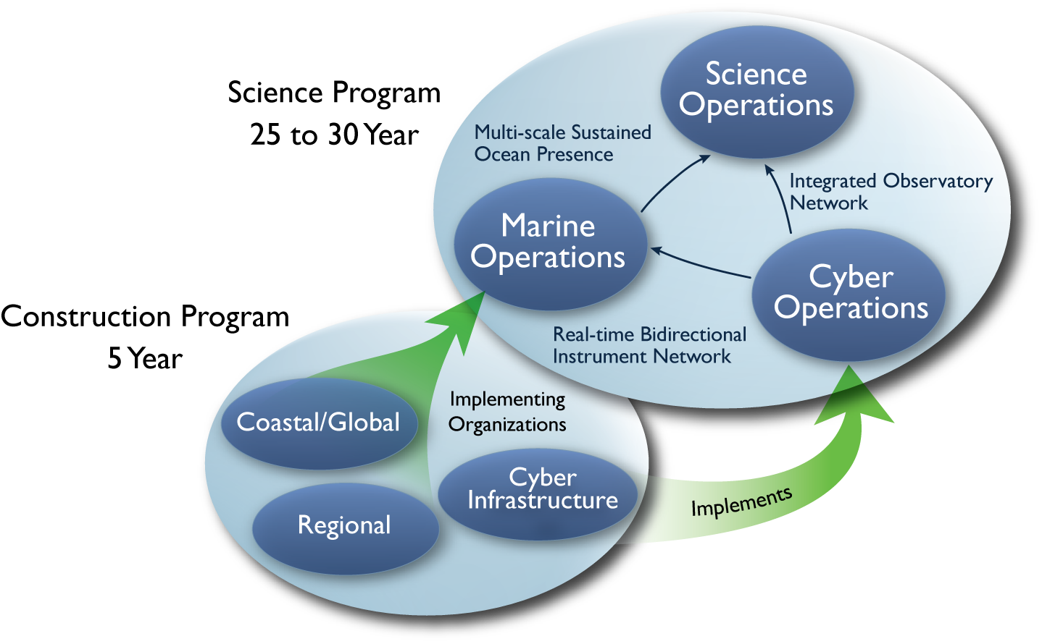
Large NSF-funded observatory with requirements for adaptive, reliable, elastic computing
Approach:
Private Nimbus regional clouds -> commercial clouds
Highly Available (HA) services that provision resources on many clouds based on need
Significant OOI CI infrastructure in data and sensor management based on this model
Status:
Scalability and reliability tests on 100s of EC2, FutureGrid and Magellan resources
HA elastic services release in 2011 (Nimbus 3)
Trail-blazing project

Slide 18
Blessings
Yes, custom, user-owned and user-controlled environments on remote resources
Yes, on-demand access
Yes, elastic processing
Yes, growth and cost management
Yes, capital expense -> operational expense

Slide 19
Challenges (Some of)
Appliance management
Elasticity and reliability, but how?
Performance of deployment
Are clouds suitable for high performance applications?
High cost
Lack of markets

Slide 20
Appliance Management
I want to manage
my own VMs!
I don’t want to manage
my own VMs!
Challenge: Many users are not skilled in appliance development yet require the control
The emergence of community appliance management and maintenance
Clovr, BarBar and Canfar @ UVIC, CernVM, and others
A new role/job description
Forward looking applications: data preservation

Slide 21
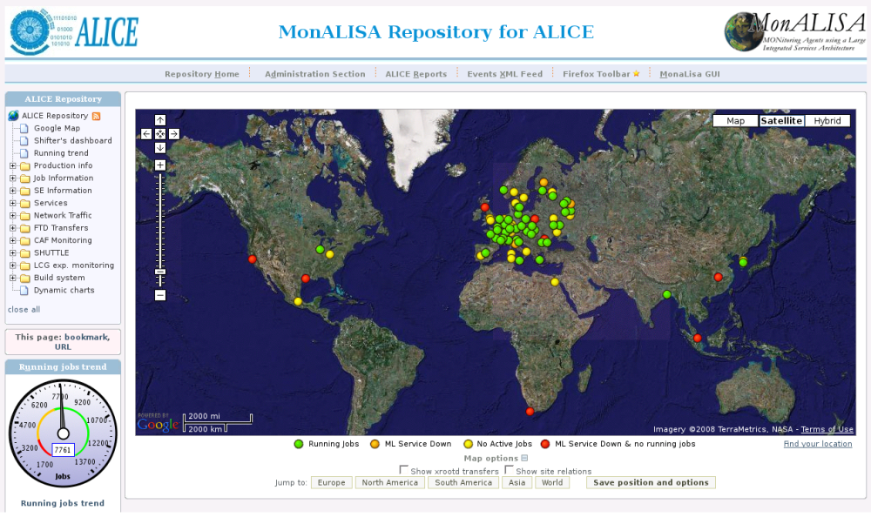
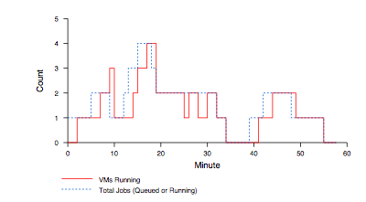
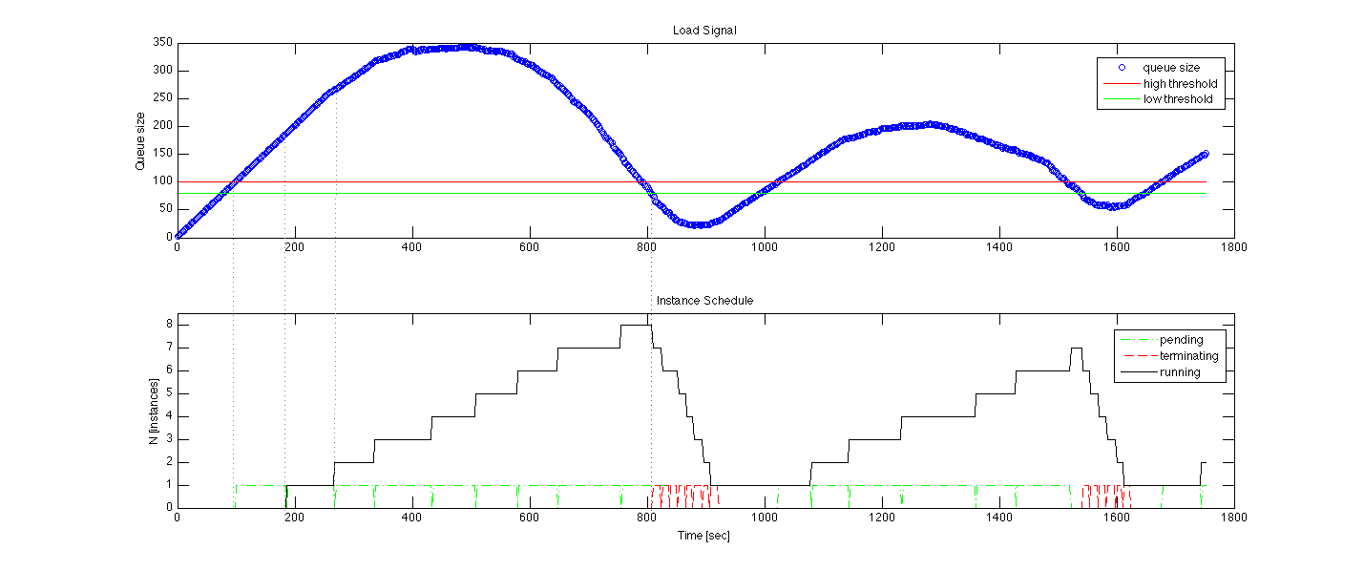
Elasticity, Reliability and Failure
Elasticity and reliability are different sides of the same coin.
2008: The ALICE proof-of-concept
2009: ElasticSite prototype
2009: OOI pilot
Paper: “Elastic Site”, CCGrid 2010
Challenge:
a generic HA
elastic service model

Slide 22
Elasticity, Reliability and Failure
Assumption: a workload queue
ALiEn, PBS, AMQP,…
React to sensor information
Queue, deployment status, VM health…
Evaluate against policies
Scale to demand
Across different cloud providers
Use contextualization to integrate machines across hybrid clouds
Highly Available
Scalable: latest tests scale to 100s of nodes on EC2, target is thousands
Release in 2011
Customizable to input, policy, decision engine, provider, etc.
Start with a queue
Sensor information
Policy
Provision resources
private
EC2
community

Slide 23
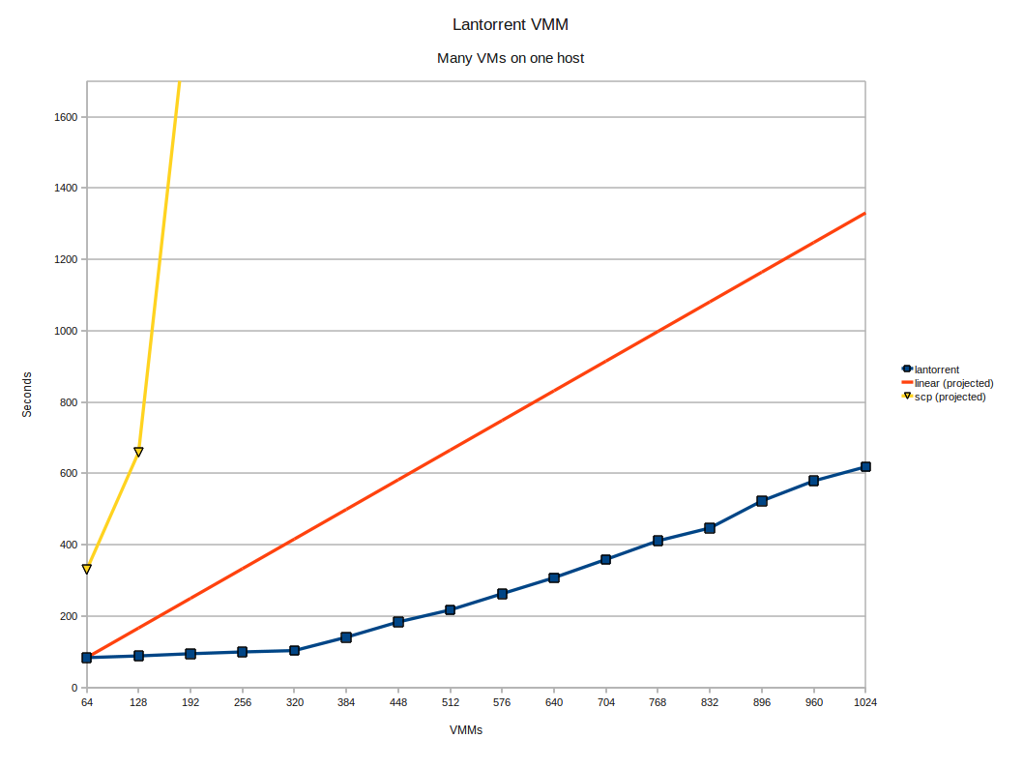
Deployment Performance
Challenge: make image deployment faster
Moving images is the main component of VM deployment
LANTorrent: the BitTorrent principle on a LAN
Streaming
Minimizes congestion at the switch
Detecting and eliminating duplicate transfers
Bottom line: a thousand VMs in 10 minutes
Nimbus release 2.6
Preliminary data using the Magellan resource
At Argonne National Laboratory
Alternative approaches:
Nicolae et al., BlobSeer
Riteau et al., QCOW

Slide 24
Execution Performance
Challenge: Virtualization overhead: myth or reality?
Ingredients of performance:
Hardware
Configuration
Stability
Things are looking up!
From performance…
…to price-performance
Instances for science
Availability@price
From Santos et al., Xen Summit 2007
How good are clouds for HPC?
“Comparisons: not as Odious as Once Thought”,
see www.scienceclouds.org/blog
And watch that space for ClusterCompute eval!

Slide 25
Cost, Utilization, and Price
Most science today is done in batch
Not very responsive…
… but very efficient!
Challenge: On-demand catch-22 for providers
You can overprovision (Expensive!)
Or you can reject requests (Not really on-demand)
Utilization -> Cost -> Price
Utilization on the Fusion cluster @ ANL
courtesy of Ray Bair, LCRC

Slide 26
Cost, Utilization, and Price
Solution 1:
Backfill with volunteer VMs
Benefits:
Up to 100% utilization!
Significantly lower cost
Solution 2:
Spot pricing
Support for auctions
Open Source community contribution
Preparing for running of production workloads on FG @ U Chicago
Extension to Nimbus Workspace Service RM available since Nimbus release 2.7
CCGrid 2011 paper, Marshal et al.

Slide 27
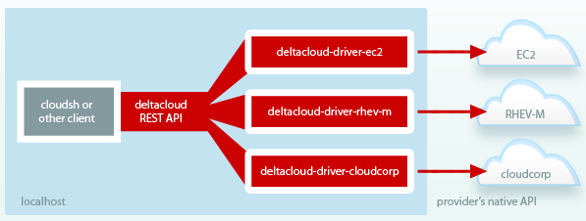
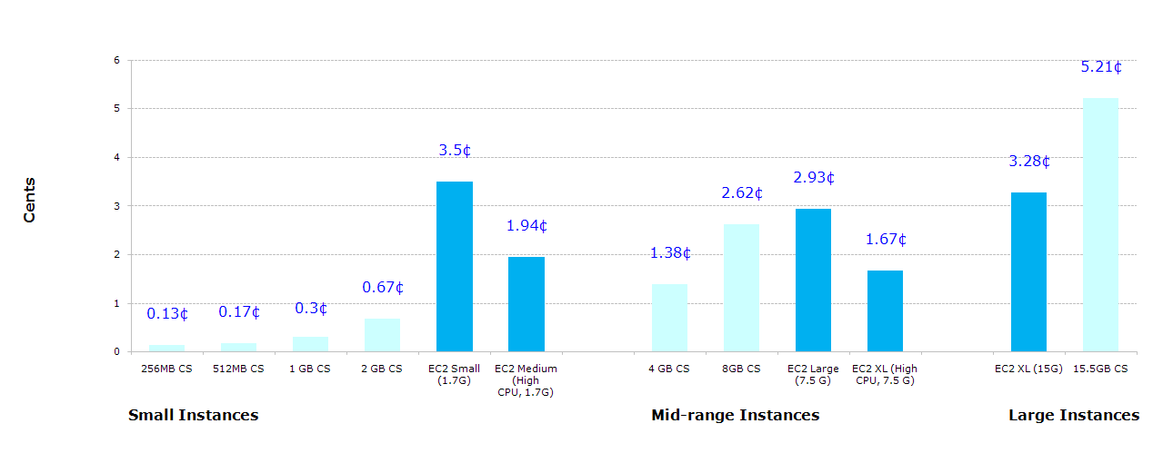
Cloud Markets (Lack Thereof)
Challenge: Are cloud resources fungible?
IaaS API standards:
Cloud standards: OCCI (OGF), OVF (DMTF), and many more…
www.cloud-standards.org
IaaS API adapters
Deltacloud, jcloud, libcloud, and many more…
VM image standards….
…and adapters
rBuilder, BCFG2, CohesiveFT, Puppet, and many more…
Comparing value….
Comprehensive
Current
And public!
What if my IaaS provider
doubles its price
tomorrow?
The Bitsource: CloudServers vs EC2 LKC Cost by Instance

Slide 28
The Nimbus Team

Slide 29
The Nimbus Team
Project lead: Kate Keahey, ANL&UC
Committers:
Tim Freeman - University of Chicago
Ian Gable - University of Victoria
David LaBissoniere - University of Chicago
John Bresnahan - Argonne National Laboratory
Patrick Armstrong - University of Victoria
Pierre Riteau - University of Rennes 1, IRISA
Github Contributors:
Tim Freeman, David LaBissoniere, John Bresnahan, Pierre Riteau, Alex Clemesha, Paulo Gomez, Patrick Armstrong, Matt Vliet, Ian Gable, Paul Marshall, Adam Bishop
And many others
See http://www.nimbusproject.org/about/people/

Slide 30
Parting Thoughts
Cloud Computing Challenge: Outsourcing
Benefits
Economy of scale, access to different resources, no operation overhead, more flexible use
Criteria
Does it provide the right offering? Is it scalable? Easy to use? Easy to outsource? Cost-effective?
Not all or nothing – but close
Is cloud computing a solution for HPC?
Mohammad and the Mountain: will clouds change or will scientific computing?
Answers at www.scienceclouds.org/blog

Slide 31
www.nimbusproject.com
Let’s make cloud computing for science happen.

