Slide 1
Cloud versus Cloud: Building an Outsourcing Ecosystem for Science
Kate Keahey
keahey@mcs.anl.gov
Argonne National Laboratory
Computation Institute, University of Chicago

Slide 2
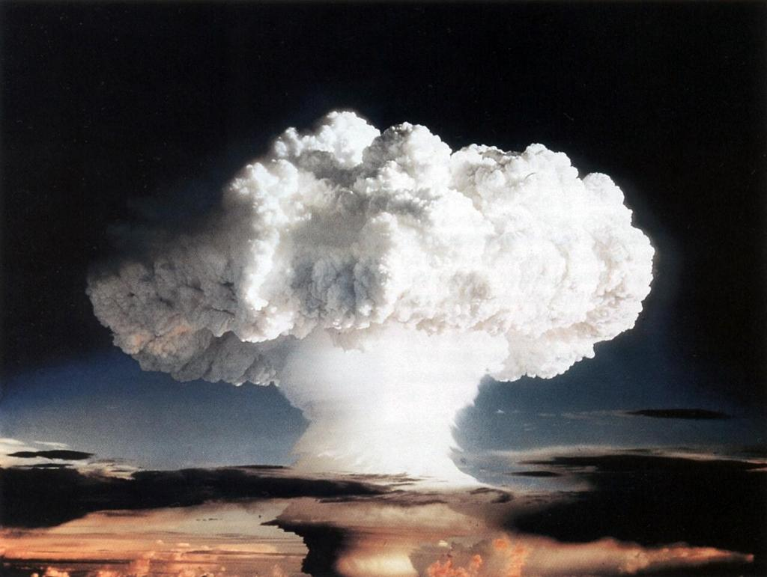
Cloud versus Cloud
Cloud computing is the solution!
Custom user environments!
On-demand and elastic computing!
Ease of use!
Capital expense -> operational expense!
Cloud Computing is TROUBLE!
New paradigm!
Do I need to turn into a sys admin?
Elastic computing but how?
What if my cloud provider goes out of business?
What about data privacy, performance and cost?

Slide 3
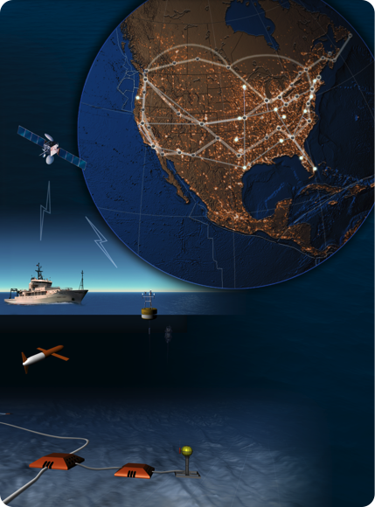
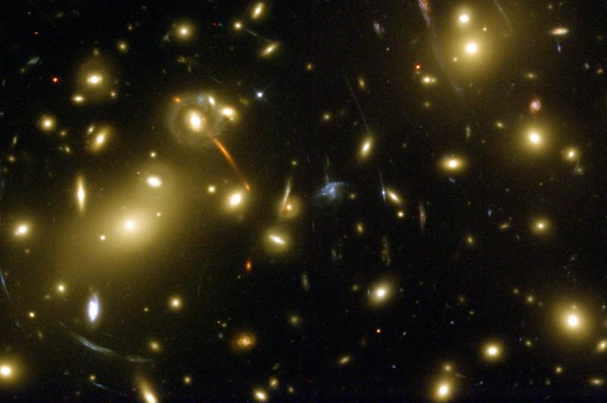
On the Nimbus Team…
Enable infrastructure clouds for science
Applications and Patterns
?
How do we turn a “bad cloud”
Into a “good cloud”?

Slide 4
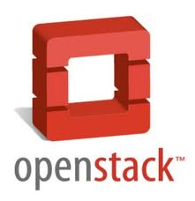
Introducing Nimbus
High-quality, extensible, customizable,
open source implementation
Nimbus Platform
Enable users to use IaaS clouds
Context Broker
Cloudinit.d
Elastic Scaling Tools
Enable providers to build IaaS clouds
Nimbus Infrastructure
Workspace Service
Cumulus
Enable developers to extend,
experiment and customize

Slide 5
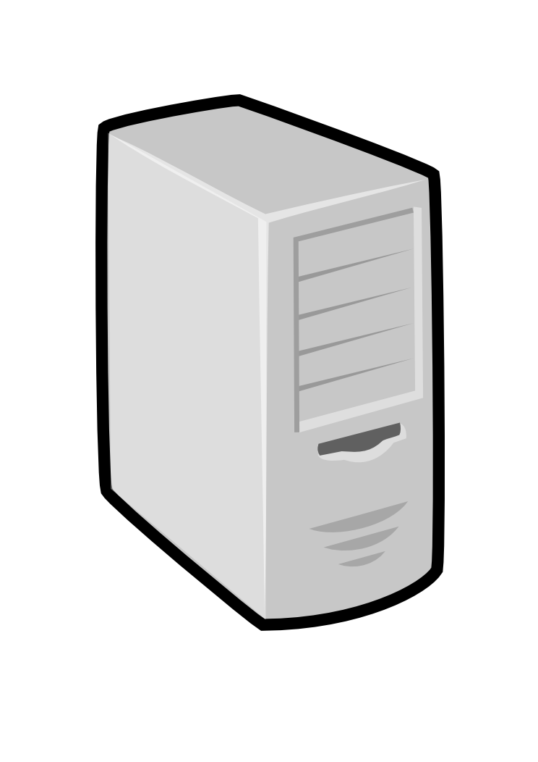
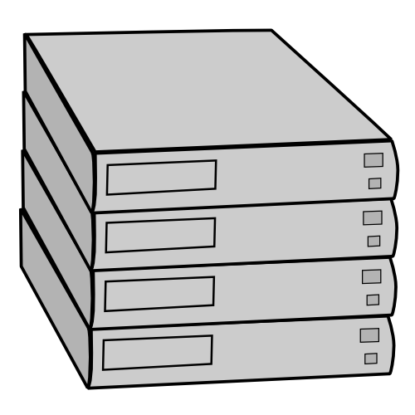
Nimbus Infrastructure
Pool
node
Pool
node
Pool
node
VWS
Service
Pool
node
Pool
node
Pool
node
Pool
node
Pool
node
Pool
node
Pool
node
Pool
node
Pool
node

Slide 6
Nimbus Infrastructure
The workspace service publishes
information about each workspace
Pool
node
Pool
node
Pool
node
VWS
Service
Pool
node
Pool
node
Pool
node
Users can find out
information about their
workspace (e.g. what IP
the workspace was bound to)
Pool
node
Pool
node
Pool
node
Pool
node
Pool
node
Pool
node
Users can interact directly with their workspaces the same way the would with a physical machine.

Slide 7
Nimbus Infrastructure
Workspace Interfaces
Cumulus interfaces
EC2: SOAP and Query
WSRF
S3
Workspace API
Cumulus API
Workspace Service Implementation
Cumulus Service Implementation
Workspace RM options
Default
Default+backfill/spot
Workspace pilot
Workspace Control Protocol
Cumulus Storage API
Workspace Control
Cumulus Implementation options
Virtualization
(libvirt)
Image Mngm
Network
Ctx
ssh
…
POSIX
Xen
KVM
LANtorrent
HDFS

Slide 8
Science Clouds and Applications

Slide 9
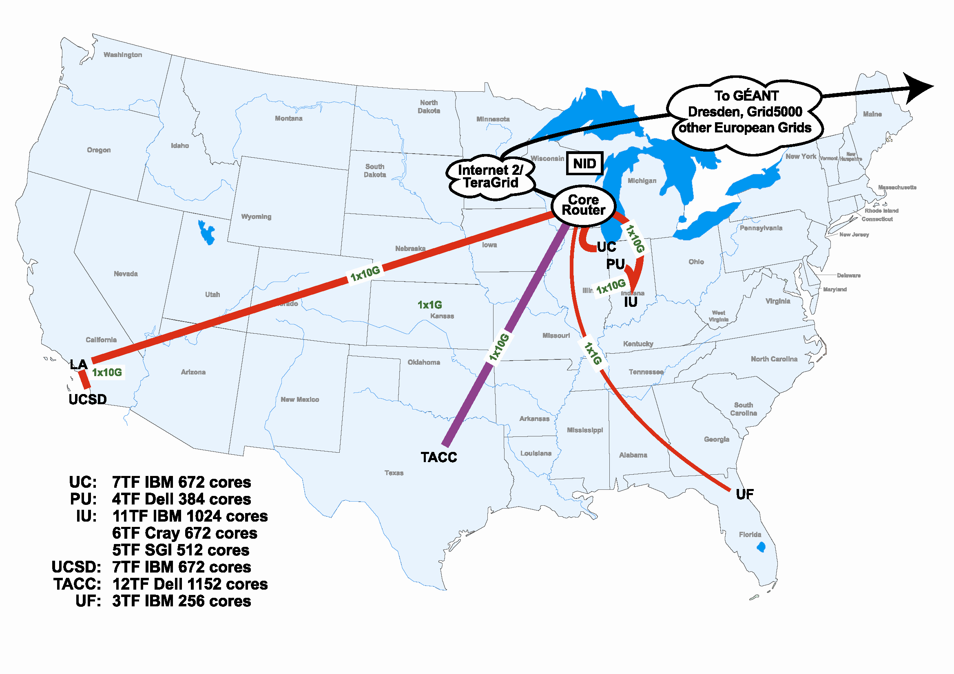
Scientific Cloud Resources
Science Clouds
UC, UFL, Wispy@Purdue
~300 cores
Magellan
DOE cloud @ ANL&LBNL
~4000 cores@ANL
FutureGrid
~6000 cores
MRI projects
DIAG (Data Intensive Academic Grid)
U of Maryland School of Medicine in Baltimore
~1200-1500 cores
Outside of US:
WestGrid, Grid5000
Magellan
FutureGrid
DIAG

Slide 10
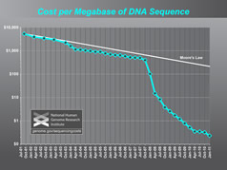
Sam Angiuoli
Institute for Genome Sciences
University of Maryland School of Medicine
The emergent need for processing
A virtual appliance for automated and portable sequence analysis
Approach:
Running on user’s desktop
Then running on Nimbus Science Clouds, Magellan and EC2
A platform for building appliances representing push-button pipelines
Impact
From desktop to cloud
http://clovr.org

Slide 11
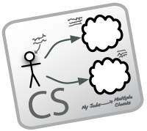
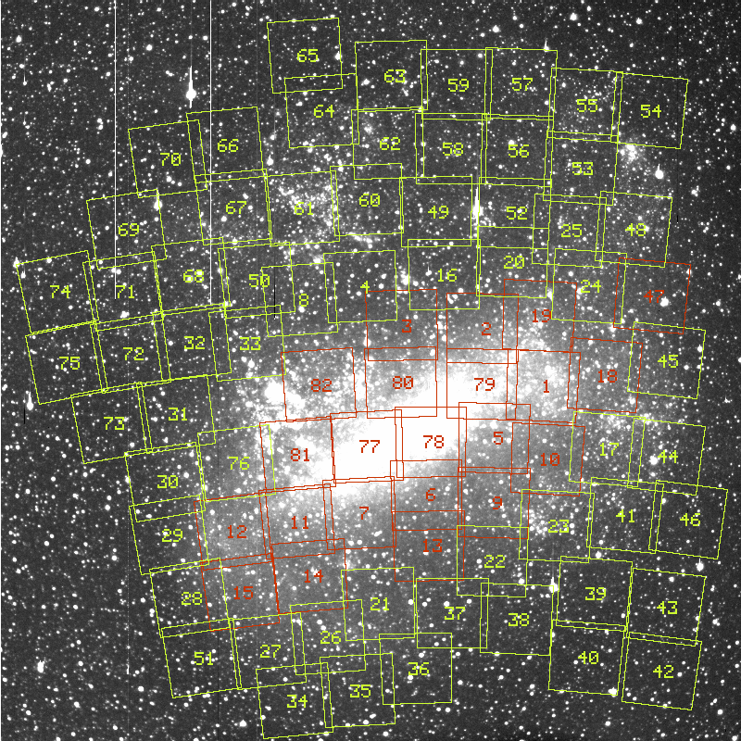
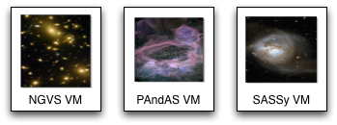
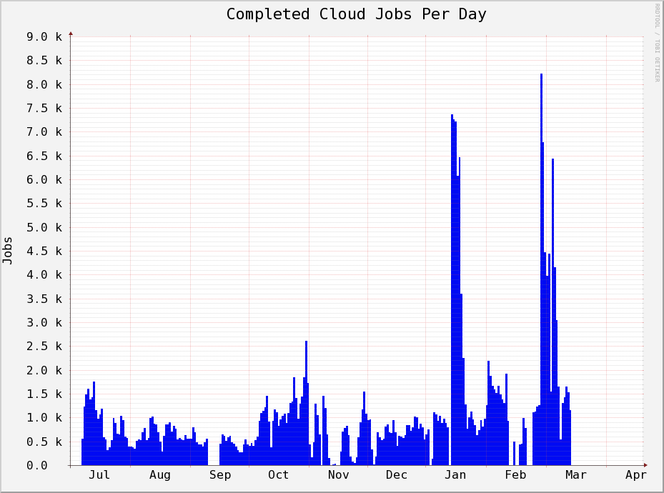
Work by the UVIC team
Detailed analysis of data from the MACHO experiment Dark Matter search
Provide infrastructure for six observational astronomy survey projects
Approach:
Appliance creation and management
Running on a Nimbus cloud on WestGrid
Dynamic Condor pool for astronomy
Status:
In production operation since July 2010

Slide 12
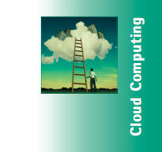
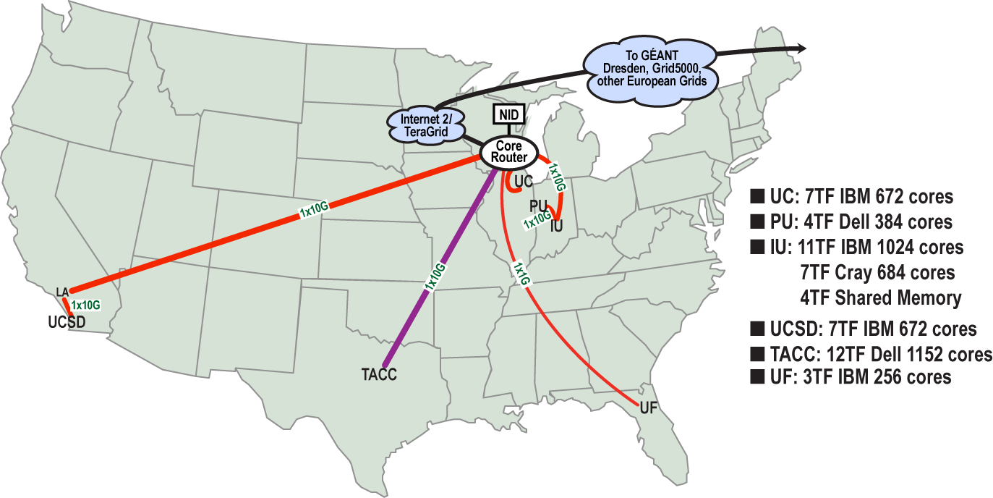
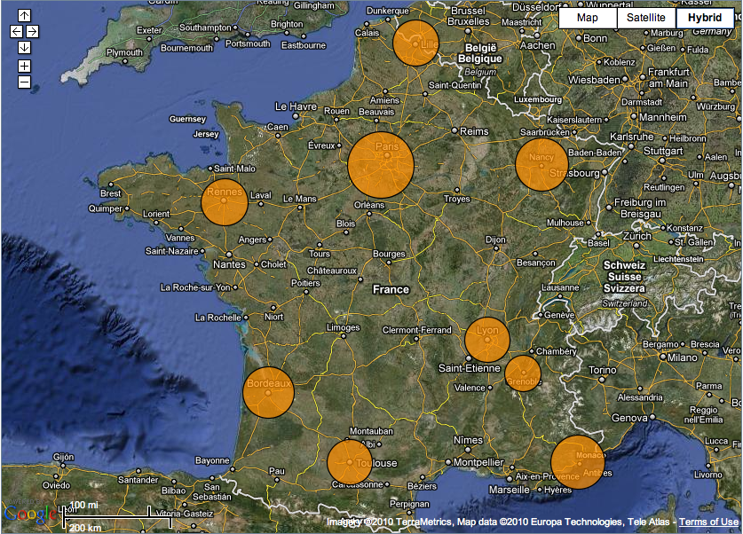
Sky Computing
Work by Pierre Riteau et al,
University of Rennes 1
Sky Computing = a Federation of Clouds
Approach:
Combine resources obtained in multiple Nimbus clouds in FutureGrid and Grid’ 5000
Combine Context Broker, ViNe, fast image deployment
Deployed a virtual cluster of over 1000 cores on Grid5000 and FutureGrid – largest of this type at the time
Grid’5000 Large Scale Deployment Challenge award
Demonstrated at OGF 29 06/10
TeraGrid ’10 poster
More at: www.isgtw.org/?pid=1002832
“Sky Computing”
IEEE Internet Computing, September 2009

Slide 13
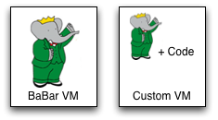
Work by the UVIC team
Canadian Efforts
BarBar Experiment at SLAC in Stanford, CA
Using clouds to simulate electron-positron collisions in their detector
Exploring virtualization as a vehicle for data preservation
Approach:
Appliance preparation and management
Distributed Nimbus clouds
Cloud Scheduler
Running production BaBar workloads

Slide 14
Work by J. Lauret, J. Balewski
and the STAR team
Challenge: what makes a proton spin?
Why run in the cloud?
Reduce "time to science”
Near real-time processing
Images courtesy of J. Balewski

Slide 15
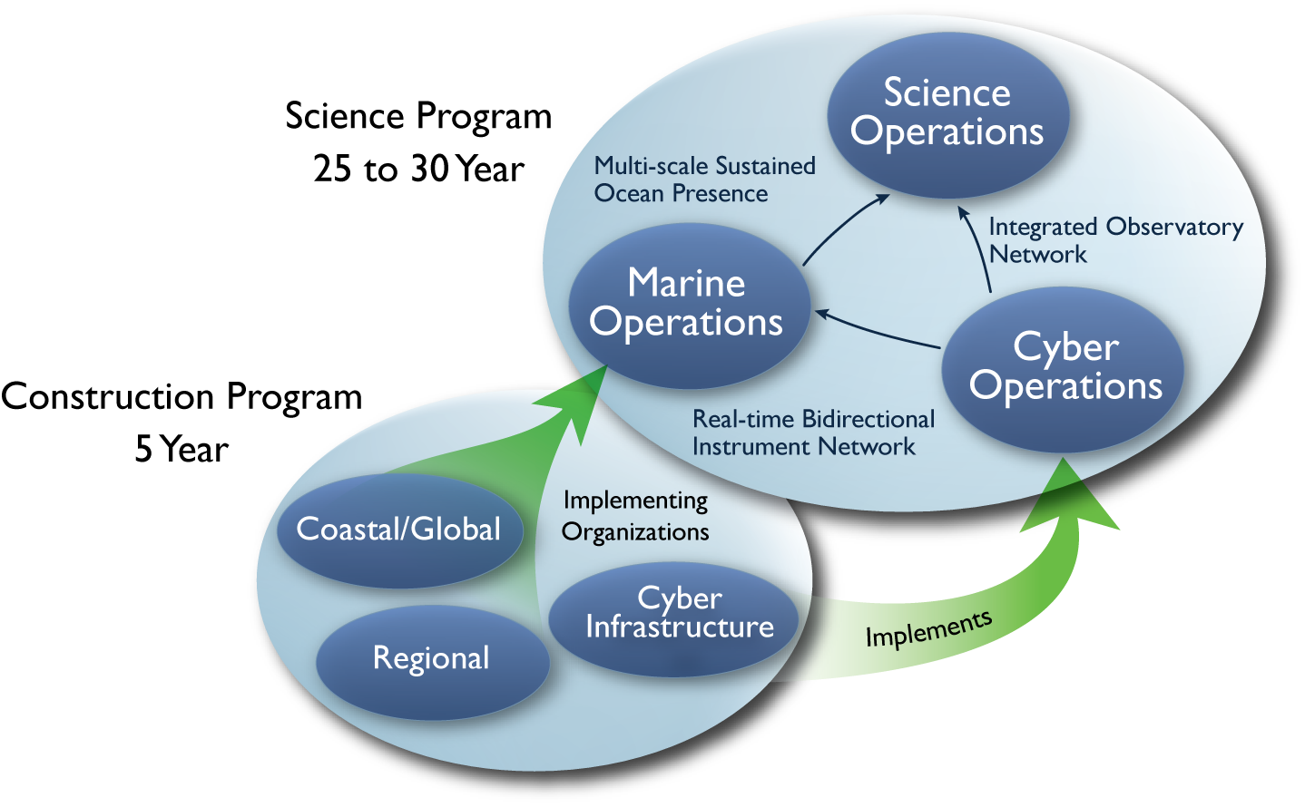
Observatory Science
Scalable, sensor driven processing
Highly Available (HA) services
Governance framework and policies in elastic environment
From regional Nimbus clouds to commercial clouds
Provide a deployment foundation for OOI CI

Slide 16
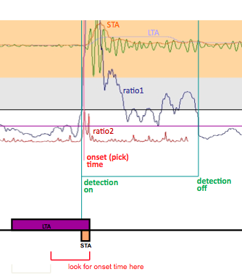
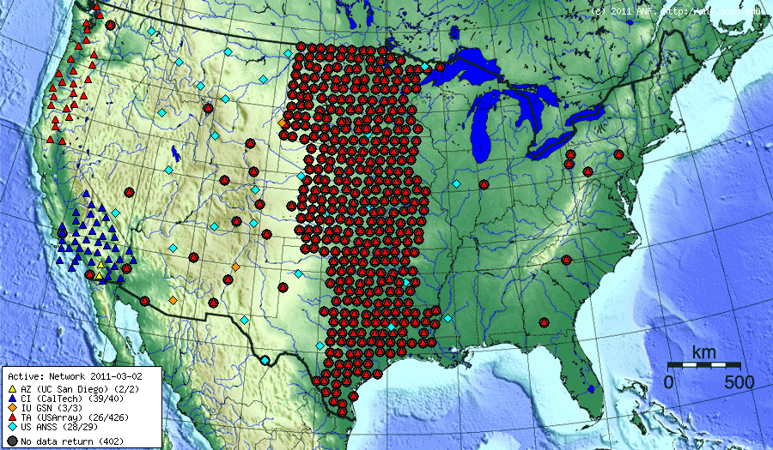
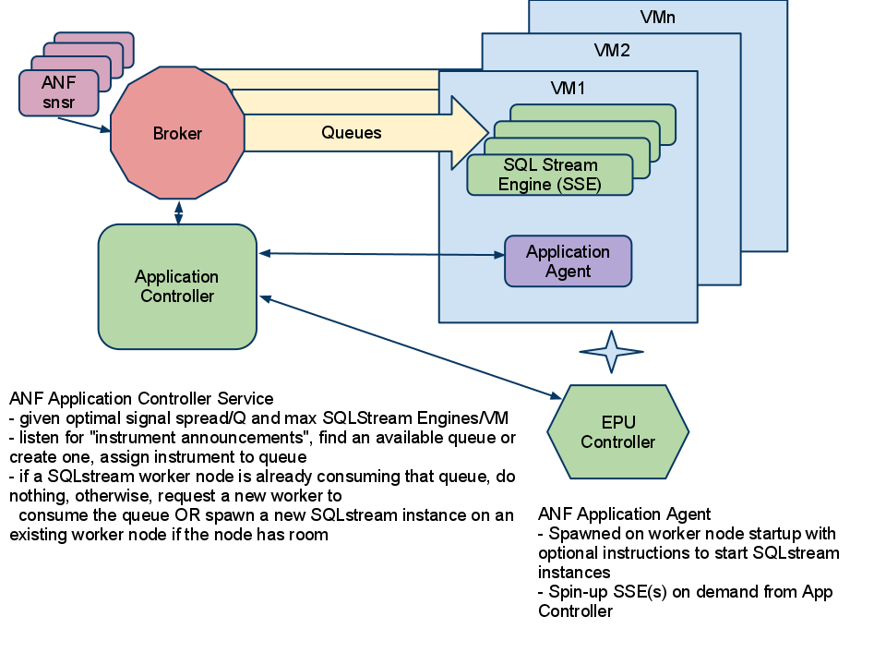
Array Network Facility (ANF)
Using elastic processing to operate on seismic data

Slide 17
Trends and Patterns
On-demand, elastic processing
Observatories, experiments, conference deadlines…
Multiple providers
Not enough cycles, but also risk-mitigation
From the desktop to the cloud
Escalation pattern: seamlessly integrating more resources
Ease of use/low barrier
Automated provisioning of infrastructure resources
From one-offs to production runs
Steadily increasing in both size and buy-in
Emphasis still on loosely-coupled
… EC2 ClusterCompute virtual clusters on Top500 list

Slide 18
Leveraging Opportunities: Building an Infrastructure Platform

Slide 19
Appliances and Contextualization
I want to manage
my own VMs!
I don’t want to manage
my own VMs!
Appliance management requires special skills
Contextualization
Managing security and configuration context
“Stem cell VMs”
One-click virtual clusters
Nimbus Context Broker
across providers, clouds and packaging mechanisms

Slide 20
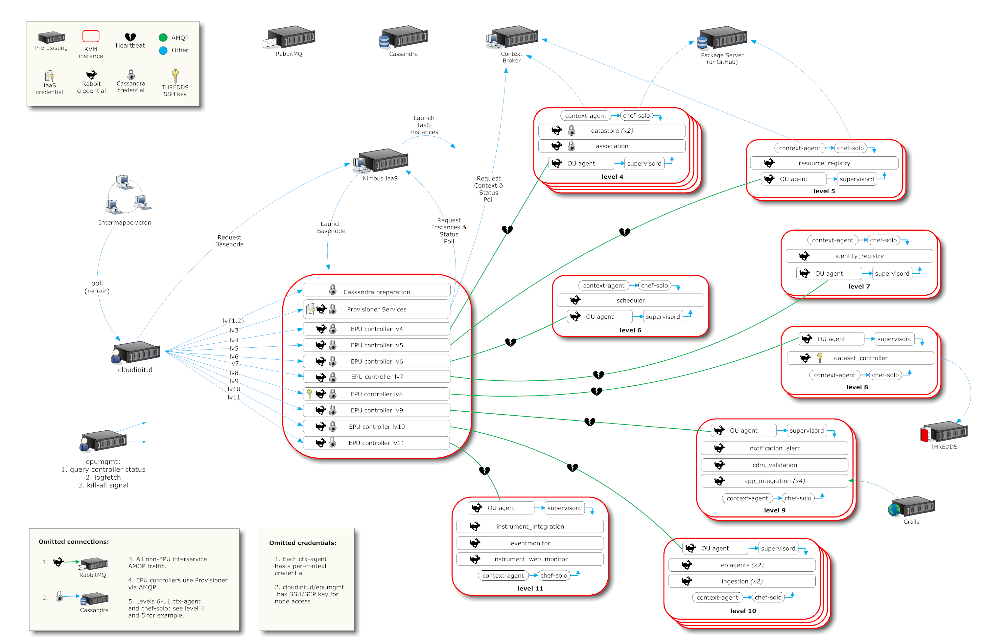
A Simplified Deployment Scenario

Slide 21
A Grid in Your Pocket…
Tim
EC2

Slide 22
A Grid in Your Pocket…
Jamie
Tim
OOI private cloud
EC2

Slide 23
A Grid in Your Pocket…
David
Jamie
Tim
FutureGrid
OOI private cloud
EC2

Slide 24
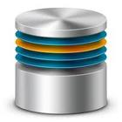
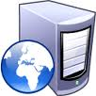
Cloudinit.d
Launch plan
database
Web Server
Web Server
Web Server
Repeatability: write a launch plan once, deploy many times

Slide 25
Cloudinit.d
Launch plan
database
Web Server
Web Server
Web Server
Deploy on cloud and non-cloud resources from many providers

Slide 26
Cloudinit.d
Launch plan
Run-level 1
database
Run-level 2
Web Server
Web Server
Web Server
Coordination of interdependent launches

Slide 27
Cloudinit.d
Launch plan
Run-level 1
database
Run-level 2
Web Server
Web Server
Web Server
User-defined launch tests

Slide 28
Cloudinit.d
Launch plan
Run-level 1
database
Run-level 2
Web Server
Web Server
Web Server
Test-based monitoring and repair

Slide 29
Cloudinit.d
Launch plan
Run-level 1
database
Run-level 2
Web Server
Web Server
Web Server
Test-based monitoring and repair

Slide 30
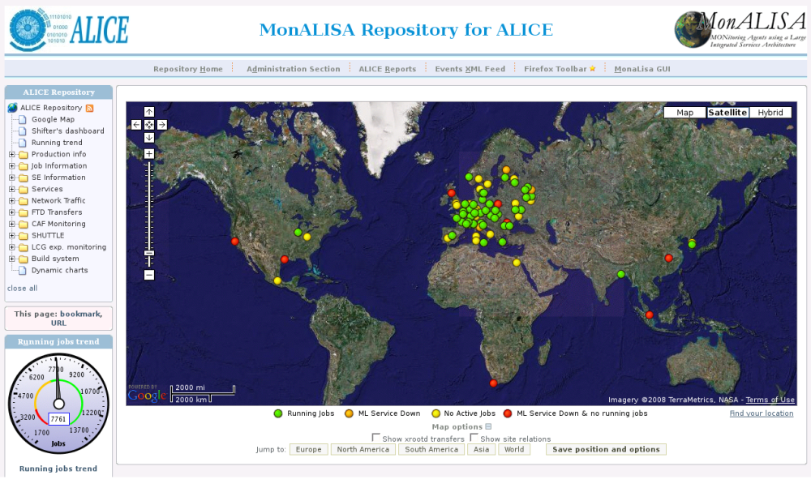
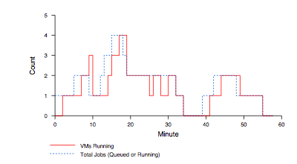
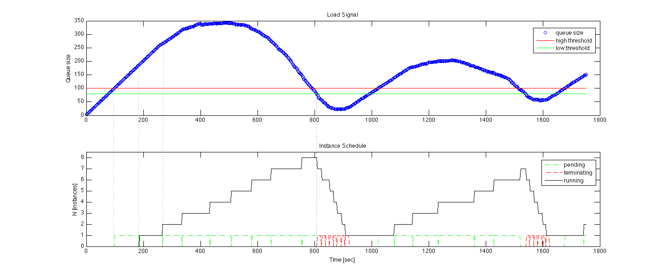
Elastic Scaling: Early Work
Elasticity and reliability are different sides of the same coin.
2008: The ALICE proof-of-concept
2009: ElasticSite prototype
2009: OOI pilot
Paper: “Elastic Site”, CCGrid 2010
Challenge:
a generic HA
elastic service model

Slide 31
Scaling Patterns
Monitor scaling factors:
A workload queue: ALiEn, PBS, AMQP,…
Application-specific qualities
Generic: deployment status, load, bank account, etc.
Evaluate against policies
Scale to demand
Across different cloud providers
Use contextualization to integrate machines across hybrid clouds
Address scientific needs for e.g., data transfer and storage
… then add High Availability (HA)
Beta release later this year
Customizable to input, policy, decision engine, provider, etc.
Sensor information
Apply Policy
Reliably manage and
contextualize resources

Slide 32
Applications
Elastic MapReduce
Portals and Gateways
Custom Applications
Schedulers
Data Transfer Systems
Data Storage Systems
Application adaptation:
Library of generic sensors
Policies
Application-specific
Sensors
Decision Engine
Nimbus Platform Services:
Contextualization, interoperability, reliable and efficient management of infrastructure cloud storage and compute resources

Slide 33
The Nimbus Team
Project lead: Kate Keahey, ANL&UC
Comitters:
Tim Freeman - University of Chicago
Ian Gable - University of Victoria
David LaBissoniere - University of Chicago
John Bresnahan - Argonne National Laboratory
Patrick Armstrong - University of Victoria
Pierre Riteau - University of Rennes 1, IRISA
Github Contributors:
Tim Freeman, David LaBissoniere, John Bresnahan, Pierre Riteau, Alex Clemesha, Paulo Gomez, Patrick Armstrong, Matt Vliet, Ian Gable, Paul Marshall, Adam Bishop
And many others
See http://www.nimbusproject.org/about/people/

Slide 34
Parting Thoughts
Cloud computing is a solution!
Computation outsourcing for science
Ease of use and automation
Science has unique outsourcing needs
Data management
A naturally bursty character
Escalation Pattern
We can’t have unlimited cycles…
…but how they are provisioned should be driven by need rather than technology limitations
Infrastructure clouds provide such mechanism – but they are still developing
Security, performance, reliability, price and markets, etc.
What would you do with dynamic resources?

Slide 35
www.nimbusproject.com
Let’s make cloud computing for science happen.

