Slide 1
Building an Outsourcing Ecosystem for Science
Kate Keahey
keahey@mcs.anl.gov
Argonne National Laboratory
Computation Institute, University of Chicago

Slide 2
Outsourcing Computing for Science
Control over environment
Complexity
Consistency
Control over availability
Many real-time scenarios
Naturally bursty character

Slide 3
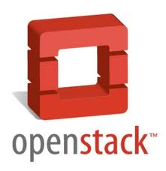
Introducing Nimbus
High-quality, extensible, customizable,
open source implementation
Nimbus Platform
Enable users to use IaaS clouds
Context Broker
Cloudinit.d
Elastic Scaling Tools
Enable providers to build IaaS clouds
Nimbus Infrastructure
Workspace Service
Cumulus
Enable developers to extend,
experiment and customize

Slide 4
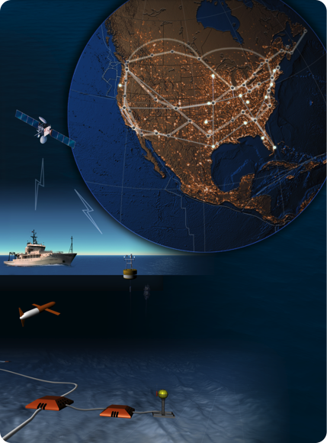
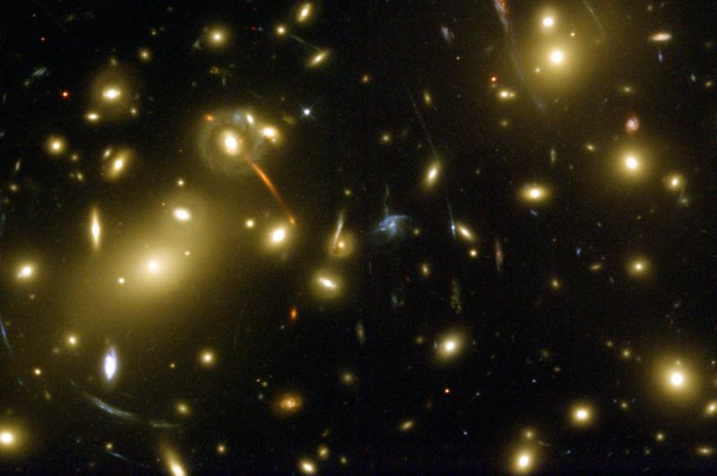
On the Nimbus Team…
Applications and Patterns
Providing infrastructure outsourcing for science

Slide 5
Applications and Patterns

Slide 6
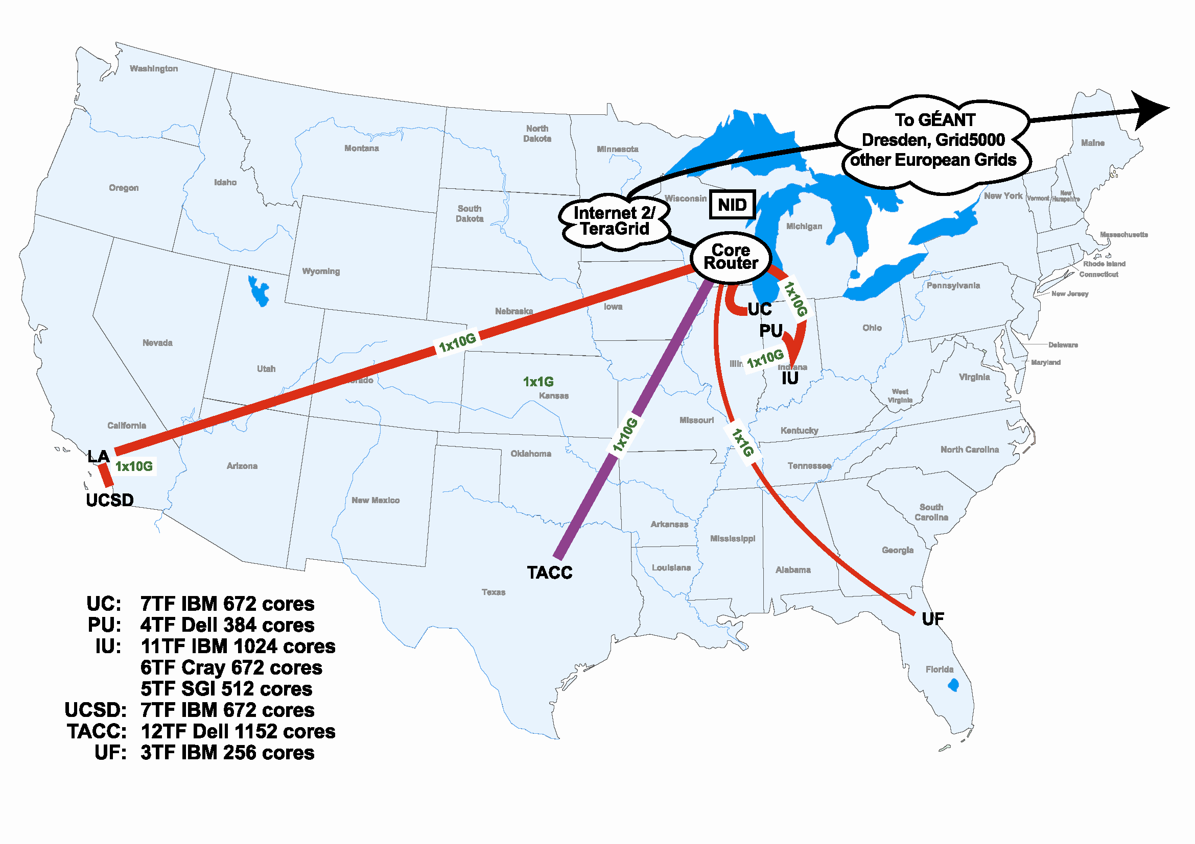
Scientific Cloud Resources
Science Clouds
UC, UFL, Wispy@Purdue
~300 cores
Magellan
DOE cloud @ ANL&LBNL
~4000 cores@ANL
FutureGrid
~6000 cores
MRI projects, e.g., DIAG =
Data Intensive Academic Grid
U of Maryland School of Medicine in Baltimore
~1200-1500 cores
Outside of US:
WestGrid, Grid’5000
Magellan
FutureGrid
has cloud cycles for you!
DIAG

Slide 7
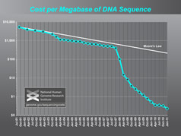
Sam Angiuoli
Institute for Genome Sciences
University of Maryland School of Medicine
The emergent need for processing
A virtual appliance for automated and portable sequence analysis
Approach:
Running on user’s desktop
Then running on Nimbus Science Clouds, Magellan and EC2
A platform for building appliances representing push-button pipelines
Impact
From desktop to cloud
http://clovr.org

Slide 8
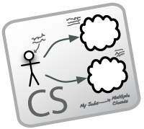
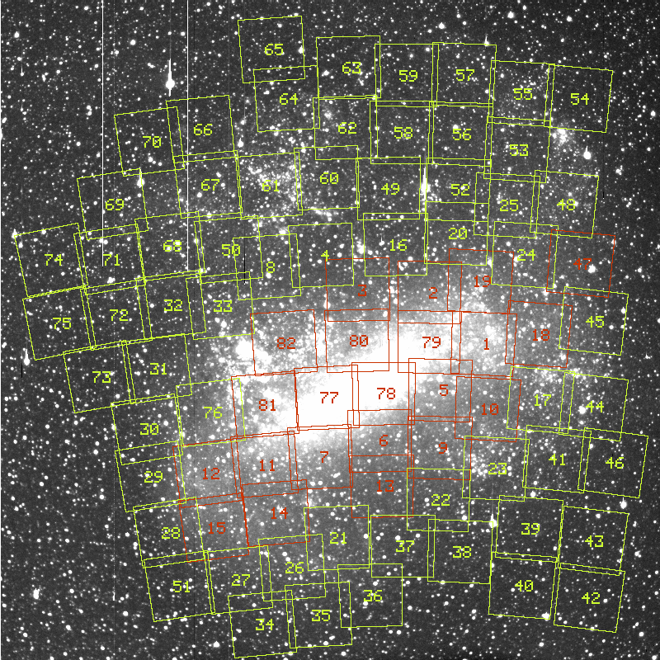
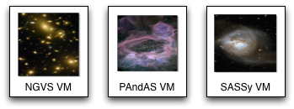
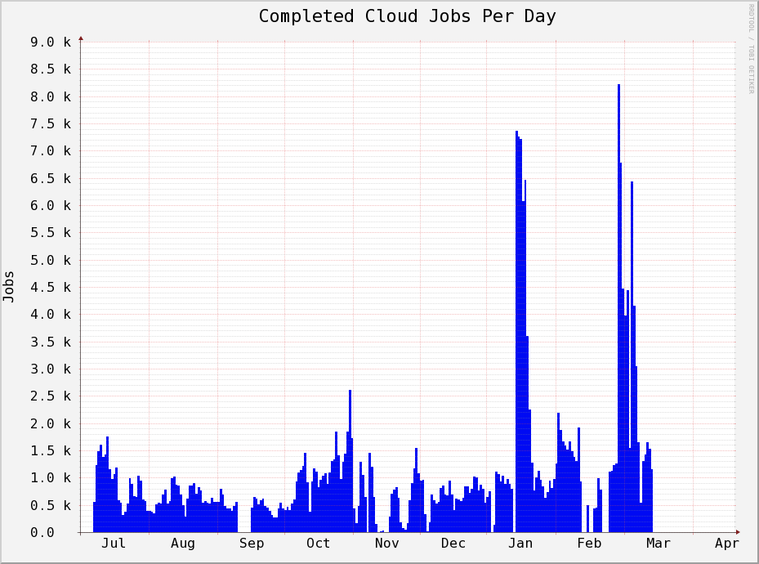
Work by the UVIC team
Detailed analysis of data from the MACHO experiment Dark Matter search
Provide infrastructure for six observational astronomy survey projects
Approach:
Appliance creation and management
Running on a Nimbus cloud on WestGrid
Dynamic Condor pool for astronomy
Status:
In production operation since July 2010

Slide 9
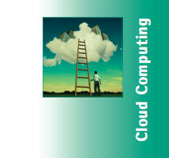
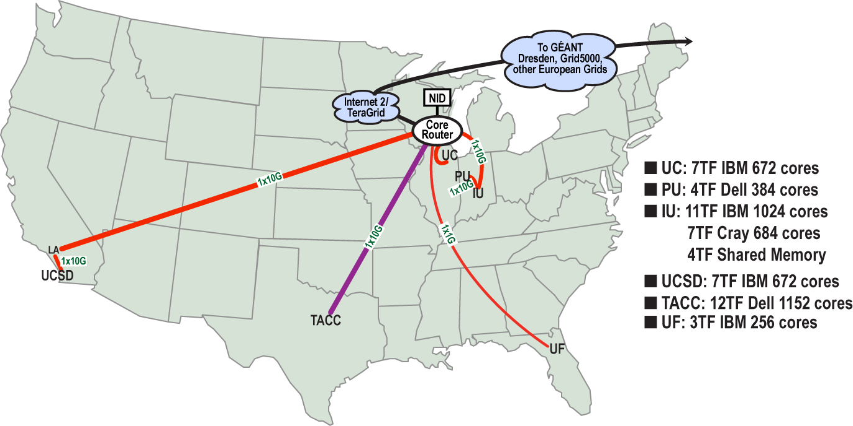
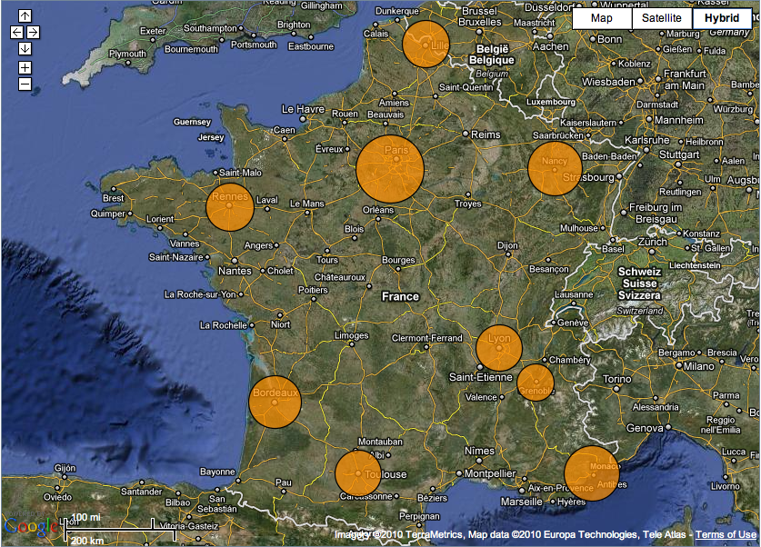
Sky Computing
Work by Pierre Riteau et al,
University of Rennes 1
Sky Computing = a Federation of Clouds
Approach:
Combine resources obtained in multiple Nimbus clouds in FutureGrid and Grid’ 5000
Combine Context Broker, ViNe, fast image deployment
Deployed a virtual cluster of over 1000 cores on Grid5000 and FutureGrid – largest of this type at the time
Grid’5000 Large Scale Deployment Challenge award
Demonstrated at OGF 29 06/10
TeraGrid ’10 poster
More at: www.isgtw.org/?pid=1002832
“Sky Computing”
IEEE Internet Computing, September 2009

Slide 10
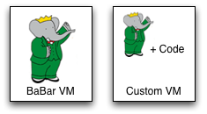
Work by the UVIC team
Canadian Efforts
BarBar Experiment at SLAC in Stanford, CA
Using clouds to simulate electron-positron collisions in their detector
Exploring virtualization as a vehicle for data preservation
Approach:
Appliance preparation and management
Distributed Nimbus clouds
Cloud Scheduler
Running production BaBar workloads

Slide 11
Work by J. Lauret, J. Balewski
and the STAR team
Challenge: what makes a proton spin?
Why run in the cloud?
Reduce "time to science”
Near real-time processing
Images courtesy of J. Balewski

Slide 12
Towards Observatory Science
Sensor-driven processing
Scalable and Highly Available (HA) services
Nimbus team leading the development of Common Execution Infrastructure
From regional Nimbus clouds to commercial clouds
Building platform services for integrated, repeatable support for on-demand science

Slide 13
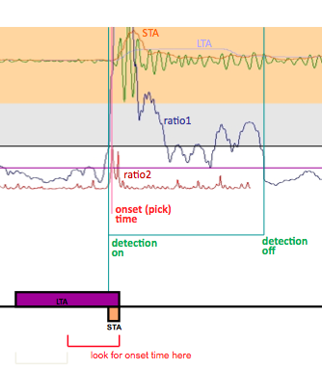
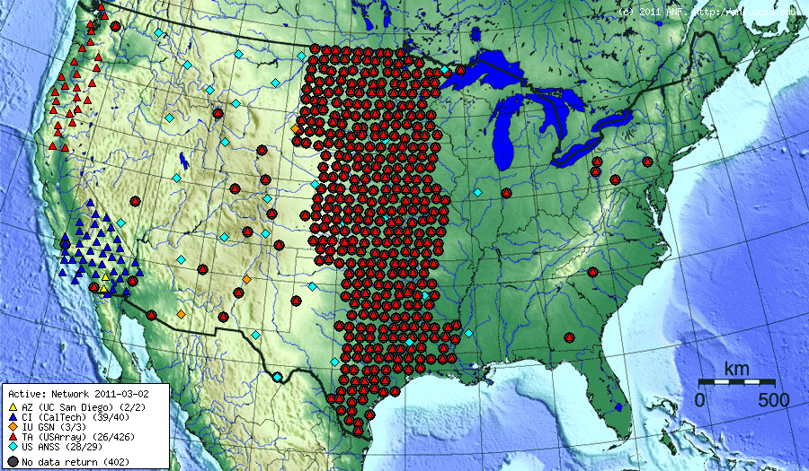
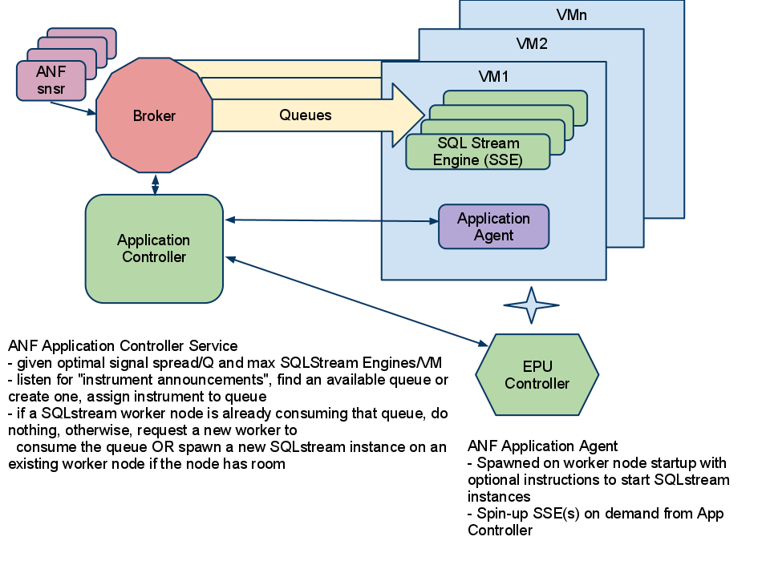
Array Network Facility (ANF)
Using elastic processing to operate on seismic data

Slide 14
Trends and Patterns
On-demand, elastic processing
Observatories, experiments, conference deadlines, growth management…
Multiple providers
Risk-mitigation: not enough cycles, failure, market factors
From the desktop to the cloud
Escalation pattern: seamlessly integrating more resources
Ease of use/low barrier
Automated provisioning of infrastructure resources
From one-offs to production runs
Steadily increasing in both size and buy-in
Emphasis still on loosely-coupled
… EC2 ClusterCompute virtual clusters on Top500 list

Slide 15
Outsourcing for Science: Building an Infrastructure Platform

Slide 16
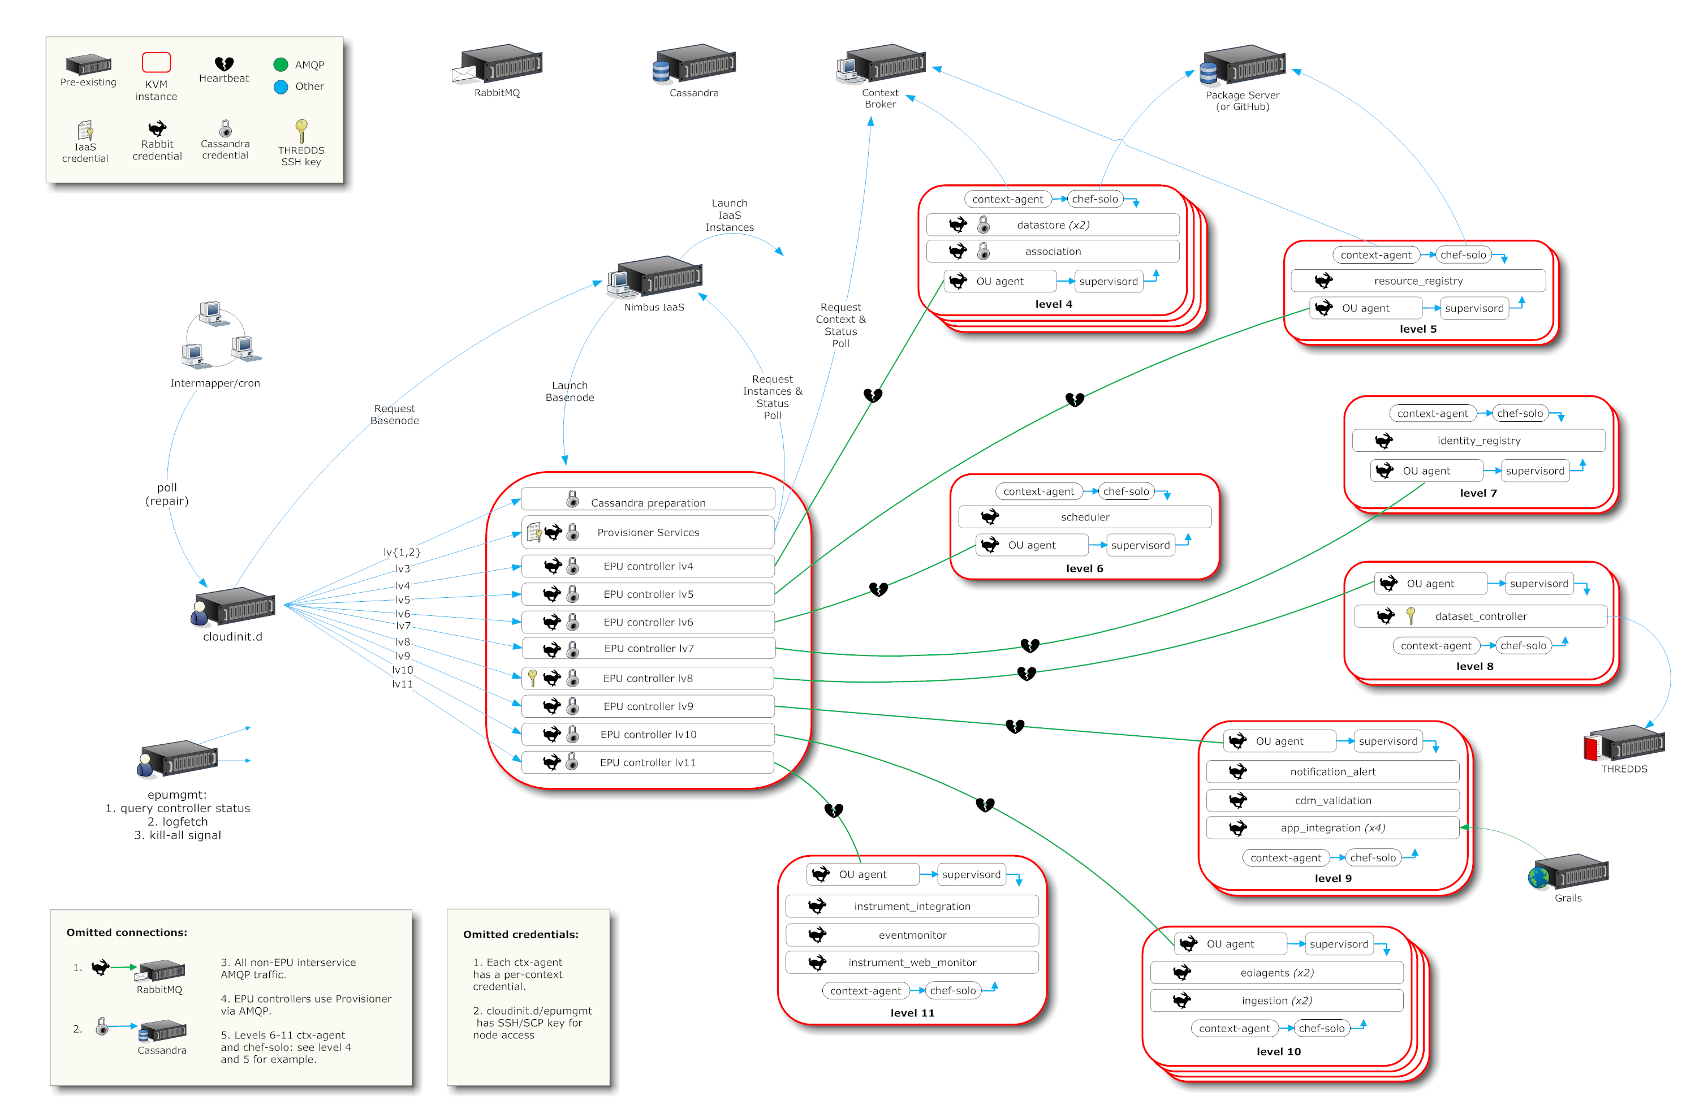
A Simplified Deployment Scenario

Slide 17
A Grid in Your Pocket…
Tim
EC2

Slide 18
A Grid in Your Pocket…
Jamie
Tim
OOI private cloud
EC2

Slide 19
A Grid in Your Pocket…
David
Jamie
Tim
FutureGrid
OOI private cloud
EC2

Slide 20
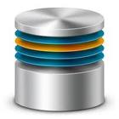
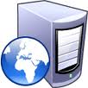
Cloudinit.d
Launch plan
database
Web Server
Web Server
Web Server
Repeatability: write a launch plan once, deploy many times

Slide 21
Cloudinit.d
Launch plan
database
Web Server
Web Server
Web Server
Deploy on cloud and non-cloud resources from many providers

Slide 22
Cloudinit.d
Launch plan
Run-level 1
database
Run-level 2
Web Server
Web Server
Web Server
Coordination of interdependent launches

Slide 23
Cloudinit.d
Launch plan
Run-level 1
database
Run-level 2
Web Server
Web Server
Web Server
User-defined launch tests

Slide 24
Cloudinit.d
Launch plan
Run-level 1
database
Run-level 2
Web Server
Web Server
Web Server
Test-based monitoring and repair

Slide 25
Cloudinit.d
Launch plan
Run-level 1
database
Run-level 2
Web Server
Web Server
Web Server
Test-based monitoring and repair

Slide 26
Cloudinit.d Goals: Easy to Use
Two roles:
Launch plan developers and users
Launch plan end-users/operators
Lightweight
Copy launch plan and “one click” action
Launch plan/application developers:
Minimal software assumptions (ssh)
“Stem cell” deployment approach
Incremental launch plan development

Slide 27
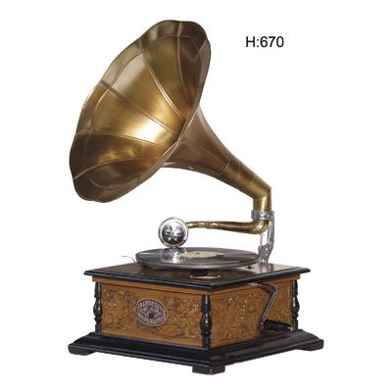
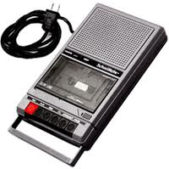
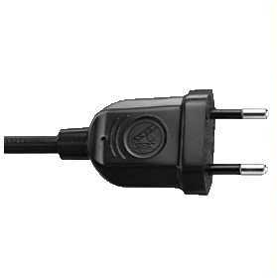
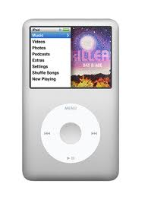
Building a Power Adapter

Slide 28
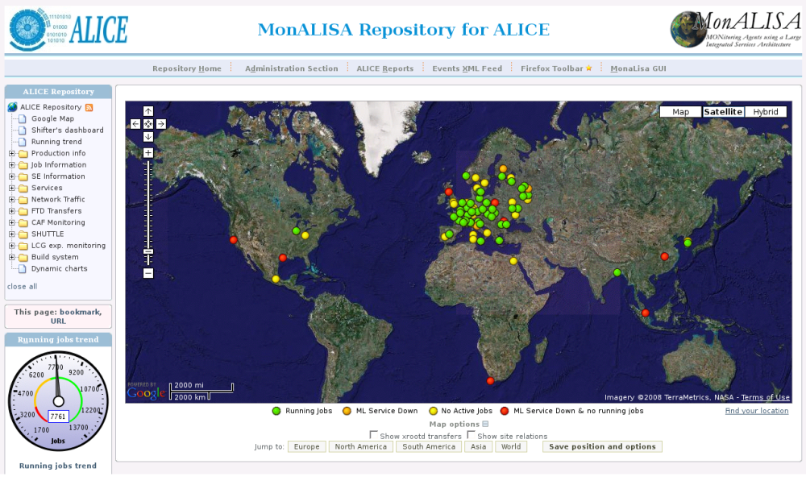
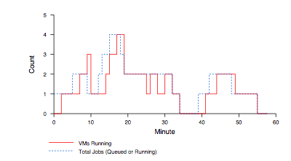
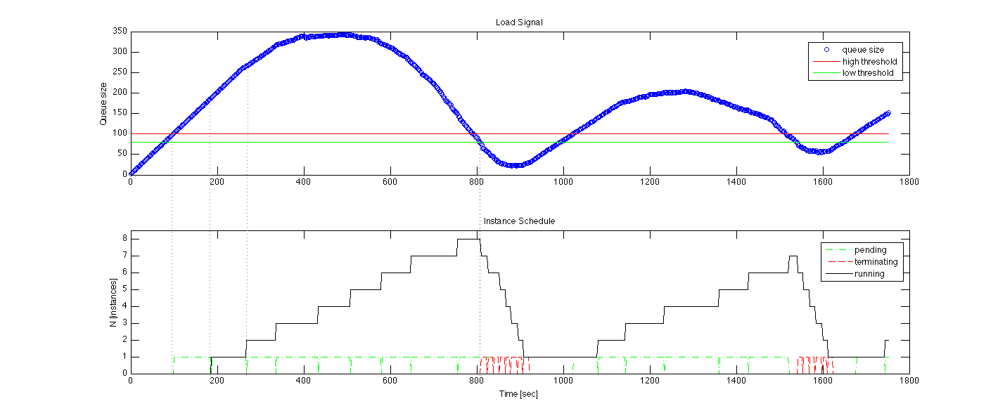
Elastic Scaling: Early Work
Elasticity and reliability are different sides of the same coin.
2008: The ALICE proof-of-concept
2009: ElasticSite prototype
2009: OOI pilot
Paper: “Elastic Site”, CCGrid 2010
Challenge:
a generic HA
elastic service model

Slide 29
Scaling Patterns
Monitor scaling factors:
A workload queue: ALiEn, PBS, AMQP,…
Application-specific qualities
Generic: deployment status, load, bank account, etc.
Evaluate against policies
Scale to demand
Across different cloud providers
Use contextualization to integrate machines across hybrid clouds
Address scientific needs for e.g., data transfer and storage
… then add High Availability (HA)
Beta release next year
Customizable to input, policy, decision engine, provider, etc.
Sensor information
Apply Policy
Reliably manage and
contextualize resources

Slide 30
Applications
Elastic MapReduce
Portals and Gateways
Custom Applications
Schedulers
Data Transfer Systems
Data Storage Systems
Application adaptation:
Library of generic sensors
Policies
Application-specific
Sensors
Decision Engine
Nimbus Platform Services:
Contextualization, interoperability, reliable and efficient management of infrastructure cloud storage and compute resources

Slide 31
The Nimbus Team
Project lead: Kate Keahey, ANL&UC
Comitters:
Tim Freeman - University of Chicago
Ian Gable - University of Victoria
David LaBissoniere - University of Chicago
John Bresnahan - Argonne National Laboratory
Patrick Armstrong - University of Victoria
Pierre Riteau - University of Rennes 1, IRISA
Github Contributors:
Tim Freeman, David LaBissoniere, John Bresnahan, Pierre Riteau, Alex Clemesha, Paulo Gomez, Patrick Armstrong, Matt Vliet, Ian Gable, Paul Marshall, Adam Bishop
And many others
See http://www.nimbusproject.org/about/people/
Opportunities for international students: GSoC

Slide 32
Parting Thoughts
Cloud computing is a solution!
Computation outsourcing for science
Ease of use and automation
Science has unique outsourcing needs
Data management
A naturally bursty character
Escalation Pattern
We can’t have unlimited cycles…
…but how they are provisioned should be driven by need rather than technology limitations
Infrastructure clouds provide such mechanism – but they are still developing
Security, performance, reliability, price and markets, etc.

Slide 33
www.nimbusproject.com
Let’s make cloud computing for science happen.

