Slide 1
Infrastructure Clouds: Outsourcing Ecosystem for Science
CONTRAIL Summer school 2011
Belambra, "Presqu'île de Giens", Hyères-les-Palmiers (France)
Kate Keahey
keahey@mcs.anl.gov
Argonne National Laboratory
Computation Institute, University of Chicago

Slide 2
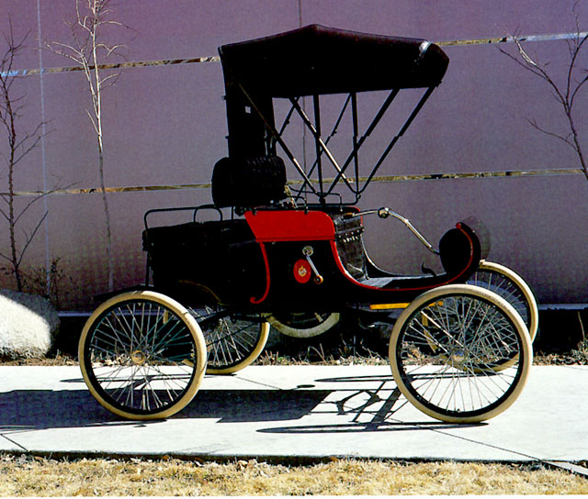
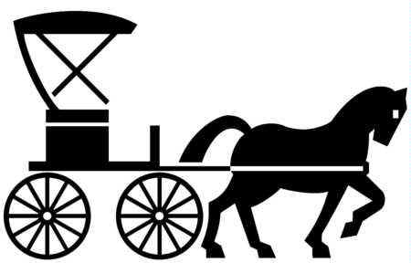
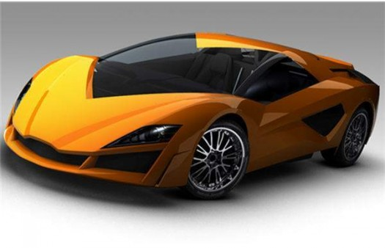
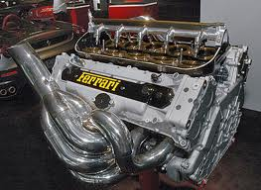
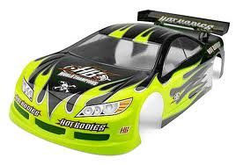
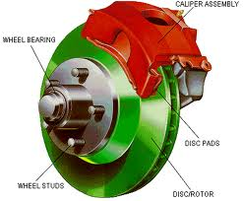
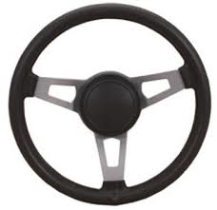
Horseless Carriage: Story of an Innovation
?
Technical Innovations
New Patterns
Ecosystem

Slide 3
The Cloud Computing Innovation
Isolation/virtualization
Representation of state
aaSes of all kinds
?
Cloud Computing
Today
Cloud Computing
Tomorrow
Technical Innovations
New Patterns
Nimbus Infrastructure
Applications
- Control over environment
- Availability
Performance &Reliability
- Security and privacy
- Cost models
- Pay-as-you-go
Multi-tenancy
Elastic computing
Outsourcing
Ecosystem
Nimbus Platform
- Appliance management
- Platform tools
- SLAs and legal underpinnings
- Standards
- Cloud markets

Slide 4
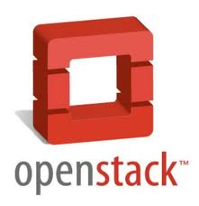
Nimbus Components
High-quality, extensible, customizable,
open source implementation
Nimbus Platform
Enable users to use IaaS clouds
Context Broker
Cloudinit.d
Elastic Scaling Tools
Gateway
Enable providers to build IaaS clouds
Nimbus Infrastructure
Workspace Service
Cumulus
Enable developers to extend,
experiment and customize

Slide 5
Nimbus Infrastructure

Slide 6
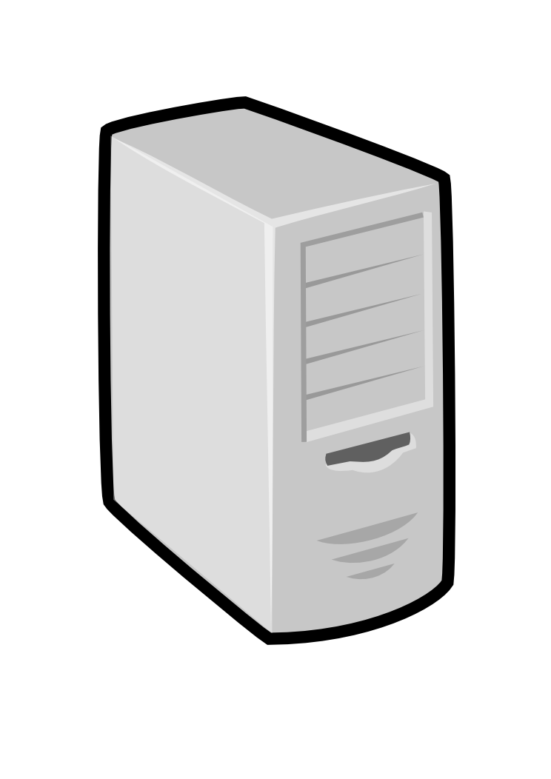
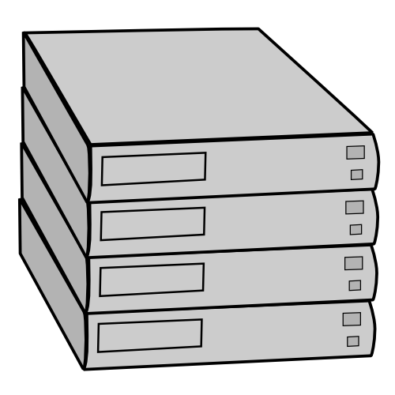
IaaS: How it Works
Pool
node
Pool
node
Pool
node
Nimbus
Pool
node
Pool
node
Pool
node
Pool
node
Pool
node
Pool
node
Pool
node
Pool
node
Pool
node

Slide 7
IaaS: How it Works
Nimbus publishes
information about each VM
Pool
node
Pool
node
Pool
node
Nimbus
Pool
node
Pool
node
Pool
node
Users can find out
information about their
VM (e.g. what IP
the VM was bound to)
Pool
node
Pool
node
Pool
node
Pool
node
Pool
node
Pool
node
Users can interact directly with their VM in the same way the would with a physical machine.

Slide 8
Nimbus Infrastructure: a Highly-Configurable IaaS Architecture
Workspace Interfaces
Cumulus interfaces
EC2 SOAP
EC2 Query
WSRF
S3
Workspace API
Cumulus API
Workspace Service Implementation
Cumulus Service Implementation
Workspace RM options
Default
Default+backfill/spot
Workspace pilot
Workspace Control Protocol
Cumulus Storage API
Workspace Control
Cumulus Implementation options
Virtualization
(libvirt)
Image Mngm
Network
Ctx
ssh
…
POSIX
Xen
KVM
LANtorrent
HDFS

Slide 9
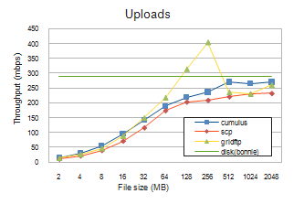
Cumulus: a Scalable Storage Cloud
Challenge: a scalable storage cloud with use-what-you-have approach
S3-compatible open source implementation
Quota support for scientific users
Pluggable back-end to various technologies such as POSIX, HDFS, Sector, BlobSeer
Configurable to take advantage of multiple servers
Paper @ ScienceCloud 2011 and HPDC 2011

Slide 10
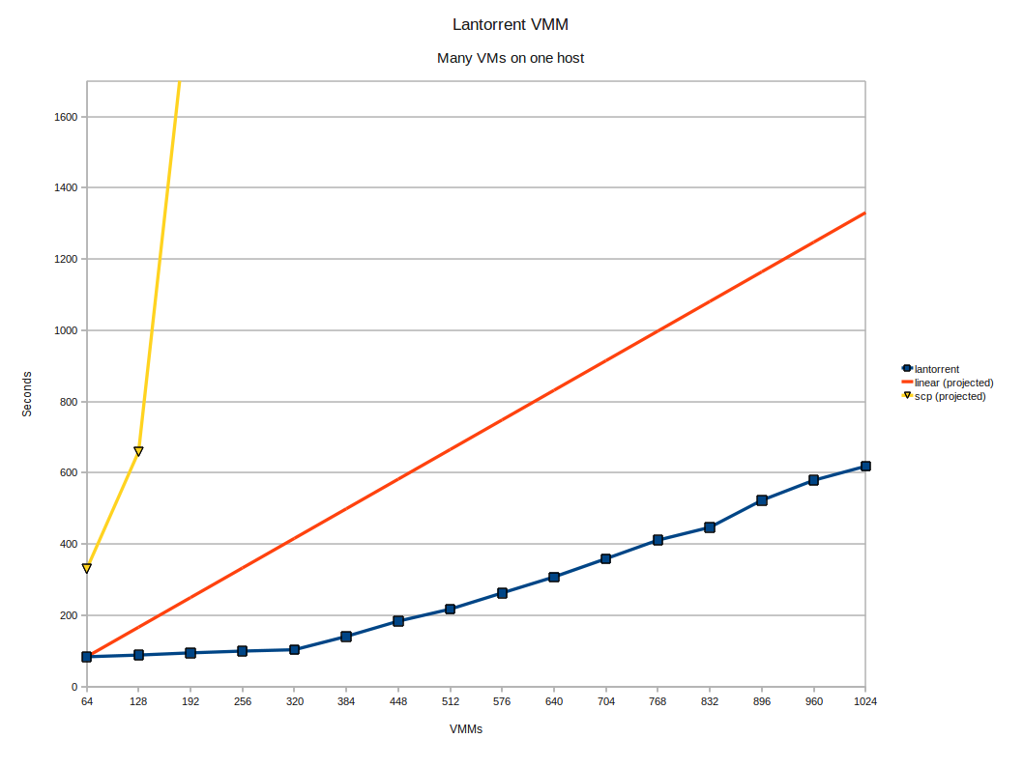
LANTorrent: Fast Image Deployment
Challenge: make image deployment faster
Moving images is the main component of VM deployment
LANTorrent: the BitTorrent principle on a LAN
Streaming
Minimizes congestion at the switch
Detecting and eliminating duplicate transfers
Bottom line: a thousand VMs in 10 minutes on Magellan
Nimbus release 2.6, see www.scienceclouds.org/blog
Preliminary data using the Magellan resource
At Argonne National Laboratory

Slide 11
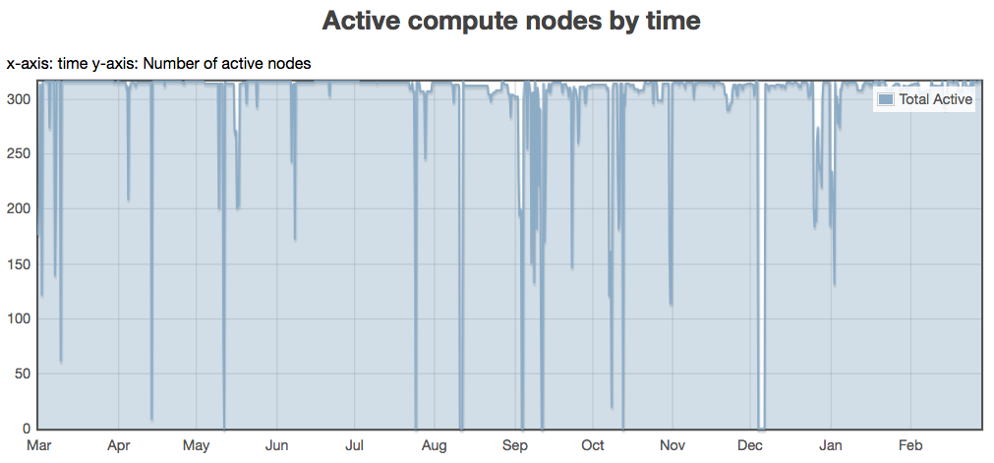
Backfill: Lower the Cost of Your Cloud
1 March 2010 through 28 February 2011
Challenge: utilization, catch-22 of on-demand computing
Solution: new instances
Backfill
Bottom line: up to 100% utilization
Who decides what backfill VMs run?
Spot pricing
Open Source community contribution
Preparing for running of production workloads on FG @ U Chicago
Nimbus release 2.7
Paper @ CCGrid 2011
94%
78%
62%
47%
31%
16%

Slide 12
Nimbus Platform

Slide 13
Nimbus Platform: Working with Hybrid Clouds
Creating Common Context
Allow users to build turnkey dynamic virtual clusters
Nimbus Elastic Provisioning
interoperability
automatic scaling
HA provisioning
policies
private clouds
(e.g., FNAL)
community clouds
(e.g., FutureGrid)
public clouds
(e.g., EC2)

Slide 14
Nimbus Platform cloudinit.d

Slide 15
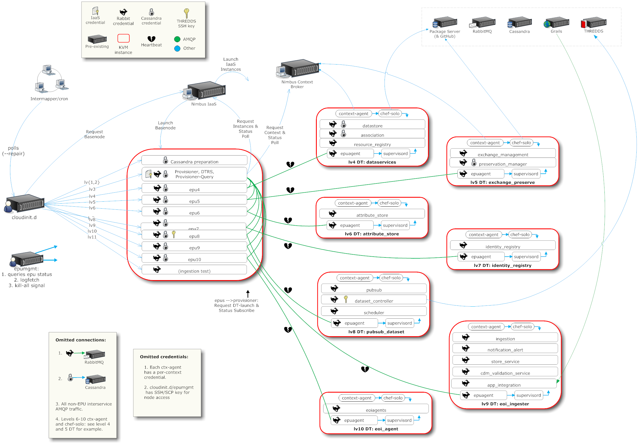
A Simplified Deployment Scenario

Slide 16
Collaborative Scenario
Tim
EC2

Slide 17
Collaborative Scenario
Jamie
Tim
OOI private cloud
EC2

Slide 18
Collaborative Scenario
David
Jamie
Tim
FutureGrid
OOI private cloud
EC2

Slide 19
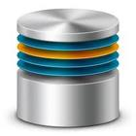
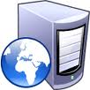
Cloudinit.d Goals
Launch plan
database
Web Server
Web Server
Web Server
Repeatability: write a launch plan once, deploy many times

Slide 20
Cloudinit.d Goals
Launch plan
database
Web Server
Web Server
Web Server
Deploy on cloud and non-cloud resources from many providers

Slide 21
Cloudinit.d Goals
Launch plan
Run-level 1
database
Run-level 2
Web Server
Web Server
Web Server
Coordination of interdependent launches

Slide 22
Cloudinit.d Goals
Launch plan
Run-level 1
database
Run-level 2
Web Server
Web Server
Web Server
User-defined launch tests

Slide 23
Cloudinit.d Goals
Launch plan
Run-level 1
database
Run-level 2
Web Server
Web Server
Web Server
Test-based monitoring and repair

Slide 24
Cloudinit.d Goals
Launch plan
Run-level 1
database
Run-level 2
Web Server
Web Server
Web Server
Test-based monitoring and repair

Slide 25
Cloudinit.d Goals
Last but not least:
lightweight and easy to use
Copy launch plan and “one click” action
Zero configuration
Minimal software assumptions

Slide 26
Cloudinit.d Status
Nimbus Platform RC1 released last week
Available from www.nimbusproject.org
Let us know what you think!
Extensively used in OOI
Paper @ TeraGrid 2011

Slide 27
The Nimbus Platform Context Broker

Slide 28
Context Broker Goals
Work with any appliance
Appliance schema, can be implemented in terms of many configuration systems
Work with any cloud provider
Simple and minimal conditions on generic context delivery
Work across multiple cloud providers, in a distributed environment

Slide 29
Turnkey Virtual Clusters
hostname
hostname
hostname
MPI
Turnkey, tightly-coupled cluster
Shared trust/security context
Shared configuration/context information

Slide 30
Turnkey Virtual Clusters
hostname
hostname
hostname
hostname
hostname
hostname
hostname
hostname
hostname
Context Broker
Turnkey, tightly-coupled cluster
Shared trust/security context
Shared configuration/context information

Slide 31
Context Broker
Context Broker
provides
Appliance
Context Object
requires
address of Ctx Broker
context id
secret
create
context
address of Ctx Broker
context id
secret
Client
Infrastructure-as-a-Service

Slide 32
Context Broker Status
Release history:
In alpha since 08/07
Initially released as a service in 2008
Source code released in Nimbus 2.3 02/10
Many updates since then
Both SOAP and REST interfaces
Integrates with Chef
Used for contextualizing hundreds of images for production runs
Contextualizable images on Science Clouds marketplace
Used and extended by OOI
Paper: Keahey&Freeman, “Contextualization: Providing One-Click Virtual Clusters”,
eScience 2008

Slide 33
Elastic Scaling, Reliability and High Availability

Slide 34
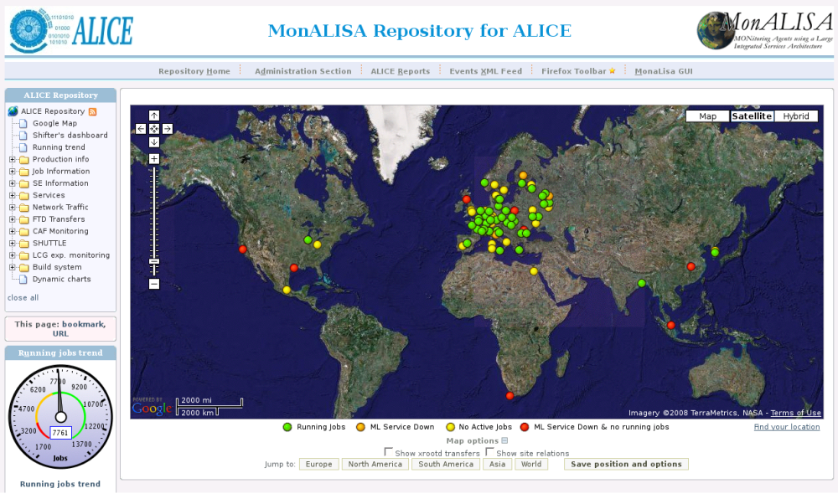
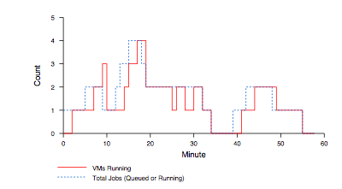
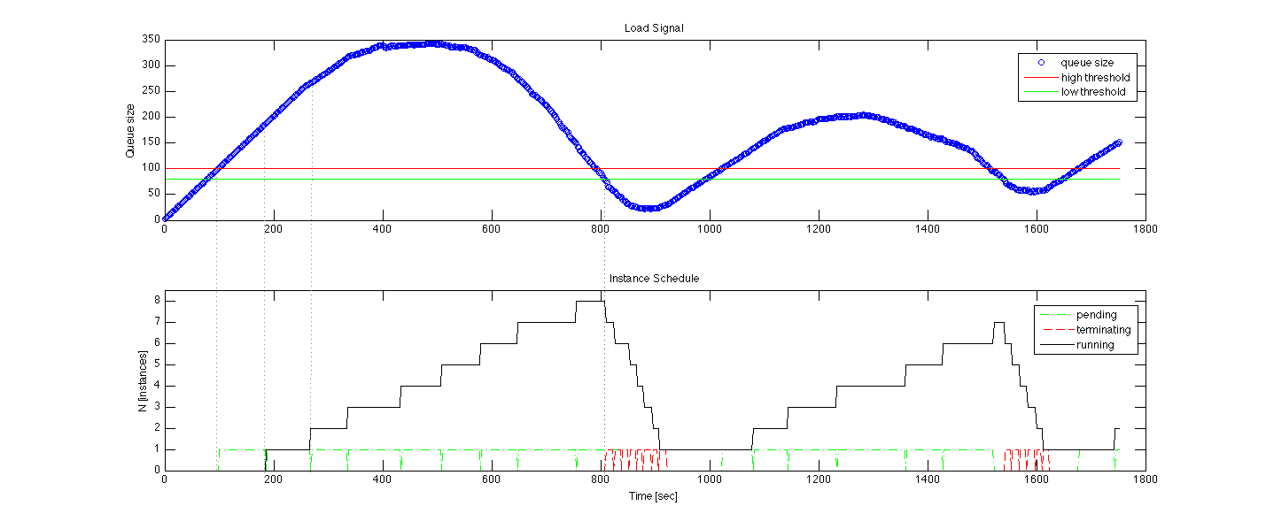
Elasticity, Reliability and Failure
Elasticity and reliability are different sides of the same coin.
2008: The ALICE proof-of-concept
2009: ElasticSite prototype
2009: OOI pilot
Paper: “Elastic Site”, CCGrid 2010
Challenge:
a generic HA
elastic service model

Slide 35
Elasticity, Reliability and Failure
Assumption: a workload queue
ALiEn, PBS, AMQP,…
React to sensor information
Queue, deployment status, VM health…
Evaluate against policies
Scale to demand
Across different cloud providers
Use contextualization to integrate machines across hybrid clouds
Scalable: latest tests scale to 100s of nodes on EC2, target is thousands
Highly Available – designed to support resiliency of all components
Release later in 2011
Customizable to input, policy, decision engine, provider, etc.
Start with a queue
Other sensor information
Apply Policy
Provision resources
private
EC2
community

Slide 36
Scientific Applications on Infrastructure Clouds

Slide 37
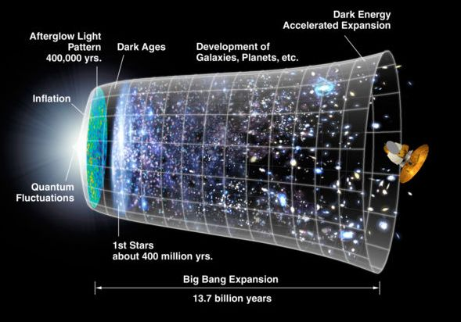
Work by Jerome Lauret (BNL) et al.
STAR: a nuclear physics experiment at Brookhaven National Laboratory
Approach:
Nimbus Science Clouds -> EC2 runs
Virtual OSG clusters with Nimbus Context Broker
Impact
Production runs on EC2 since 2007
The Quark Matter 2009 deadline: producing just-in time results
The small issues of cost

Slide 38
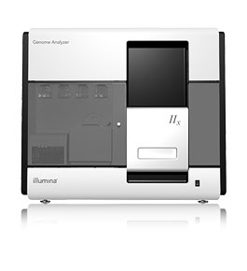
Sam Angiuoli
Institute for Genome Sciences
University of Maryland School of Medicine
The emergent need for processing
A virtual appliance for automated and portable sequence analysis
Approach:
Running on Nimbus Science Clouds, Magellan and EC2
A platform for building appliances representing push-button pipelines
Impact
From desktop to cloud
http://clovr.org

Slide 39
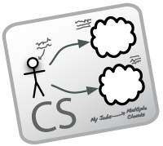
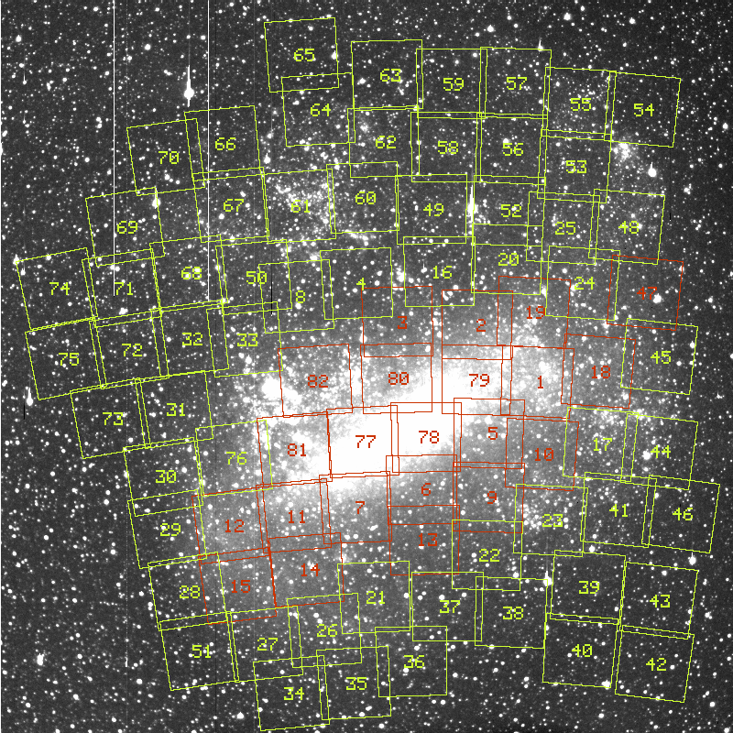
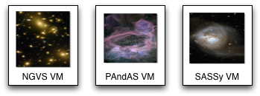
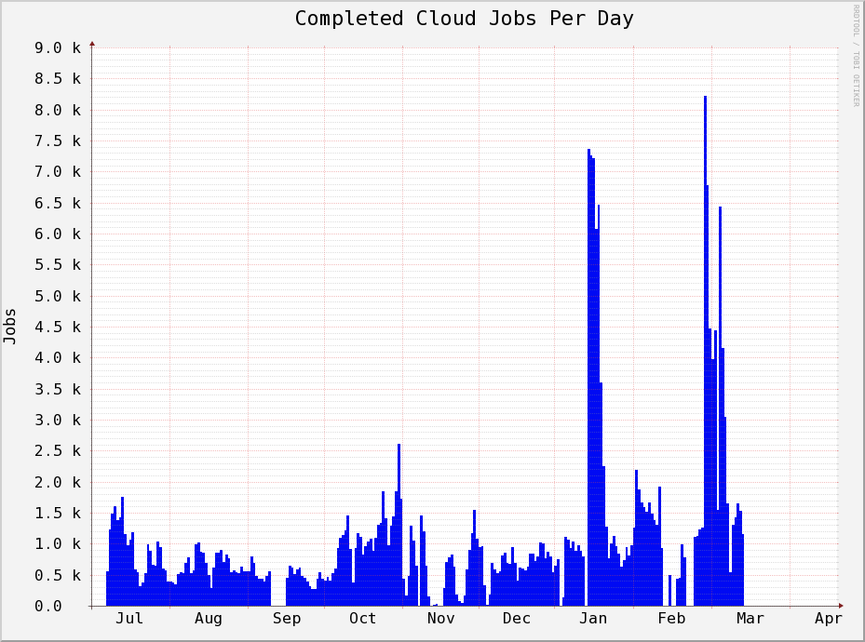
Work by the UVIC team
Detailed analysis of data from the MACHO experiment Dark Matter search
Provide infrastructure for six observational astronomy survey projects
Approach:
Running on a Nimbus cloud on WestGrid
Appliance creation and management
Dynamic Condor pool for astronomy
Status:
In production operation since July 2010

Slide 40
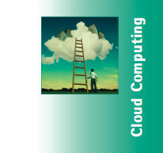
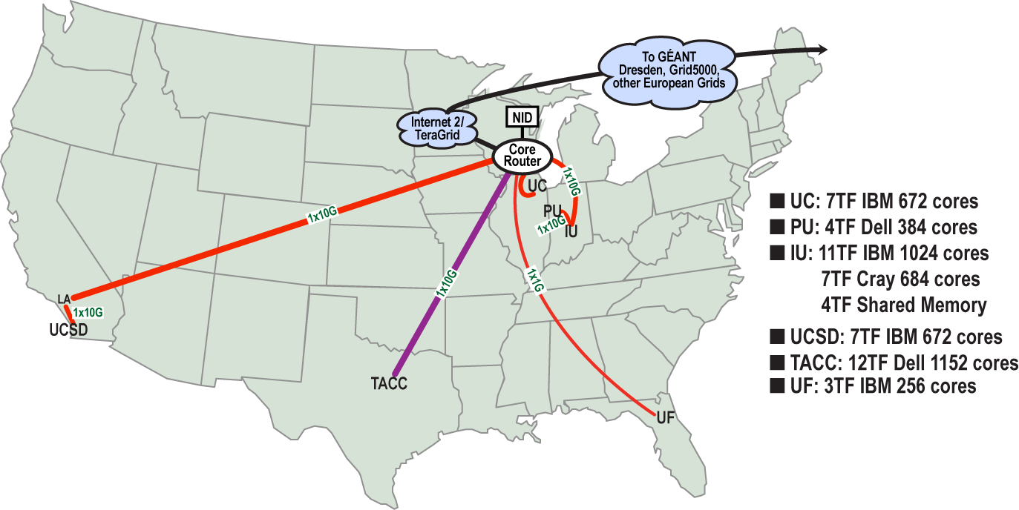
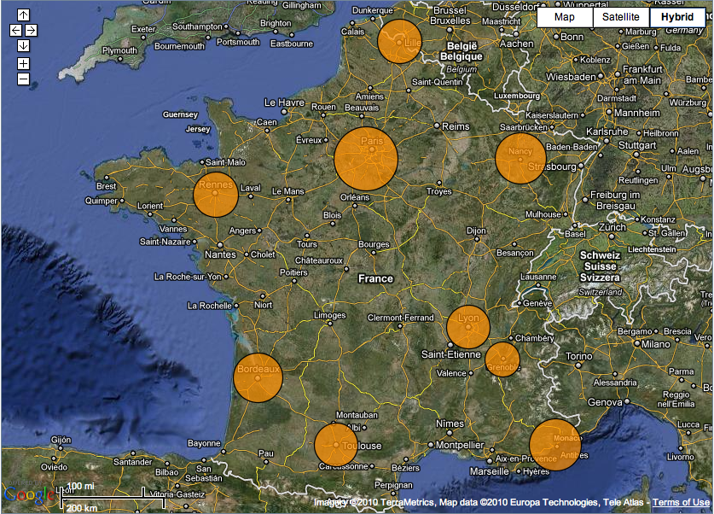
Sky Computing
Work by Pierre Riteau et al,
University of Rennes 1
Sky Computing = a Federation of Clouds
Approach:
Combine resources obtained in multiple Nimbus clouds in FutureGrid and Grid’ 5000
Combine Context Broker, ViNe, fast image deployment
Deployed a virtual cluster of over 1000 cores on Grid5000 and FutureGrid – largest ever of this type
Grid’5000 Large Scale Deployment Challenge award
Demonstrated at OGF 29 06/10
TeraGrid ’10 poster
More at: www.isgtw.org/?pid=1002832
“Sky Computing”
IEEE Internet Computing, September 2009

Slide 41
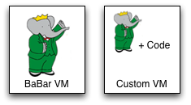
Work by the UVIC team
Canadian Efforts
BarBar Experiment at SLAC in Stanford, CA
Using clouds to simulating electron-positron collisions in their detector
Exploring virtualization as a vehicle for data preservation
Approach:
Appliance preparation and management
Distributed Nimbus clouds
Cloud Scheduler
Running production BaBar workloads

Slide 42
More About
Searching for the W-boson -- and nearly finding it!
Typical timelines:
5 months of data taking
10 months of detector calibration, reconstruction and analysis
Benefits of running in the cloud:
Reducing "time to science” (by ~ 6 months)
Near real-time processing

Slide 43
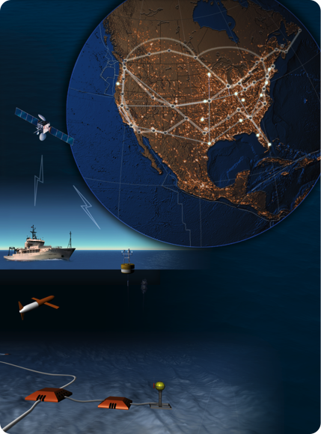
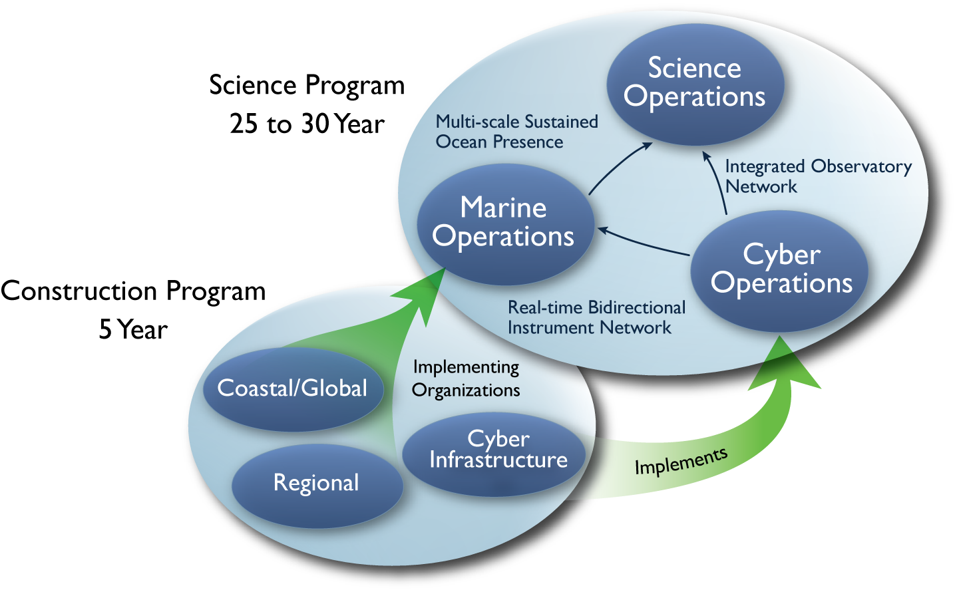
Large NSF-funded observatory with requirements for adaptive, reliable, elastic computing
Approach:
Private Nimbus regional clouds -> commercial clouds
Highly Available (HA) services that provision resources on many clouds based on need
Significant OOI CI infrastructure in data and sensor management based on this model
Status:
Scalability and reliability tests on 100s of EC2, FutureGrid and Magellan resources
HA elastic services release in 2011 (Nimbus 3)
Trail-blazing project

Slide 44
The Nimbus Team

Slide 45
The Nimbus Team
Project lead: Kate Keahey, ANL&UC
Committers:
Tim Freeman - University of Chicago
Ian Gable - University of Victoria
David LaBissoniere - University of Chicago
John Bresnahan - Argonne National Laboratory
Patrick Armstrong - University of Victoria
Pierre Riteau - University of Rennes 1, IRISA
Github Contributors:
Tim Freeman, David LaBissoniere, John Bresnahan, Pierre Riteau, Alex Clemesha, Paulo Gomez, Patrick Armstrong, Matt Vliet, Ian Gable, Paul Marshall, Adam Bishop
And many others
See http://www.nimbusproject.org/about/people/

Slide 46
Parting Thoughts
Cloud Computing Challenge: Outsourcing
Benefits
Economy of scale, access to different resources, no operation overhead, more flexible use
Criteria
Does it provide the right offering? Is it scalable? Easy to use? Easy to outsource? Cost-effective?
Changing patterns of how people work
On-demand availability, acceptance of bursty demand, ease-of-portability
Many challenges left!

Slide 47
www.nimbusproject.com
Let’s make cloud computing for science happen.

