Slide 1
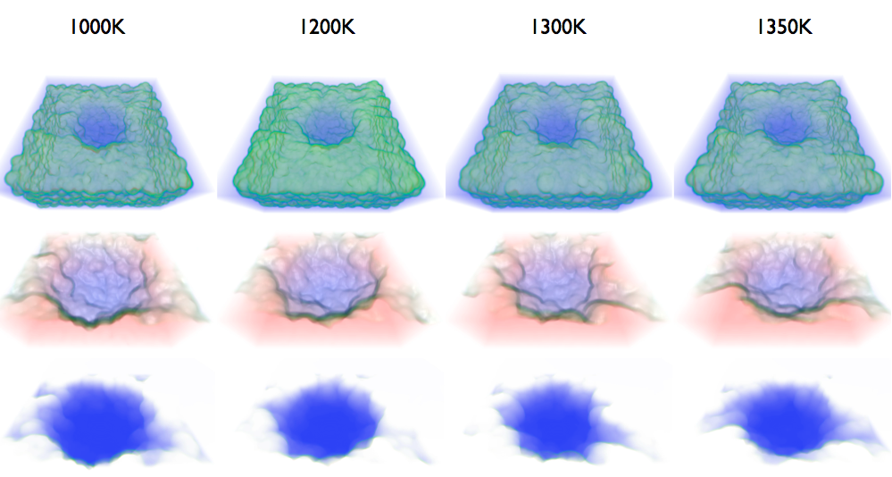
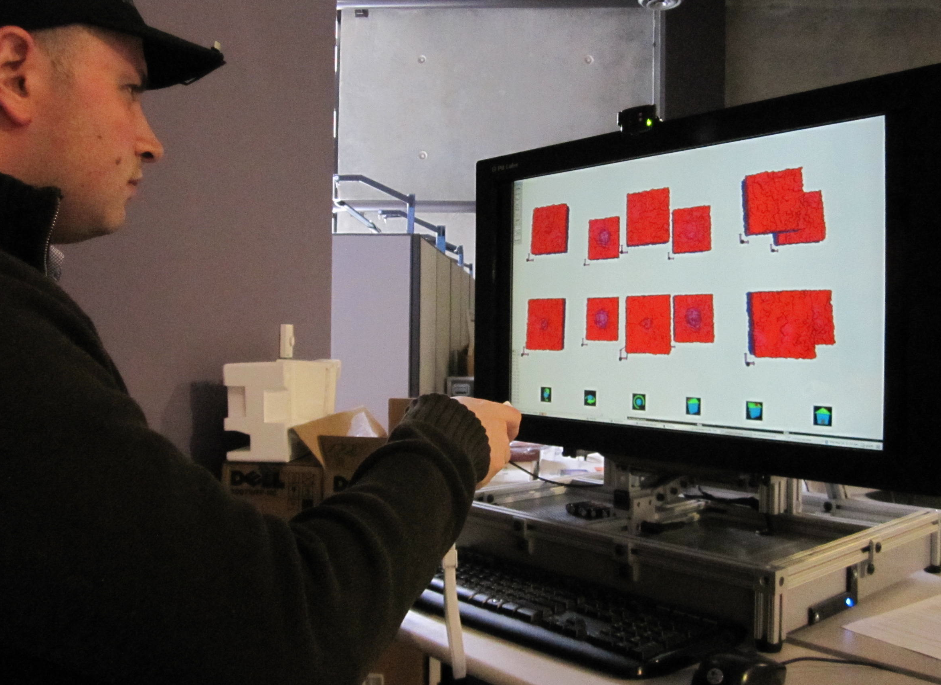
Novel Hardware and Software for Exploration of Material Interfaces
Material interfaces are key to energy breakthroughs.
Current analysis, visualization, and display methods are inadequate for complex multiscale materials science.
Nanobowls are nanoscale bowl-shaped aluminum oxide structures designed to trap catalysts for chemical reactions. Scientists model these structures under different conditions and use visual analysis to determine whether they are stable.
Material interfaces require quantitative and visual analysis.
A unified volumetric representation for electrostatic material boundaries
Advanced 3D display technology for improved depth perception
Analysis, 3D visualization, and validation in an end-to-end work environment
Exploration environment is assisting in scientific discovery.
Our solution revealed that the volume of the simulated nanobowl varied over time and temperature.
This result helped guide future simulations and facilitated communication with other scientists.
Evolution of 15 angstrom nanobowls at different temperatures
Custom-built autostereoscopic display for resolving complex structures

